Slide 1
A brief history of videoconferencing
S. Keshav
Dept. of Comp. Sci. and Tech.
University of Cambridge
April 28, 2020

Slide 2
When was the first videoconference?

Slide 3
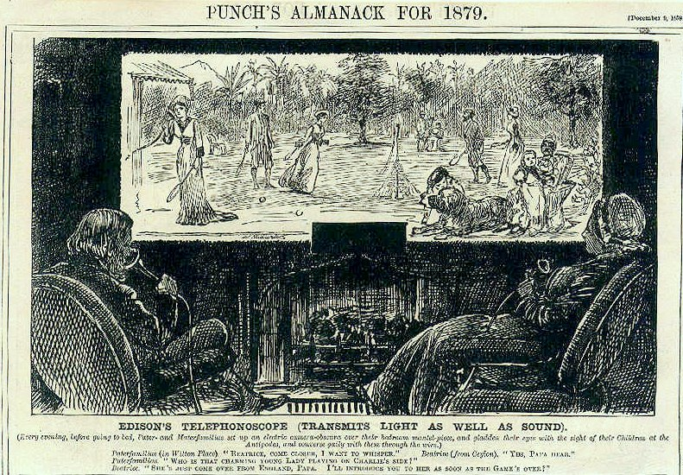
The idea is almost 150 years old!
Every evening, before going to bed, Pater and Materfamilias set up their electric Camera-obscura over their bedroom mantel-piece, and gladden their eyes with the sight of their Children at the Antipodes and converse daily through the wires. December 1878

Slide 4
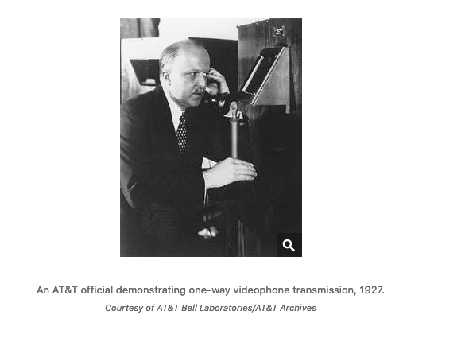
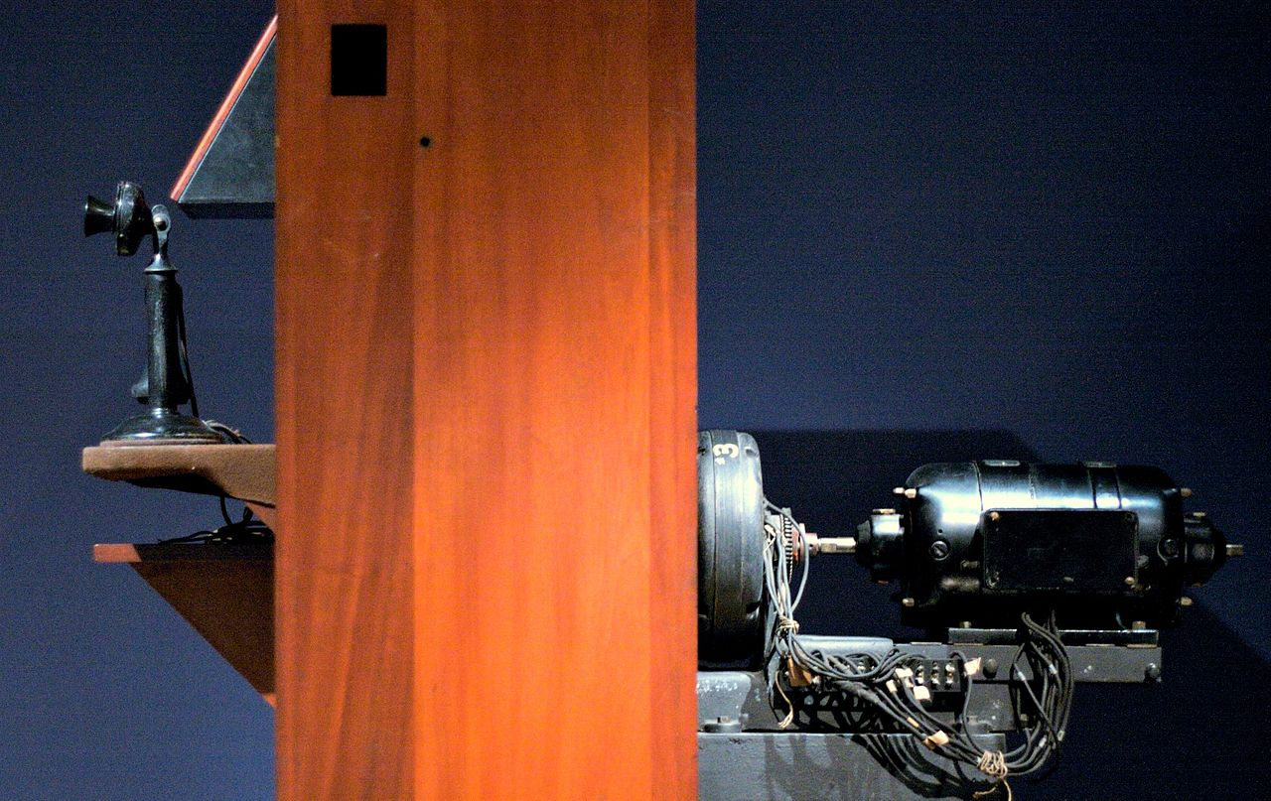
the first videoconference (1927)
1-way video/2-way audio call occurred on April 7, 1927 between Herbert Hoover and AT&T executives

Slide 5
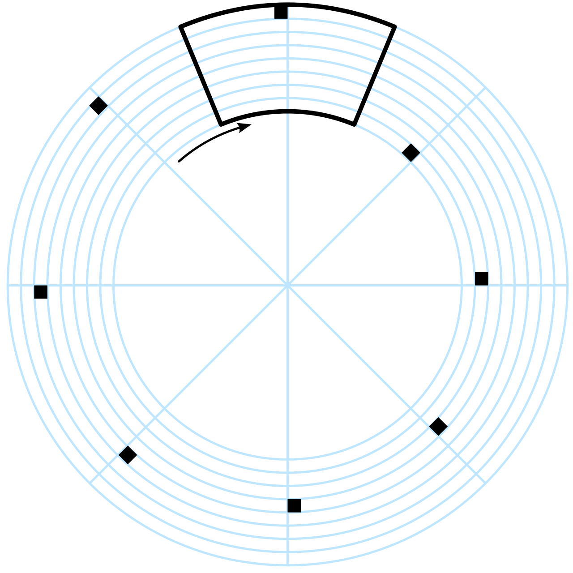
Gegensehn-Fernsprechanlagen (1936)
First public videoconferencing service
Inaugurated in Berlin on March 1, 1936
Berlin to Leipzig (160 km)
Available at special post office Fernsehsprechstellen
Mechanical rotating disk converted an image to a series of dark and light spots
Nipkow scanning disk

Slide 6
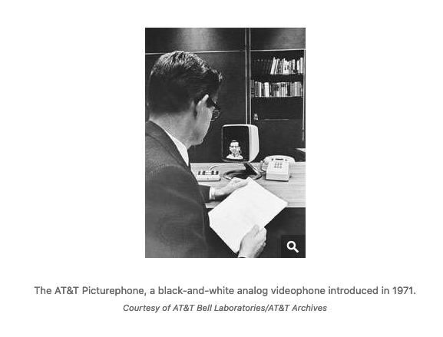
Picturephone (1963)
The first (failed) attempt at mass market
Analogue
14 x 12.5 cm (5.5 x 5 inches) screen
Mic
Speaker
Electron-tube camera
CRT
About $200/3-minute call
$15M in costs, 500 users worldwide

Slide 7
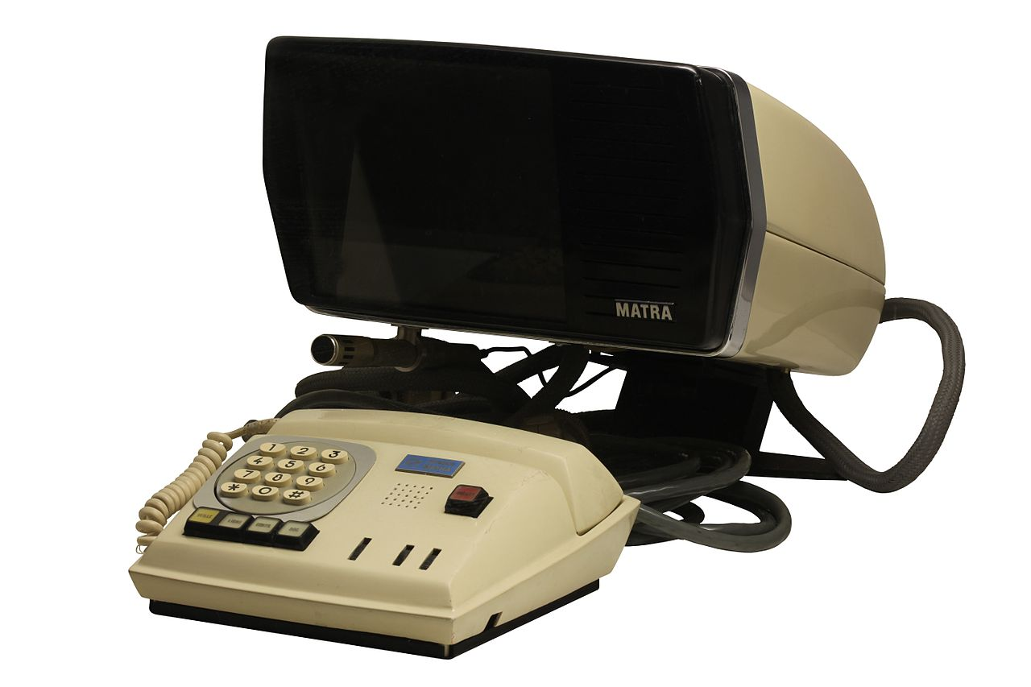
MATRA (1972)
French manufacturer
About USD 500

Slide 8
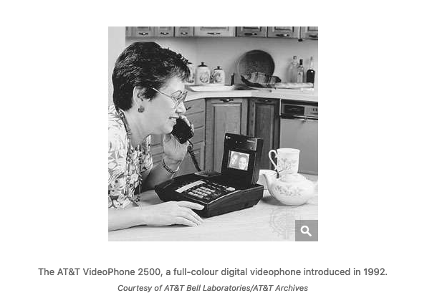
AT&T Videophone 2500 (1992)
AT&T tries again
Digital
Colour screen
$1500
On POTS
30 K units sold
Another failure

Slide 9
Internet timeline (highlights)
1973: Danny Cohen at ISI demonstrated network voice protocol
1981: Voice Funnel at BBN; 3- and 4-way video conferencing
1988: H.261 codec
1991: Speak Freely, Brian Wiles
1992: vat, vic from LBNL, Jacobson and McCanne
1992: IVS: INRIA videoconferencing system, Turletti
1993: nv from PARC, Ron Fredericks
1993: FreePhone and Rendez-Vous, RODEO group, INRIA, Bolot, Diot, et al
1995: VocalTec, Webex commercial software
2003: H.264 v1 codec, Skype
2010: FaceTime
2011: WebRTC, Zoom
2015: WhatsApp

Slide 10
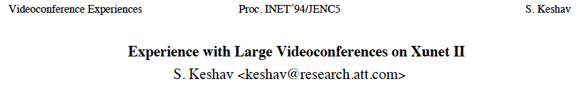
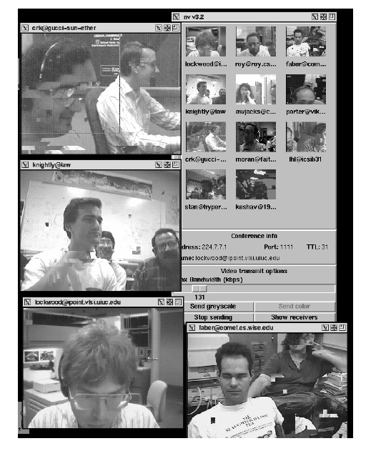
Videoconferencing over MBONE over IP over ATM over XUNET II (45Mbps)
25 audio streams
12 video streams

Slide 11
Experiences
1. Poor video quality
0.1 – 1.5 frame/sec
Software could not keep up with video compression (25 MHz CPU)
2. Complex UI
3. Lack of conference control
Who speaks next?
4. Echo suppression makes meetings unfair
5. Limited screen space
6. Poor picture resolution (unable to read text)
7. Slow update of session directory

Slide 12
Myths
1. “Need special purpose systems”
IP works with general purpose computers
2. “Build it and they will come”
Email works better because its asynchronous
Time zones a problem
3. “Video is more important than audio”
If audio quality is good, video can be poor or even turned off

Slide 13
Present (2020)
We have built it and they have come!
HD quality audio and video
Intuitive UI
Sophisticated meeting control
Gallery mode and speaker view maximizes use of screen space
Plus
Free or nearly so
Customized backgrounds
Recording
Automatic transcripts
Screen sharing
End-to-end security
Integration with calendars and scheduling
‘Personal rooms’

Slide 14
In the works
Gaze correction
Automatic session summaries
Augmented reality
Virtual reality
Searchable video

Slide 15
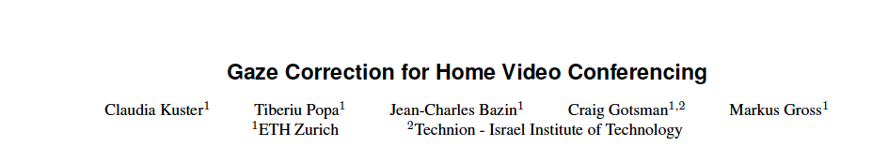
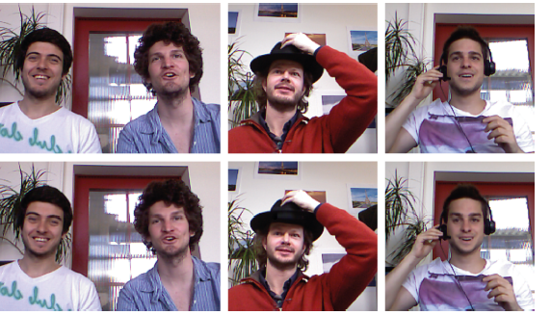

Slide 16
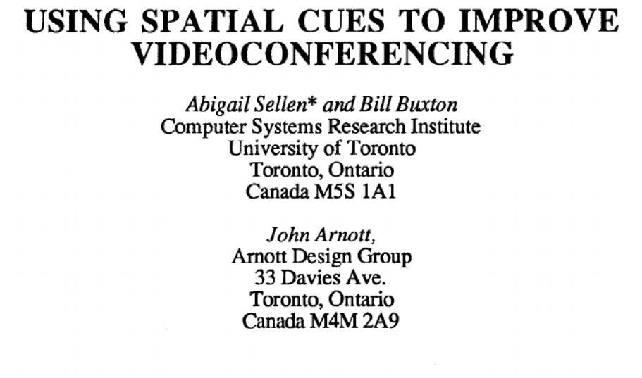
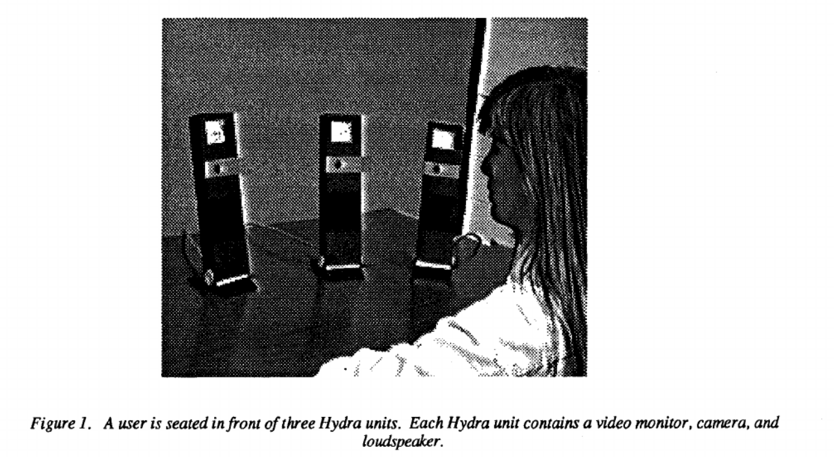
In the works
Gaze correction
Automatic session summaries
Augmented reality
Virtual reality
Searchable video
Directional audio and video
1992

Slide 17
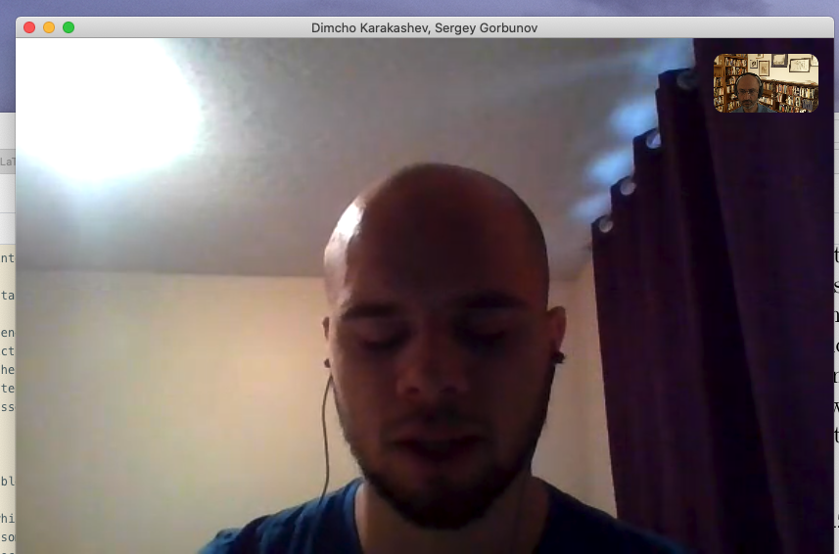
Research areas
Integration with existing workflows
Rather than forcing workflows into a ‘meeting’ paradigm
AI assistants
Compensating for poor lighting
Security/privacy
Legal issues
Who owns the call?
Who owns the chat text?
Dealing with time zones

