Slide 1
ISS4E
S. Keshav and Catherine Rosenberg
University of Waterloo
November 2012

Slide 2
ISS4E vision
To apply our expertise in Information Systems and Sciences to find innovative solutions to problems in energy systems
http://iss4e.ca
2

Slide 3
Team
Directors
Prof. S. Keshav (CS)
Prof. Catherine Rosenberg (ECE)
Affiliated Faculty
Prof. Tim Brecht (CS) Prof. Lukasz Golab (Management Sciences) Prof. Alex Lopez-Ortiz (CS) Prof. Bernard Wong (CS)
Postdocs
Yashar Ghiassi Kirill Kogan Negar Koochakzadeh
Hanan Shpungin
Ph.D. Students
Adedamola Adepetu Omid Ardakanian Tommy Carpenter
Rayman Preet Singh Matharu
Masters Students
Peter Xiang Gao Elnaz Rezaei
Sahil Singla
Research Associates
Bo Hu Pirathayini Srikantha
Hadi Zarkoob

Slide 4
Current and Recent Projects

Slide 5
Electric vehicles
Car pools to reduce range anxiety (Carpenter)
Optimal charging of vehicle fleets (Zarkoob)
Distributed optimal charging (Ardakanian)
App-based telemetry (Carpenter)

Slide 6
Smart homes and buildings
Temperature setpoint market (Singla)
Smart appliances (Srikantha)
Home peak load prediction (Matharu/Gao)
Analysis of home load seasonality (Rezaei/Adepetu)
Automatic clustering of home loads (Matharu/Ardakanian)
Optimal scheduling of home storage (Carpenter/Singla)

Slide 7
Smart homes and buildings (contd.)
Personal thermal comfort (Gao)
Regression models for building loads (Case)
Per-panel solar load monitoring and anomaly detection (Hu)
Private storage and analysis of home meter data (Matharu)
Optimal battery sizing to deal with outages (Singla/Ghiassi)

Slide 8
Distribution network
Optimal storage location (Shpungin)
Optimal load scheduling in microgrids (Kogan)

Slide 9
Generation
Firming up solar power (Ghiassi)

Slide 10
Sample projects

Slide 11
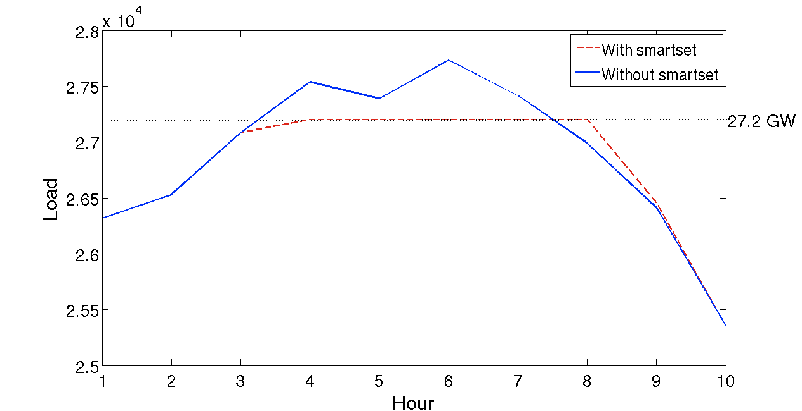
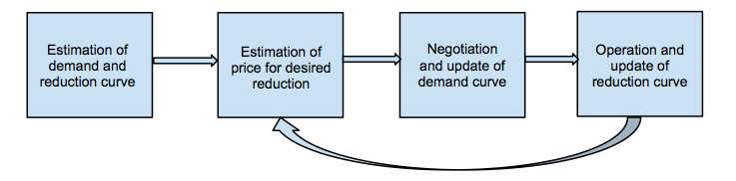
Demand Response through a Temperature Setpoint Market in Ontario
Ontario has peak load for a few hours in summers
Peak load reduction possible by increasing thermostat during peak hours
Payment of $2 per hour of setback can reduce operating costs by $688 million over 20 years
smartset
Ref: S. Singla, S. Keshav: Demand Response through a Temperature Setpoint Market in Ontario, IEEE SmartGridComm, 2012

Slide 20
Consumer-centric Smart Grid

Slide 21
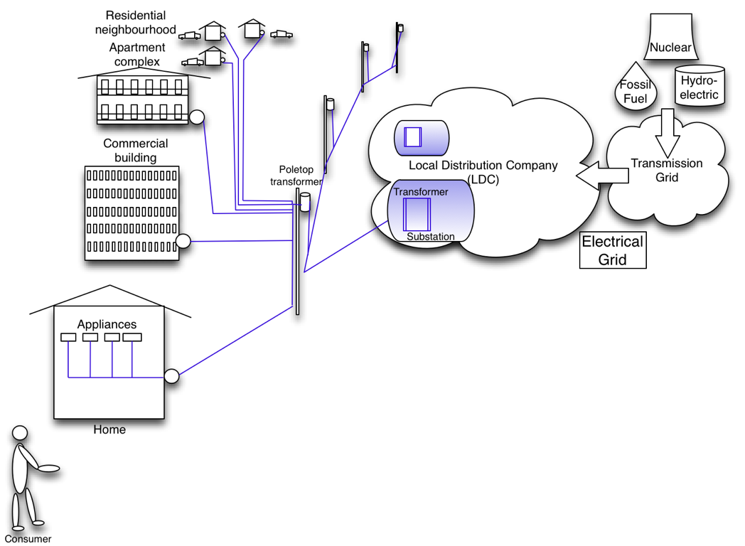
The Traditional Grid
21

Slide 22
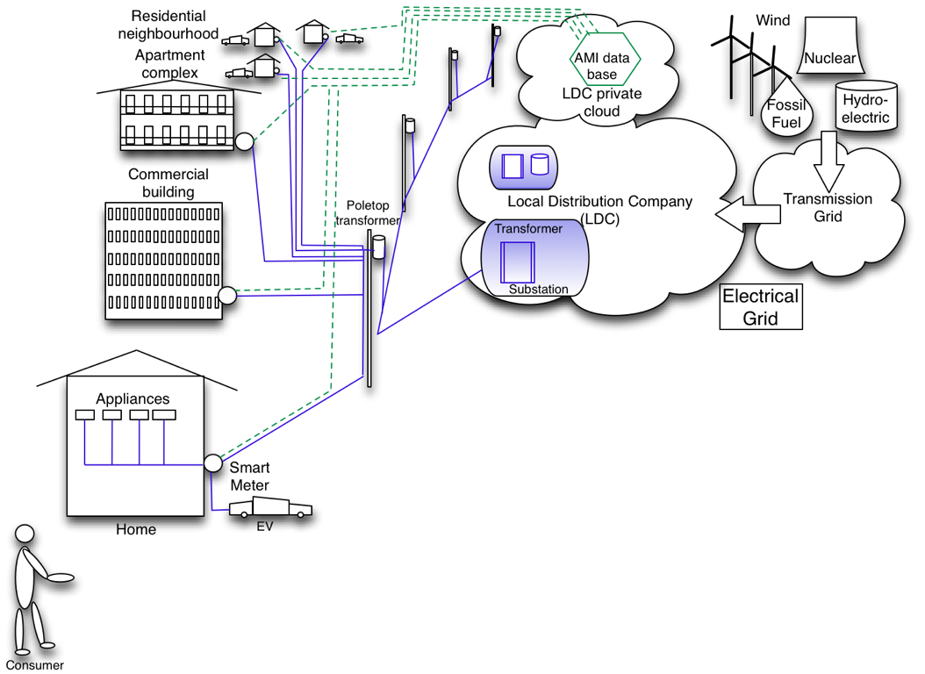
The grid of today
22

Slide 23
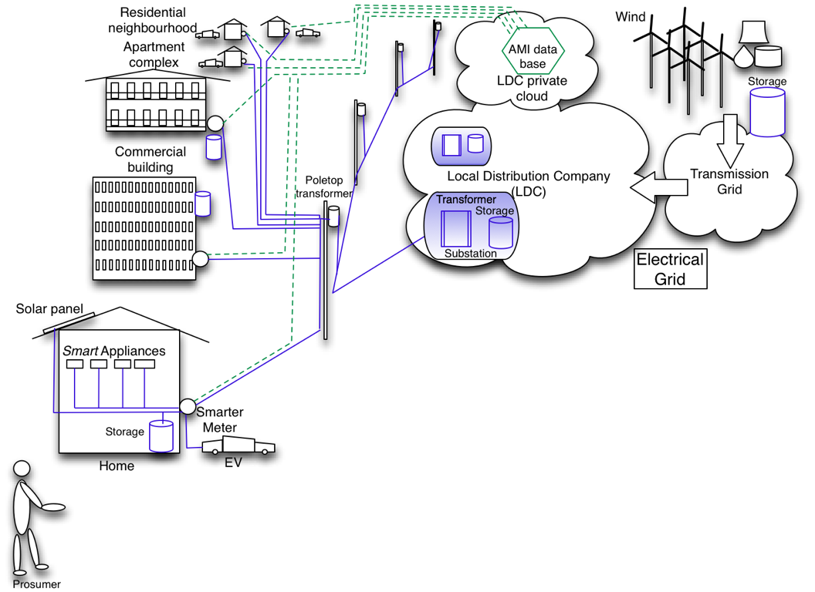
The utility-centric Smart Grid vision
23

Slide 24
