Slide 1
Smart Grid: Status and Challenges
S. Keshav
School of Computer science
University of Waterloo
CCSES Workshop
April 28, 2014

Slide 2
Outline
The grid has real problems
that smart grids can solve
These problems are intrinsic and difficult
so progress has been slow
Three areas where changes are imminent are solar, storage, and sensing
I’ll give some examples of my work in these areas

Slide 3
The grid has some real problems

Slide 4
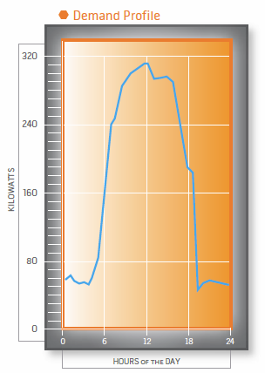
1. Overprovisioned
capacity

Slide 5
2. Inefficient
5% better efficiency of US grid
= zero emission from 53 million cars
http://www.oe.energy.gov/

Slide 6
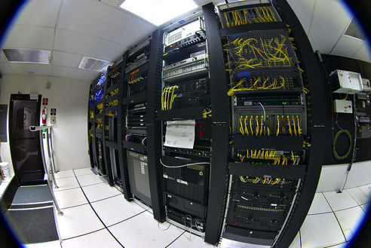
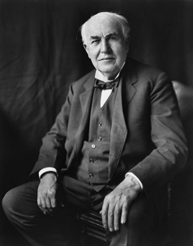
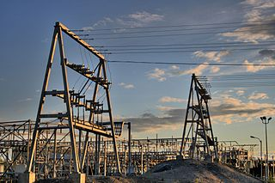
3. Aging
Post-war infrastructure is reaching EOL

Slide 7
4. Uneven
TWh generated
China 4,938
US 4,256
Daily W/capita (2012 est.)
395
1402
Wikipedia

Slide 8
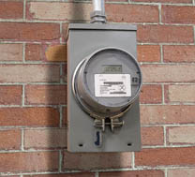
5. Poorly measured

Slide 9

6. Poorly controlled
Electrons are not addressible

Slide 10
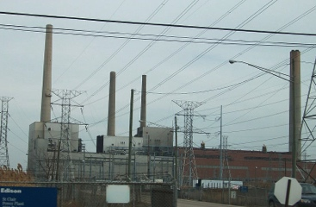
7. Huge carbon footprint

Slide 11
Smart grid vision

Slide 12
Current grid
“Smart” grid
High carbon footprint
Little to no storage
Poorly measured
Poorly controlled
Ossified
Inefficient
Centralized generation
Renewables/low carbon
Storage rich
Sensing rich
Control rich
Flexible
Energy frugal
Decentralized generation

Slide 13
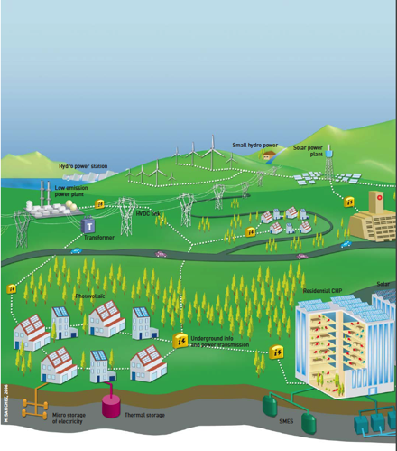
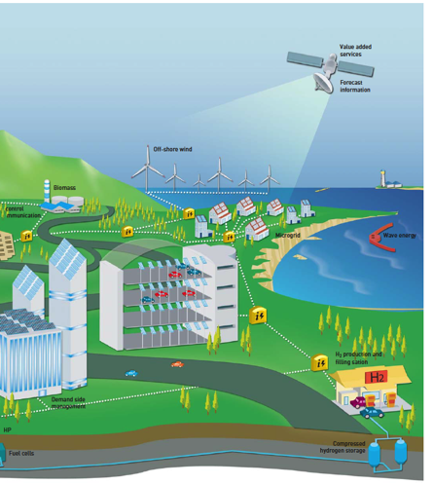
Source: European technology platform: Smart Grids
Notes:
Just like Lan/Wan

Slide 14
Intrinsic challenges

Slide 15
1. Matching demand and supply
Barnhart et al, Proc. Energy and Environment, 6:2804, 2013

Slide 16
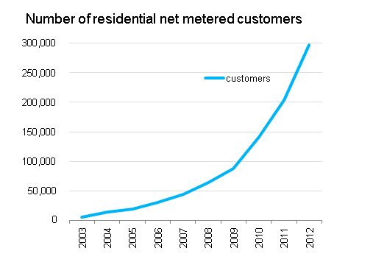
2. Controlling distributed generators
US EIA

Slide 17
3. Control over many time scales
Jeff Taft, Cisco

Slide 18
4. Complex control architecture
Cisco

Slide 19

5. Consumers lack incentives
Energy savings of 10%
$10/month

Slide 20
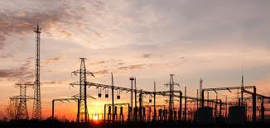
6. Utilities also lack incentives!

Slide 21
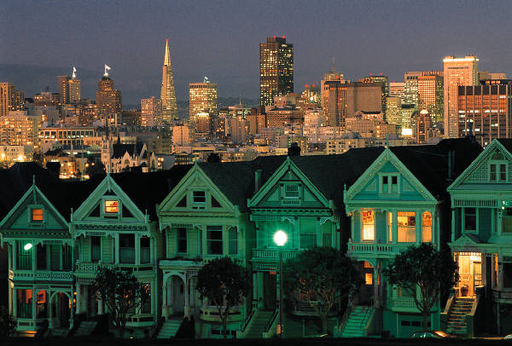
7. Huge legacy infrastructure

Slide 22
8. Storage is complex and expensive
No clear winner in terms of technology
Need to balance energy and power

Slide 23
Status

Slide 24
Depressing…
Demand response – only time of use pricing
Storage - tiny
Smart buildings and homes – demo stage
Microgrids – rare
Electric vehicles – early stage
Security and privacy – mostly missing

Slide 25
Three inflection points
Solar
Storage
Sensing

Slide 26
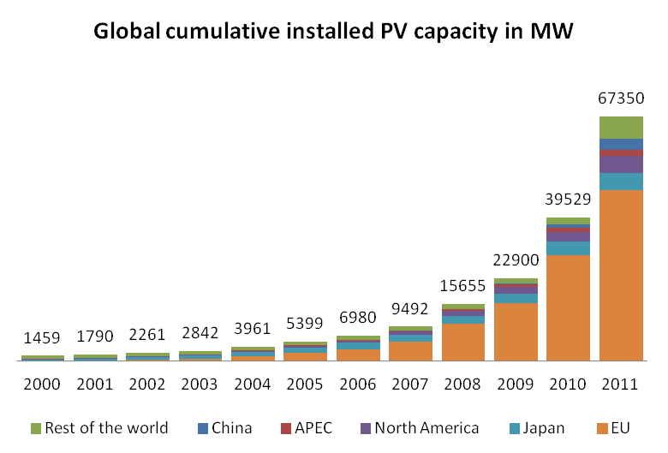

Slide 28
McKinsey, 2014

Slide 29
Storage
Global investment to reach $122 Billion by 2021
Pike Research

Slide 30
Storage alternatives
“Bytes”
“Bits/s”
Declining to $125/KWh

Slide 31
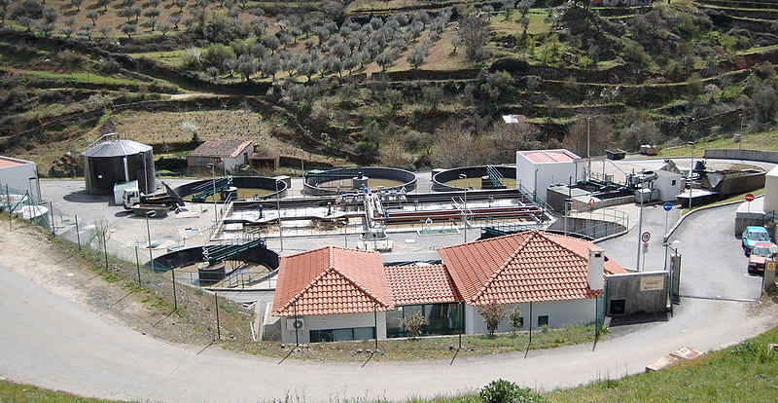
Process storage

Slide 32
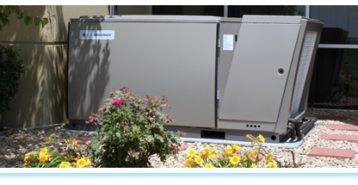
Thermal storage

Slide 33
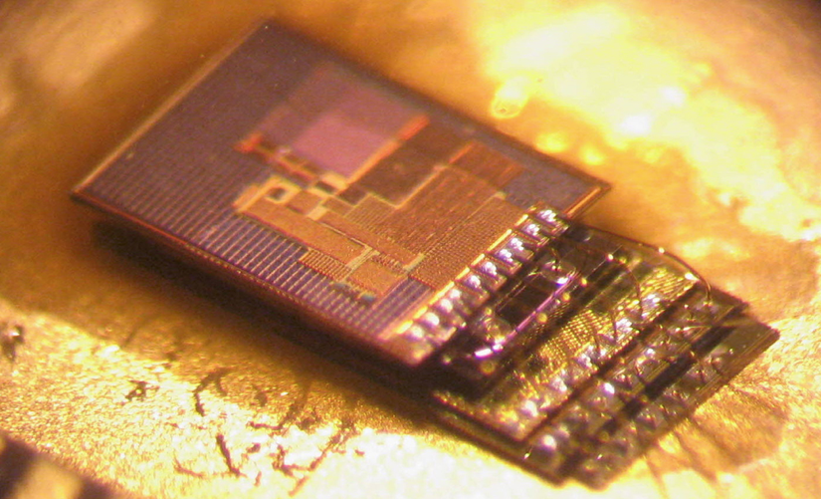
Sensing
Michigan Micro Mote

Slide 34
So what?

Slide 35
Grid
Internet
Solar
Electrons
Storage
Transmission line
Transmission network
Distribution network
Demand response
Variable bit-rate source
Bits
Buffer
Communication link
Tier 1 ISP
Tier 2/3 ISP
Congestion control

Slide 36
Equivalence theorem
Every trajectory on the LHS has an equivalent on the RHS
can use teletraffic theory to study transformer sizing
O. Ardakanian, S. Keshav, and C. Rosenberg. On the Use of Teletraffic Theory in Power Distribution Systems, e-Energy ’12.

Slide 37
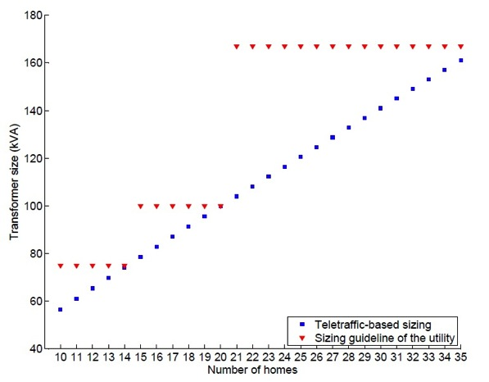
Guidelines for transformer sizing
HydroOne’s guidelines
Prediction from teletraffic theory
Can also quantify impact of storage
O. Ardakanian, S. Keshav, and C. Rosenberg. On the Use of Teletraffic Theory in Power Distribution Systems, e-Energy ’12.

Slide 38
“TCP” for EV charging
1 EV = 5 homes
Creates hotspots
Real-time AIMD control of EV charging rate
Solution is both fair and efficient
O. Ardakanian, C. Rosenberg and, S. Keshav, “Distributed Control of Electric Vehicle Charging”. e-Energy ’13

Slide 39
Stochastic network calculus
Joint work with Y. Ghiassi-Farrokhfal and C. Rosenberg

Slide 40
“Rainbarrel” model
uncontrolled stochastic input
What barrel size to avoid
overflow and underflow
“with high probability”?
range
uncontrolled stochastic output

Slide 41
Envelope idea
lower envelope ≤ Σinput ≤ upper envelope
Envelopes are computed from
a dataset of trajectories
lower envelope ≤ Σ output ≤ upper envelope

Slide 42
Stochastic envelopes
P((Σinput - lower envelope) > x) = ae^{-x}
P((upper envelope –Σinput) > x) = be^{-x}

Slide 43
Stochastic network calculus
Equivalence
Wang, Kai, et al. "A stochastic power network calculus for integrating renewable energy sources into the power grid.” Selected Areas in Communications, IEEE Journal on 30.6 (2012): 1037-1048.

Slide 44
Analytic results
Minimizing storage size to smooth solar/wind sources
Optimal participation of a solar farm in day-ahead energy markets
Modeling of imperfect storage devices
Optimal operation of diesel generators to deal with power cuts in developing countries
Joint work with Y. Ghiassi-Farrokhfal, S. Singla, and C. Rosenberg

Slide 45
Load reduction using extreme sensing

Slide 46


Smart Personal Thermal Comfort
Fine-grained thermal control of individual offices
P.X. Gao and S. Keshav, Optimal Personal Comfort Management Using SPOT+, Proc. BuildSys Workshop, November 2013.
P. X. Gao and S. Keshav, SPOT: A Smart Personalized Ofﬁce Thermal Control System, Proc. ACM e-Energy 2013, May 2013.

Slide 47

Our insight

Slide 48
In a nutshell
Mathematical comfort model
When occupied, reduce comfort to the minimum acceptable level
When vacant, turn heating off
Pre-heat
Optimal model-predictive control

Slide 49
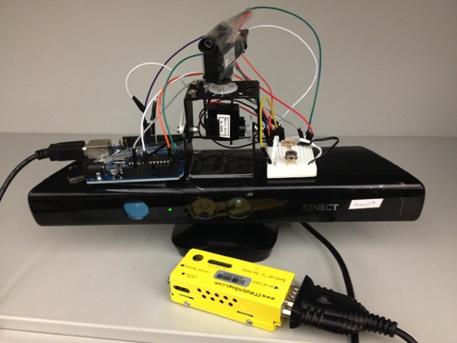
Extreme sensing
5° infrared sensor
Servos
90° infrared sensor
Microsoft Kinect
Microcontroller
Weatherduck sensor

Slide 50
Comparision of schemes
Discomfort

Slide 51
Reflections on the research area

Slide 52
Energy research
Pros
Cons
Rapidly growing area
Many open problems
Industry interest and support
Motivated students
Potential for impact
Requires learning new concepts and ideas
Entrenched interests
Difficult to obtain data
Field trials nearly impossible

Slide 53
Many open research problems
Renewables integration
Multi-level control
Non-cash incentive design for consumers
Energy efficiency policies for utilities
Storage size minimization in energy systems
Incentives for EV adoption
Data mining of energy data sets
Peak load reduction
HCI for energy applications
Data center energy minimization
Microgrid/nanogrid design
Building energy use monitoring and reduction

Slide 54
Many publication venues
Conferences/workshops
Journals
ACM eEnergy
IEEE SmartGridComm
ACM Buildsys
ACM GreenMetrics
IEEE CCSES
ACM Sustainability
AAAI AAMAS
IEEE Trans. Smart Grid
IEEE PES magazine
Energy and Buildings
J. Solar Power
J. Power Sources
Transportation

Slide 55
ACM e-Energy 2014
Premier conference at the intersection of Internet technologies and energy systems
Sponsored by ACM SIGCOMM
June 11-13, 2014 in Cambridge, UK
Early registration deadline is Wednesday!

Slide 56
Conclusions
The grid has some real problems
Smart grid offers solutions, but it is still early days
Three areas to watch out for
Solar
Storage
Sensing

Slide 57
Acknowledgements

Slide 58







ISS4E
Co-Director
Affiliated faculty
http://iss4e.ca

Slide 59
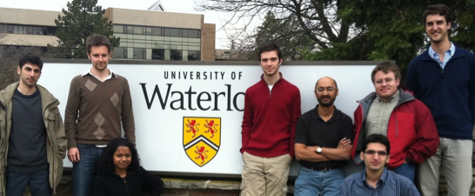
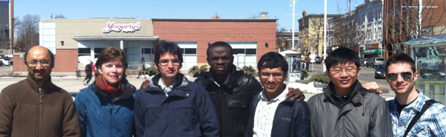
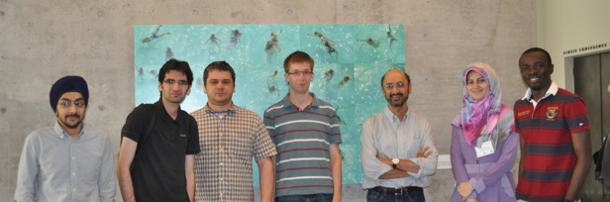
ISS4E students

Slide 60
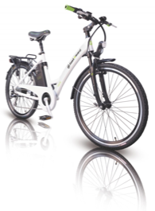
Our next project

