Slide 1







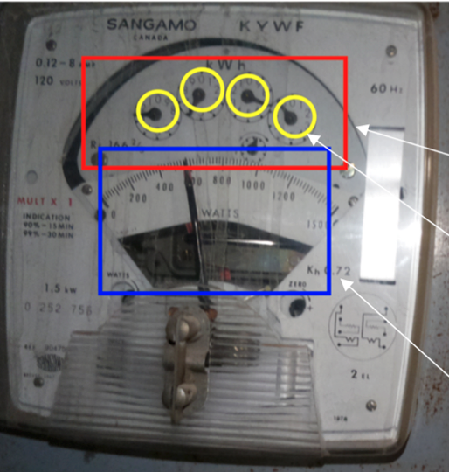
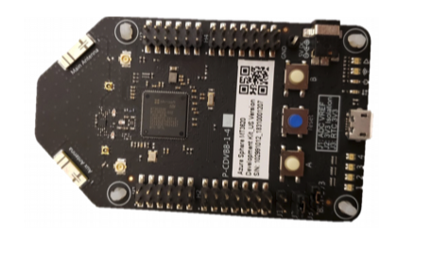

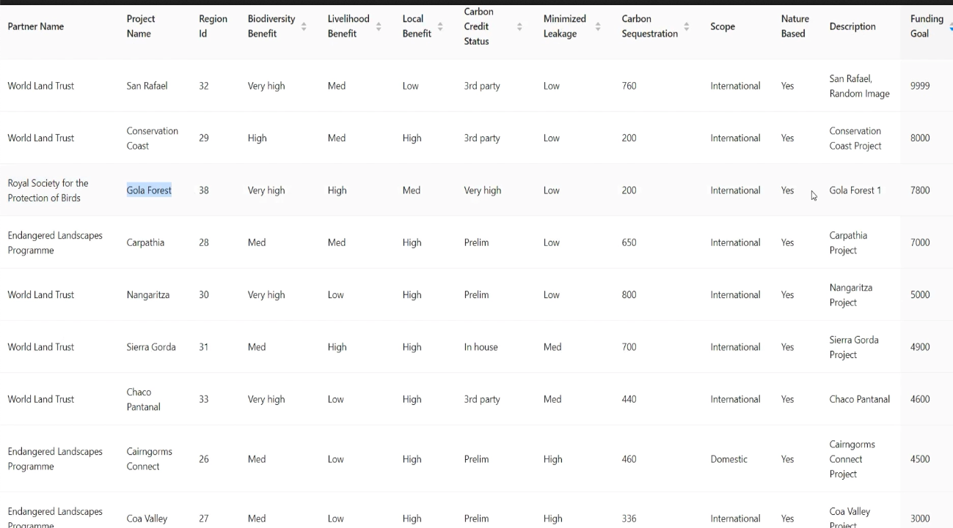







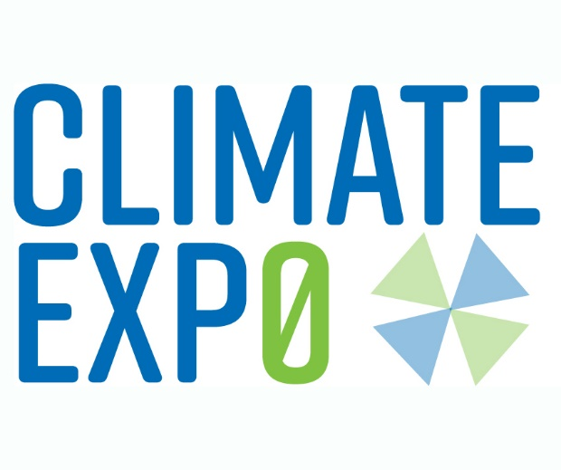
Towards a Trusted Marketplace for Nature-based Solutions
Srinivasan Keshav
Robert Sansom Professor of Computer Science, Department of Computer Science and Technology, University of Cambridge
Motivation:
The biodiversity and climate crises are examples of a ‘Tragedy of the Commons’ where the pursuit of private profit has resulted in deforestation, biodiversity loss, and the dumping of CO₂ into the atmosphere.
Nature-based solutions can provide several giga-tons of carbon sequestration each year as well as tackle the biodiversity crisis but are poorly monitored and poorly funded with heavy administrative overheads.
Carbon offset purchasers and ESG-oriented investment funds are keen to fund such projects but require assurances of additionality, permanence, and absence of leakage. Such assurances are lacking today [1].
Nature-based solutions
Third party verifies
project ownership
Clean blockchain [3,4]
Analytics
Our contributions
Forest conservation
Re-forestation
Peatlands renewal
Rewilding
…
Positive externalities:
Carbon sequestration
Biodiversity
AI and ML to map primary
observations to
tokens representing:
Carbon offsets
Biodiversity benefit
Direct funding of project owners with no intermediaries
Trust through transparency of primary data and transactions
Reduced overheads
Creates a token market for resale and portfolio creation
Knowledge of failures is immediately reflected system-wide
Legacy-compatible
Stores:
Certificates of ownership
Hashes of primary data
Tokens to represent positive externalities
Token transfers
Smart contracts
Creates certificates of ownership
Token marketplace
Offset purchasers
Quantifies
Additionality
Permanence
Leakage
Allows purchasers to directly fund projects by purchasing tokens
Guarantees
Transparency
No double-counting
Corporations
ESG investment funds
Market makers
Individuals
Earth observation
No single point of trust or failure
Proof-of-stake:
No wasted energy
Low transaction fees (< 1 US cent)
Fast completion time
Automated meter reading using Azure Sphere trusted hardware [2]
Hashes of primary data
Trusted crowdsourcing
Trusted primary observations
Store of primary observations
Cloud data store [5]
[1] Blaufelder, Christopher, Cindy Levy, Peter Mannion, and Dickon Pinner. 2020. “A Blueprint for Scaling Voluntary Carbon Markets to Meet the Climate Challenge.” McKinsey & Company. November 9, 2020.
[2] Karakashev, Dimcho, Sergey Gorbunov, and Srinivasan Keshav. "Making Renewable Energy Certificates Efficient, Trustworthy, and Anonymous." 2020 IEEE International Conference on Communications, Control, and Computing Technologies for Smart Grids (SmartGridComm). IEEE, 2020.
[3] Chen, Jing, and Silvio Micali. "Algorand: A secure and efficient distributed ledger." Theoretical Computer Science 777 (2019): 155-183.
[4] Allombert, Victor, Mathias Bourgoin, and Julien Tesson. "Introduction to the Tezos blockchain." 2019 International Conference on High Performance Computing & Simulation (HPCS). IEEE, 2019.
[5] Benet, Juan. "IPFS-content addressed, versioned, p2p file system." arXiv preprint arXiv:1407.3561 (2014).
Acknowledgments: This work was carried out by following students at the University of Waterloo: Yerbol Aussat, Rui Chai, Dimcho Karakashev, Bihan Liu, David Liu, Ivy Liu, Yingchao Shan, and Runbiao Zhong as well as Alan Marko at the University of Cambridge, and Fiodar Kazhamiaka at Stanford University. My thanks to them all.

