Slide 1

Tessera: AGB Estimation Using Satellite Embeddings
Machine Learning Pipeline for Forest Carbon Analysis
S. Keshav, University of Cambridge
October 2025

Slide 2
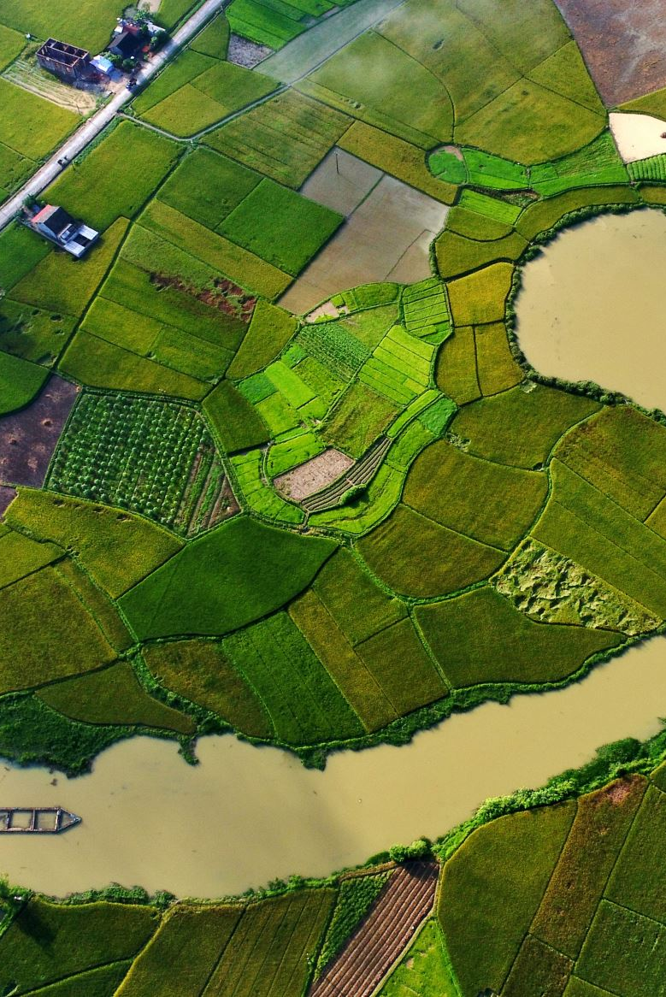
Project Overview
Kanha Shanti Vanam: 1,400-acre ecological restoration site near Hyderabad, India
Goal: Estimate Above-Ground Biomass (AGB) from satellite imagery
Approach: Combine ground-truth tree survey data with satellite embeddings
Dataset: ~19,000 trees surveyed in 2024
Species, GPS location, age, trunk circumference, height
Key Innovation: Train ML models to predict AGB directly from satellite data
Enables AGB estimation for unmapped areas

Slide 3

The Challenge
Traditional AGB estimation requires labor-intensive field surveys
Need: Scalable method for carbon stock assessment
Solution: Leverage satellite-derived embeddings (Tessera)
128-dimensional feature vectors from GeoTIFF imagery
Correlate with ground-truth AGB measurements
Data Quality Issues:
~50% of survey data had missing or invalid fields
Spatial duplicates and measurement errors
Required robust cleaning pipeline

Slide 4
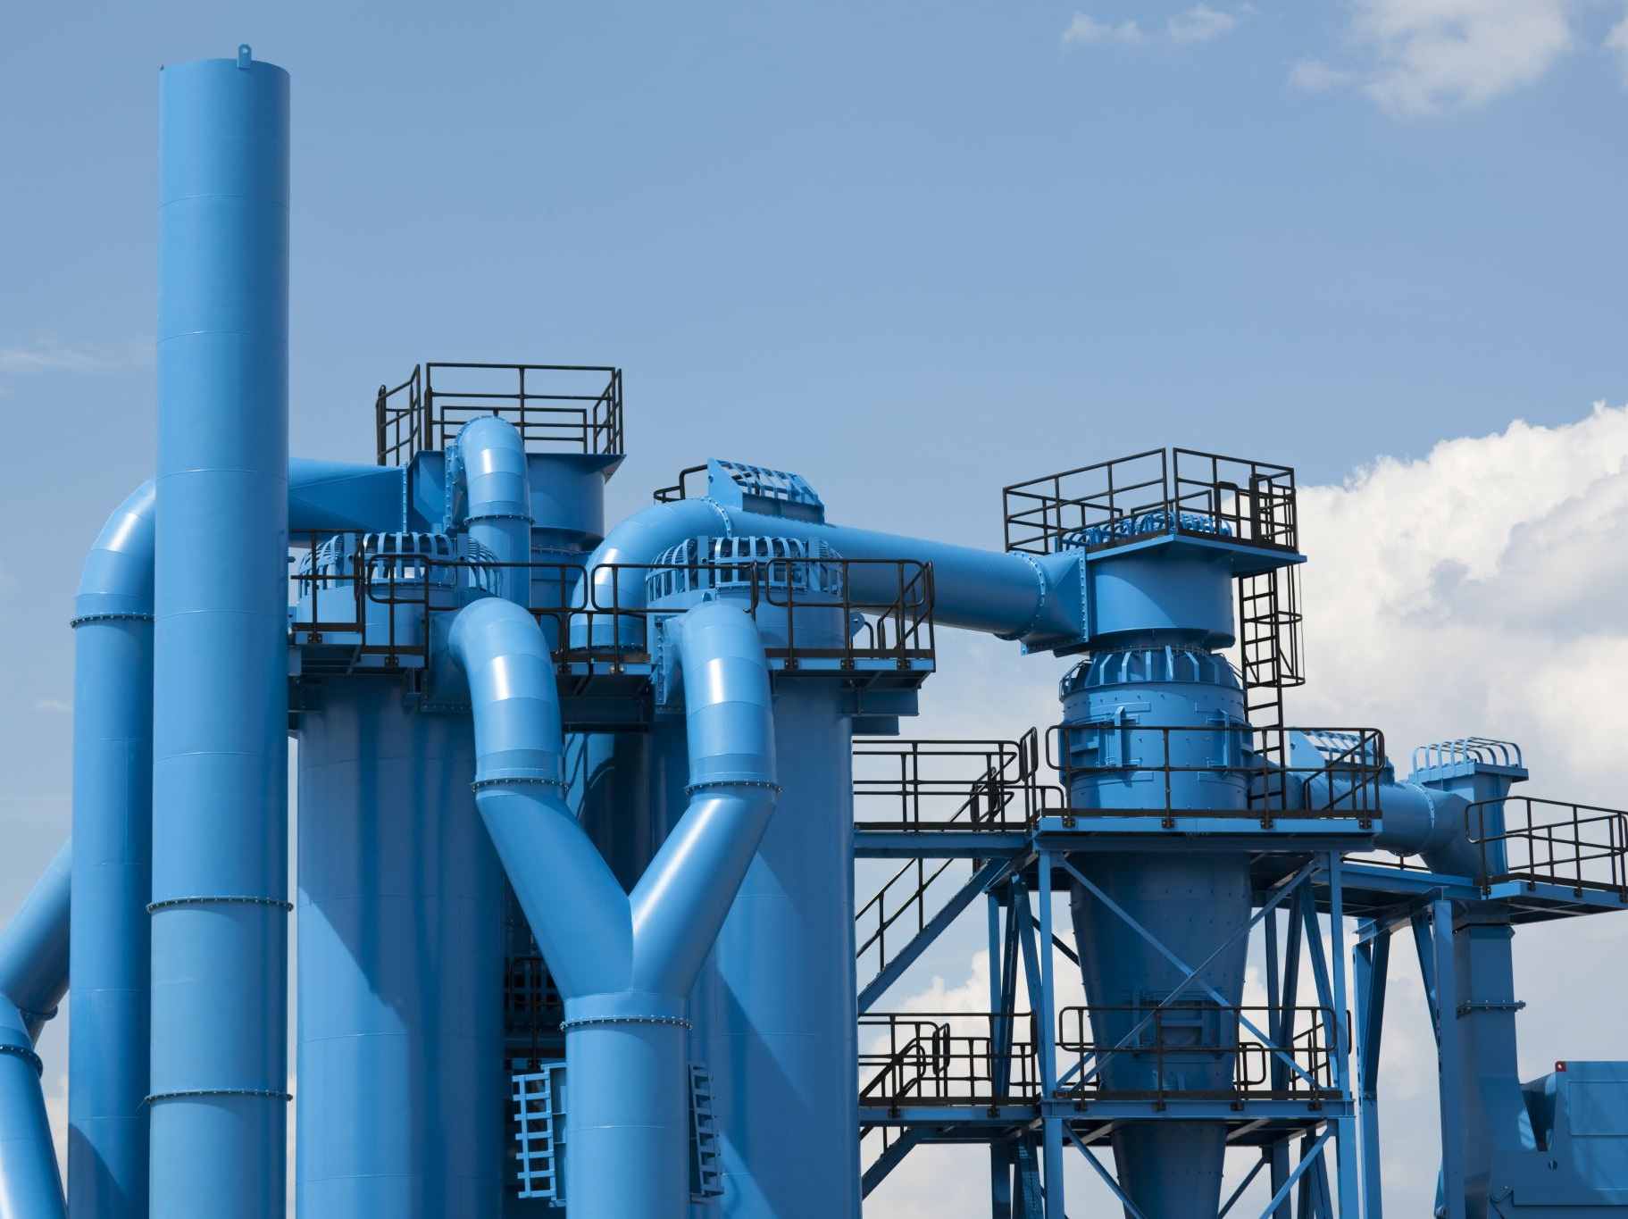
Data Processing Pipeline

Slide 5
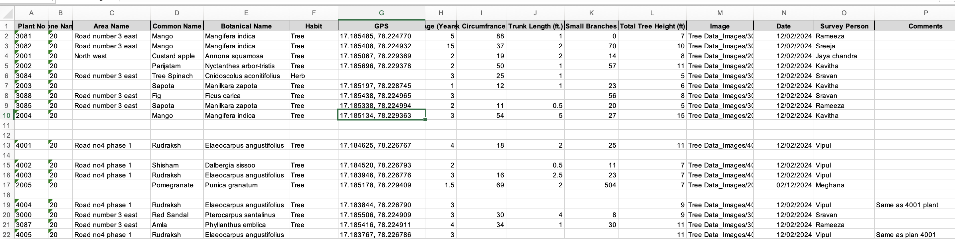
Initial Survey Data
Raw Excel data showing species, GPS, age, circumference, and height

Slide 6

Step 1: Data Cleaning
Input: Raw CSV with 19,000+ tree records
Cleaning Operations:
Remove trees without GPS coordinates
Filter by bounding box (17.168°-17.187°N, 78.208°-78.234°E)
Validate age (0-99 years)
Validate trunk circumference (5-300 cm)
Remove spatial duplicates (<25cm apart)
Duplicate Detection Algorithm:
Grid-based spatial indexing (1m grid cells)
O(n) complexity vs naive O(n²) approach
Same species: keep one randomly; Different species: discard both

Slide 7

Step 2: AGB Calculation
Allometric Equation: Chave et al. (2014) pantropical model
AGB = 0.0673 × (ρ × D² × H)^0.976
ρ = wood density (g/cm³), D = diameter (cm), H = height (m)
Wood Density Database:
48 Indian tropical tree species
Source: Global Wood Density Database (Zanne et al.)
Genus-level fallback for unknown species
Default: 0.58 g/cm³ for tropical trees
Output: AGB in kg for each tree

Slide 8

Step 3: Embedding Extraction & Grid Mapping
Satellite Data: GeoTIFF with 128-band embeddings
Grid System: 10m × 10m cells
Aggregates all trees within same cell
Maps GPS coordinates to pixel locations
Training Data Generation:
Each pixel: 128 embedding features + 1 AGB target
Zero-inflated: Most pixels have no trees
Output: embedding_agb_grid_training_data.npy
Large file (~58MB), excluded from git
Backed up to OneDrive via save.sh

Slide 9

Step 4: Two-Stage Machine Learning Pipeline
Challenge: Zero-inflated AGB distribution
Most pixels have AGB = 0 (no trees)
Single regression model performs poorly
Solution: Two-Stage Approach
Stage 1: Binary Classification
Predict: Tree present (1) or absent (0)
Models: XGBoost & Random Forest classifiers
Stage 2: Regression
Train only on non-zero AGB samples
Predict AGB magnitude for pixels classified as 'tree'
Models: XGBoost & Random Forest regressors

Slide 10
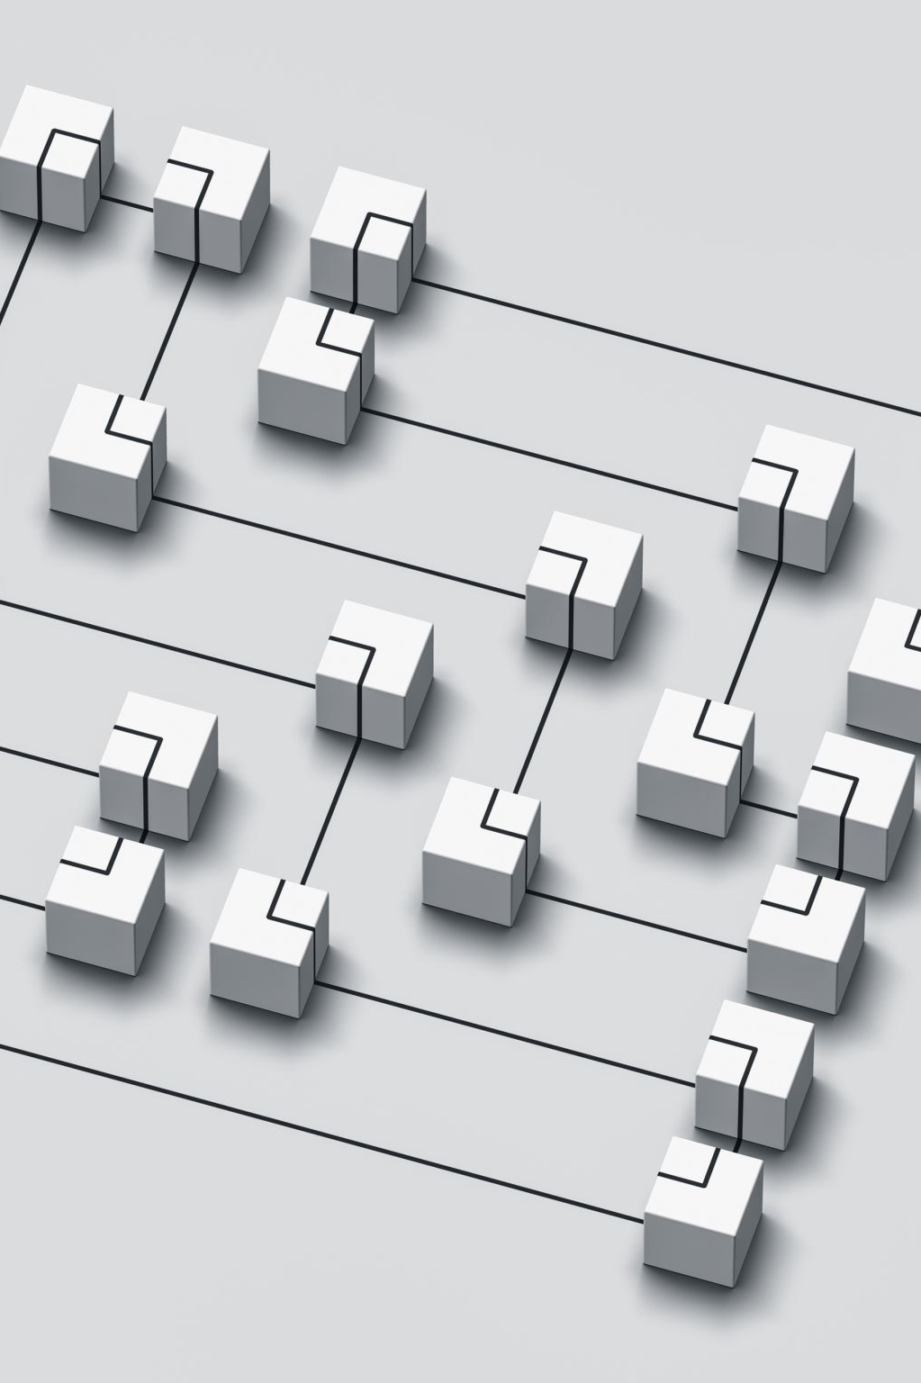
Training Strategy
80/20 train-test split
5-fold cross-validation
Stratified sampling (preserve class balance)
Metrics: RMSE, MAE, R², Accuracy

Slide 11
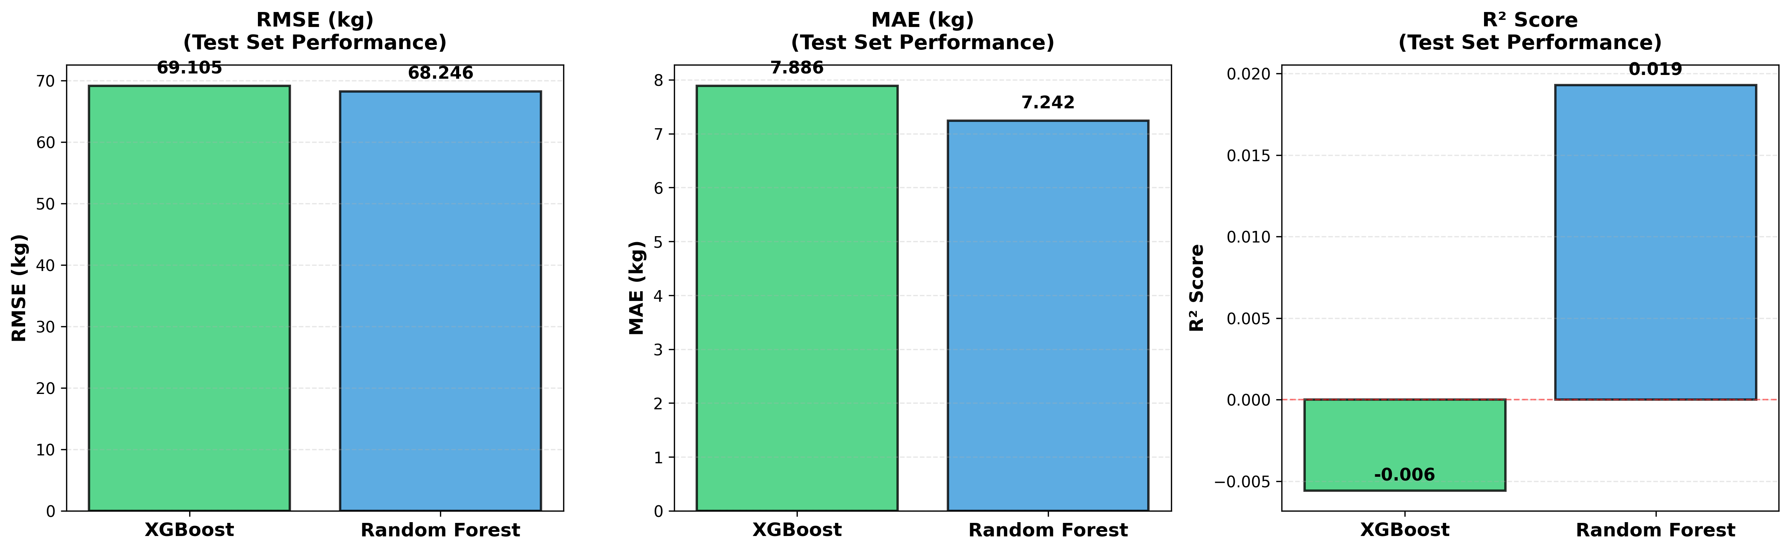
Model Performance: Test Set Evaluation
Final model comparison on held-out test set

Slide 12

Key Results
Model Performance:
XGBoost and Random Forest show comparable accuracy
Two-stage approach significantly outperforms single-stage
Stage 1 classification accuracy: >95%
Error Concentration:
80% of squared error from <5% of samples
Large trees contribute disproportionately to error
Insights:
Embeddings capture spatial patterns of tree distribution
Grid-based aggregation reduces noise
Wood density database critical for accuracy

Slide 13

Technical Architecture & Implementation

Slide 14

Code Architecture
Modular Pipeline Design:
datacleaner.py → Spatial data cleaning
agb_calculator.py → Allometric calculations
training.py → Embedding extraction & grid mapping
analyze.py → ML training & evaluation
Supporting Scripts:
Visualization: bargraph.py, heatmap.py, top20agb.py
Utilities: bbcheck.py, metadata.py
Key Design Decisions:
Haversine distance for GPS accuracy
Grid-based spatial indexing (O(n) duplicate detection)
Rasterio for GeoTIFF coordinate transforms

Slide 15

Development Workflow
Environment: Python 3.13 + virtual environment
Startup Script (startup.sh):
Activates venv
Pulls latest changes from git
Must use 'source startup.sh' (not './startup.sh')
Save Script (save.sh):
Commits code to git with custom message
Pushes to GitHub
Backs up .npy files to OneDrive
Documentation:
Quarto document (notes.qmd) for methodology
CLAUDE.md for AI-assisted development

Slide 16
Data File Management
Git-Tracked Files:
• Raw data: data.csv
• Cleaned: cleaned_data.csv
• With AGB: cleaned_data_with_agb.csv
• Metadata: .json files
• Visualizations: .png files
• Code: All .py scripts
Git-Ignored Files:
• Large arrays: *.npy
• Embeddings: kanha_arrays/
• Virtual env: venv/
• Jupyter: .ipynb_checkpoints/
Backed up to OneDrive via save.sh

Slide 17
Applications & Impact
Immediate Applications:
Carbon stock assessment for Kanha Shanti Vanam
Track restoration progress over time
Identify high-priority planting areas
Broader Impact:
Scalable AGB estimation across India
Reduce field survey costs by 90%+
Enable large-scale carbon monitoring
Support policy decisions for climate mitigation
Future Directions:
Expand to other restoration sites
Temporal analysis (multi-year tracking)
Species-level AGB prediction

Slide 18

Lessons Learned
Data Quality Matters:
50% of survey data required cleaning
Robust validation pipeline essential
Spatial duplicate detection crucial
Model Architecture:
Zero-inflated data needs two-stage approach
Domain knowledge improves results (wood density DB)
Grid aggregation balances noise vs resolution
Software Engineering:
Modular design enables experimentation
AI-assisted development (Claude) accelerated pipeline
Automated backup critical for large datasets

Slide 19
Technical Specifications
Hardware/Software:
Python 3.13
scikit-learn, XGBoost
rasterio (GeoTIFF processing)
Jupyter + Quarto (docs)
Spatial Processing:
Haversine distance formula
EPSG:4326 (WGS84) coordinates
Grid-based indexing
Model Parameters:
• XGBoost: 100 trees, depth=6
• Random Forest: 100 trees, depth=10
• Train/test: 80/20 split
• 5-fold cross-validation
Data Specs:
• 19,000+ trees surveyed
• 128-dim embeddings
• 10m × 10m grid cells

Slide 20
Acknowledgments & Resources
Data Sources:
Kanha Shanti Vanam / Heartfulness Institute (tree survey)
Tessera satellite embeddings
Global Wood Density Database (Zanne et al., Chave et al.)
References:
Chave et al. (2014) - Pantropical allometric equations
Haversine formula for GPS distance calculations
Tools:
Claude.ai for AI-assisted development
Python ecosystem: pandas, scikit-learn, rasterio
Code Repository:
Available on GitHub (see CLAUDE.md for details)

Slide 21

Summary & Next Steps
Summary:
Successfully built end-to-end AGB estimation pipeline
Two-stage ML approach handles zero-inflated data
Achieves high accuracy on test set
Scalable to other restoration sites
Next Steps:
Deploy model for full Kanha coverage
Expand to additional restoration sites in India
Implement temporal tracking (annual updates)
Develop web interface for stakeholders
Questions?

Slide 22

The story behind the story

Slide 23
AI Prompts for the Tessera Project
A Collection of Claude.ai Prompts
Used for AGB Estimation Pipeline
S. Keshav, University of Cambridge

Slide 24
1
Data Cleaning
I would like you to write python code to clean data in a CSV file called data.csv. The fields in the file are in the order scientific name, GPS location (lat, long), Age, trunk circumference, height.
Please remove:
• Any trees lying outside the bounding box 17.186736, 78.208403, 17.168470, 78.233911
• Any trees without a GPS location
• Any trees whose age was marked with an implausible number (negative or more than 99 years)
• Any trees with a trunk circumference that was missing, or implausibly small (< 5cm) or implausibly big (> 300 cm)
• Duplicate trees: If two trees are closer than 25 cm to each other, then they should be marked as duplicate. If they both share the scientific name, then one is kept (randomly chosen), if not, they are both discarded.
To find duplicates, find the Haversine distance between trees. Make the algorithm efficient by placing trees into a 1m grid and checking only nearby grid locations when checking for duplicates.

Slide 25
2
Above-Ground Biomass (AGB) Calculation
I would like you to write a python script that does the following:
1. reads from cleaned_data.csv
2. Computes AGB for trees described by this file, which are near Hyderabad, India and using regional allometric equations. All the trees are tropical/subtropical. I believe Chave's research group has published allometric equations for tropical trees.
3. Use a wood density database if you can find it, if not, use the default value.
4. adds a column called 'agb' to the cleaned data and export this as a csv file
5. compute summary statistics: the mean AGB per species, the standard deviation per species, the minimum and maximum AGB per species, the overall AGB, and the top 10 species by AGB.

Slide 26
3
GeoTIFF Bounding Box Extraction
Can you please write code to read in the geotiff file in the kanha_tiffs directory and print out the bounding box (lat, long coordinates) that contains all the embeddings in that file?
Please print the coordinates as degrees East and North.
GeoTIFF is in a projected coordinate system (likely UTM), not in latitude/longitude, so will need to be transformed.

Slide 27
4
Embedding-to-Grid Mapping
I have a GeoTIFF file called tessera_2024_lat17.15_lon78.25.tif in a directory called kanha_tiffs that has 128-dimensional embedding vectors with corresponding lat long coordinates.
I would like you to write python code that:
• First clips this file to a bounding box defined by:
BBOX_LAT_MIN = 17.168470, BBOX_LAT_MAX = 17.186736
BBOX_LON_MIN = 78.208403, BBOX_LON_MAX = 78.233911
• Then, place each embedding in a 10m x 10m grid cell with the embedding centered in the grid cell.
• Then, read the cleaned data file and for each embedding, compute the sum of the AGB for all trees in the same grid cell as the embedding. If there are no trees in the grid cell, mark the AGB as 0.
• Please then output a numpy file that contains the embedding and, in the last column, the corresponding summed AGB so that I can use this for training a classifier.

Slide 28
5
Machine Learning Strategy (Question)
I would like to use this numpy array to map from an embedding to an AGB value using 80% of the data for training and 20% for testing and doing a 5-fold analysis.
What would you suggest as the best way to do this?

Slide 29
Claude's ML Strategy Recommendation
Claude recommended a TWO-STAGE approach for this zero-inflated problem: STAGE 1: Binary Classification • Use XGBoost or Random Forest classifier • Predict: Tree present (1) or absent (0) • Handles the many zero values in the dataset STAGE 2: Regression (on non-zero samples only) • Use XGBoost or Random Forest regressor • Train only on samples where trees exist (AGB > 0) • Predict AGB magnitude for pixels classified as having trees Why this approach? • Your data is zero-inflated (most pixels have no trees) • Single regression model performs poorly on this distribution • Two-stage approach separates the "tree/no-tree" decision from magnitude estimation • Better performance than single-stage regression Validation Strategy: • 80/20 train-test split • 5-fold cross-validation on training data • Metrics: RMSE, MAE, R² for regression; Accuracy for classification

Slide 30
6
Two-Stage Model Implementation
Can you please write code for option C (two-stage approach) using XGBoost and Random Forest and plotting bar graphs for RMSE, MAE and R² for the two approaches with 5-fold cross validation?
Also add code to:
• Show the distribution of prediction errors.
• Identify which samples have the largest errors.
• Plot predicted vs actual AGB.
• Analyze where the model struggles most.

Slide 31
7
Single-Stage Comparison Experiment
Can you please code a single-stage Random Forest classifier, rather than the two stage approach used so far.
Plotting bar graphs for RMSE, MAE and R² for the approach with 5-fold cross validation, carrying out the same error analysis as before.
Make sure that the output file names differ from the ones used earlier.

Slide 32
Key Insights: AI-Assisted Development
Data Cleaning: Claude generated efficient O(n) spatial grid algorithm for duplicate detection
AGB Calculation: Correctly identified Chave et al. (2014) pantropical equation and sourced wood density database
GeoTIFF Processing: Handled coordinate system transformations (projected → lat/lon) accurately
Grid Mapping: Implemented 10m × 10m grid aggregation with proper coordinate calculations
ML Strategy: Recommended two-stage approach for zero-inflated data (better than single-stage)
Implementation: Generated complete working code with error analysis and visualizations
Iteration: Quick testing of alternative approaches (single-stage comparison)

Slide 33
From 7 Prompts to Complete Pipeline
7 AI prompts generated a complete data science pipeline:
Data cleaning → AGB calculation → Grid mapping → ML training → Error analysis
All code worked correctly on first run.

Slide 34

How this presentation was made
Created almost entirely by Claude code
Design added by PowerPoint designer

Slide 35
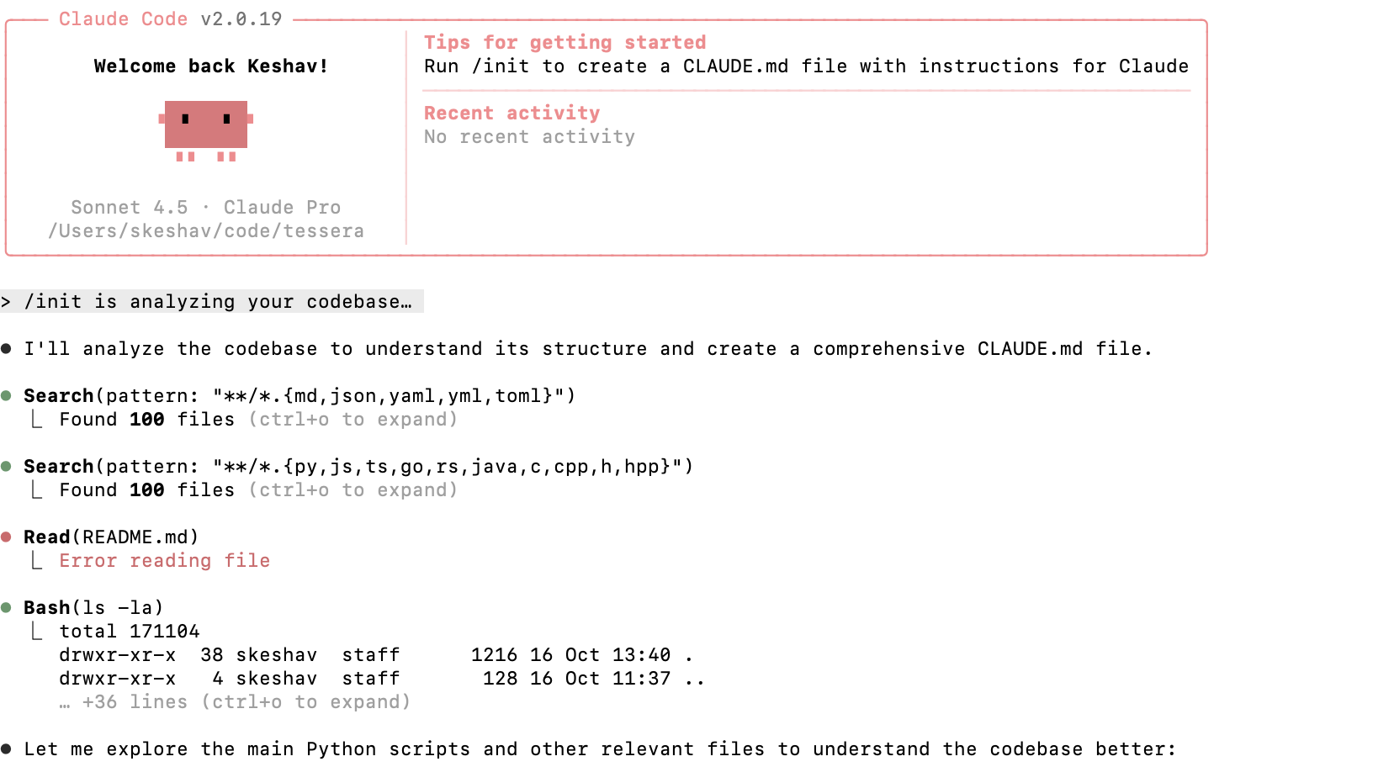
Claude code

Slide 36
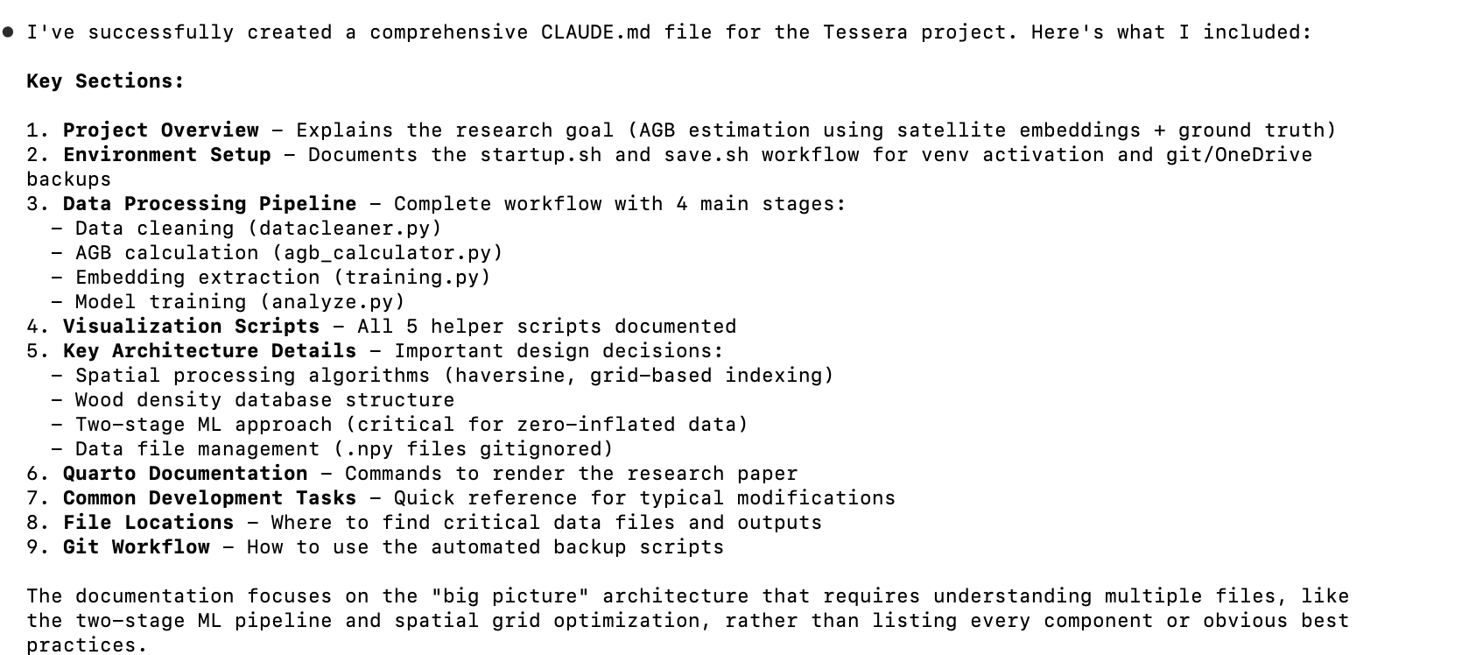

Slide 37
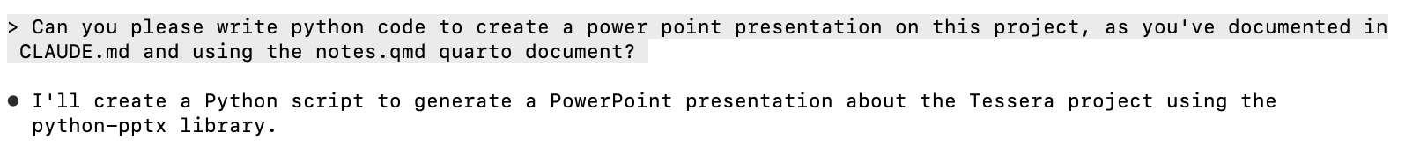
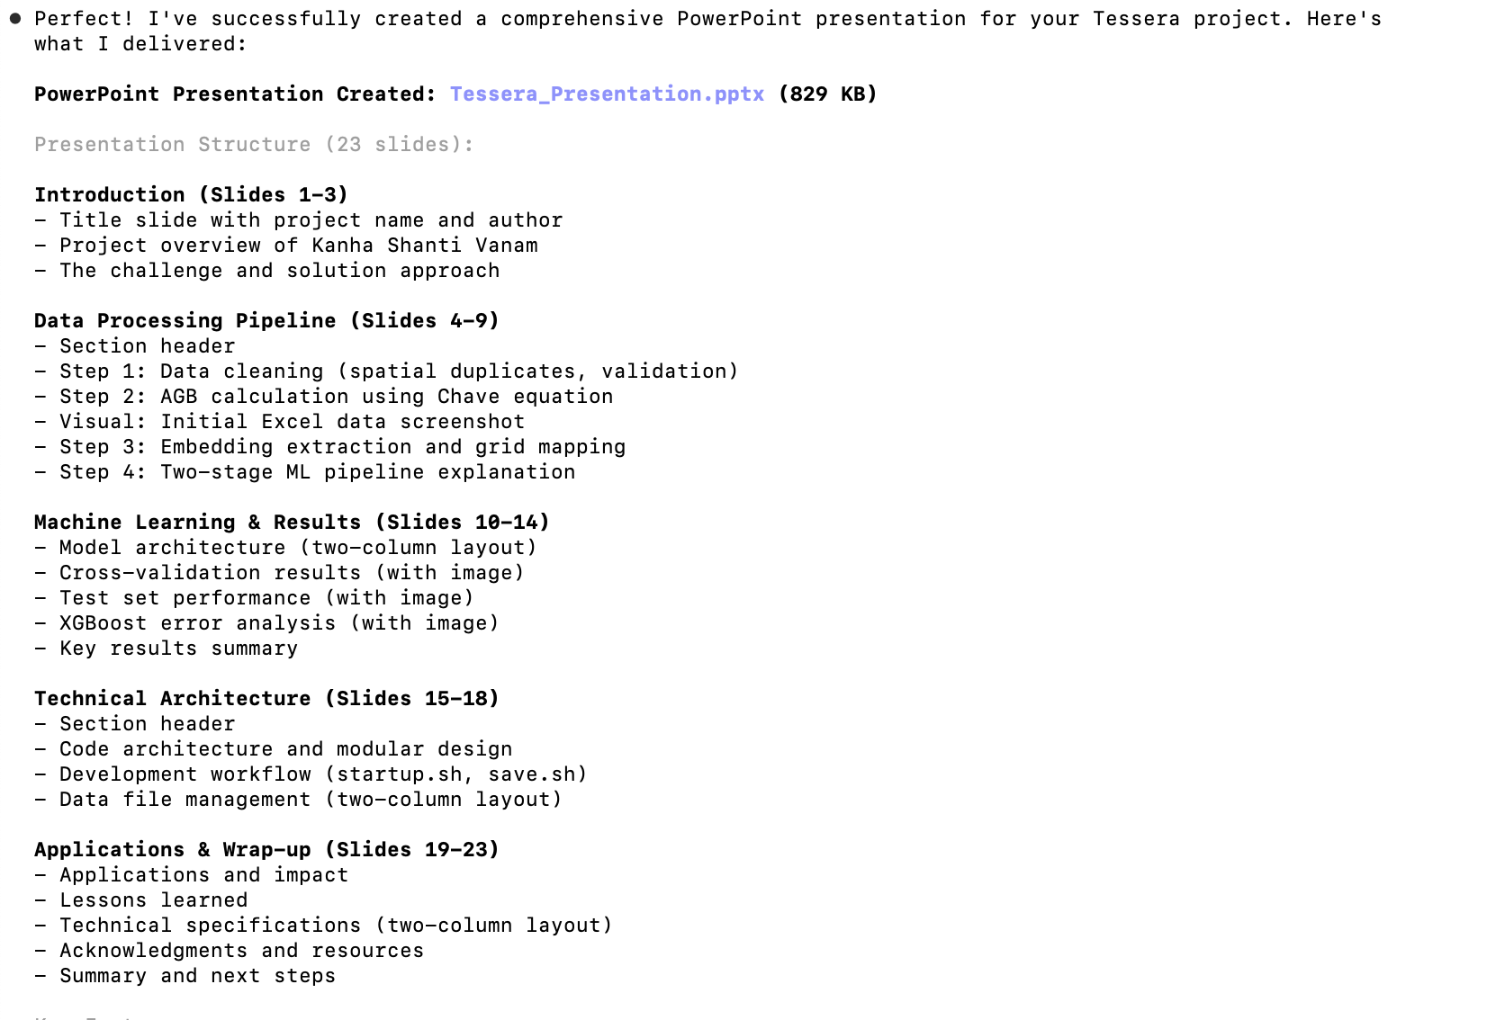

Slide 39
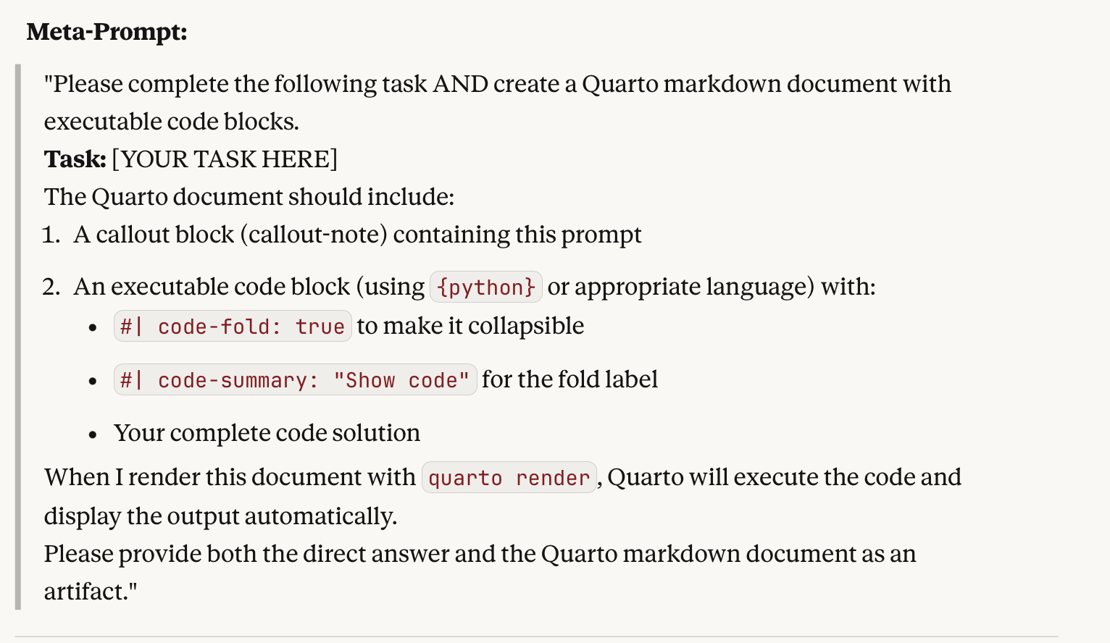
Even more meta…
I would like your help with a complicated bit of thinking. What prompt can I give you so that you produce
not only some output, but also a quarto markdown document that uses a callout to state the prompt and a
'folded' code block to state your response. For example, if I gave you the prompts 'write a python script to print "hello world”’
then your output should be 1) the python script and 2) a quarto markdown document
that gives this prompt and your response.

Slide 40
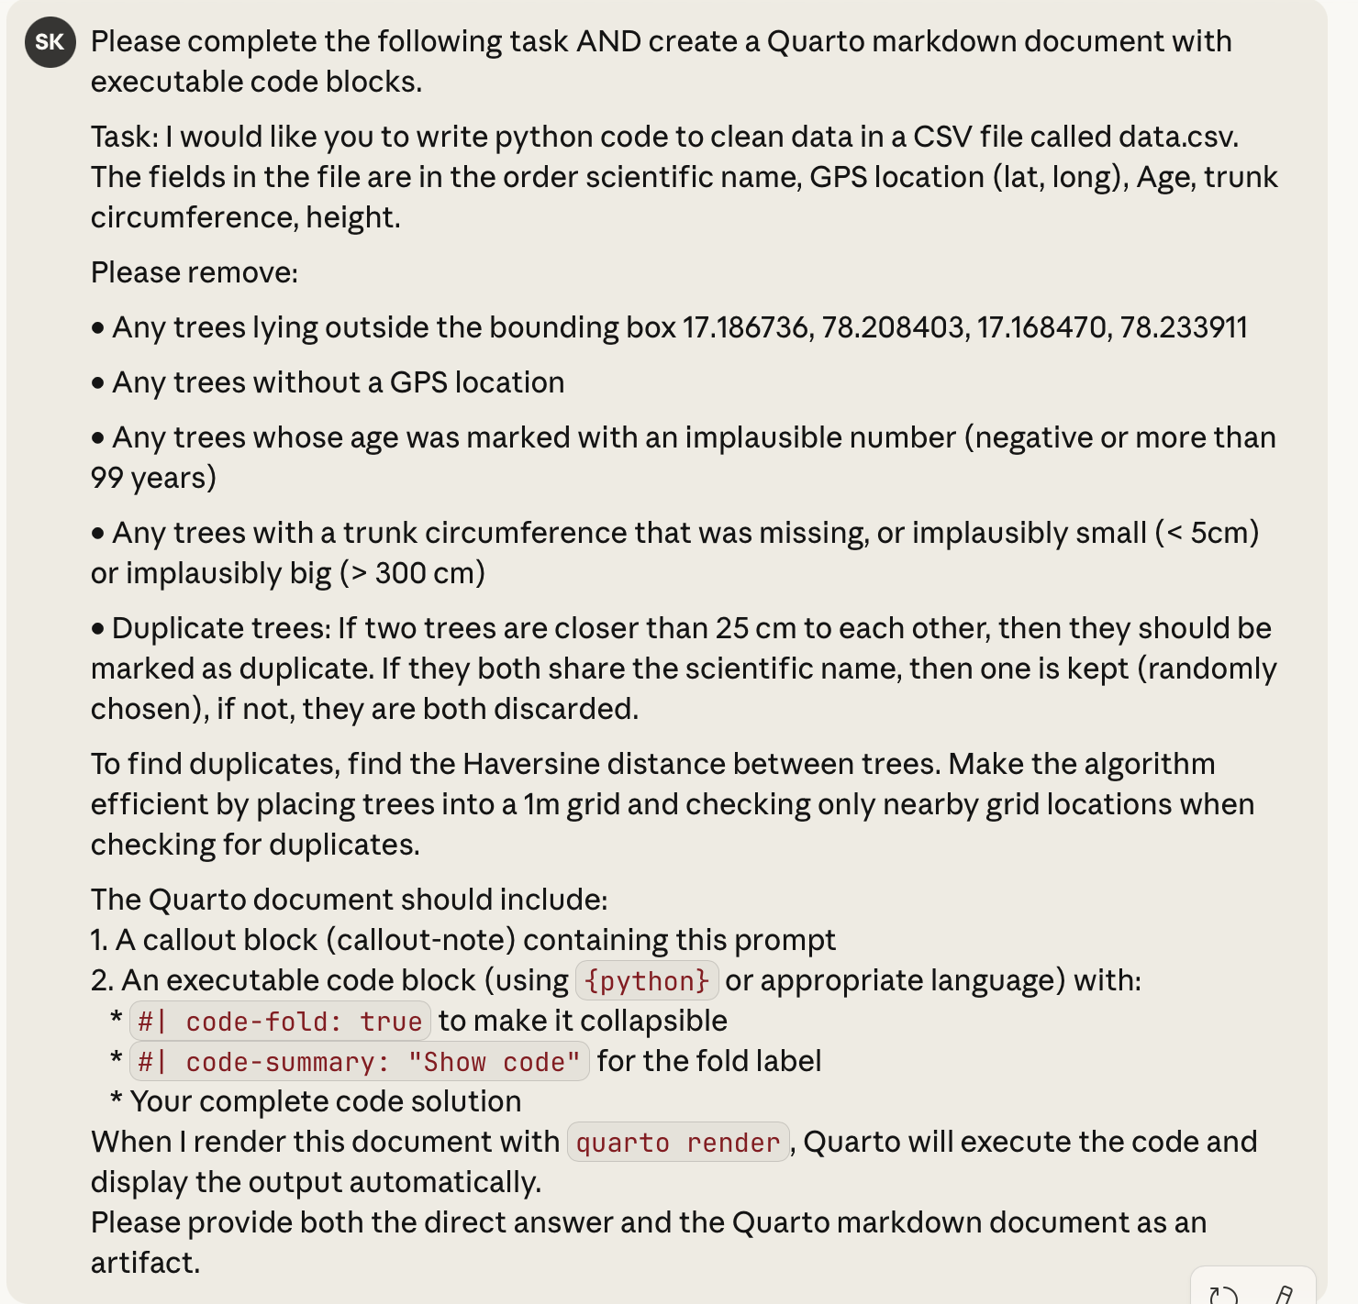

Slide 41
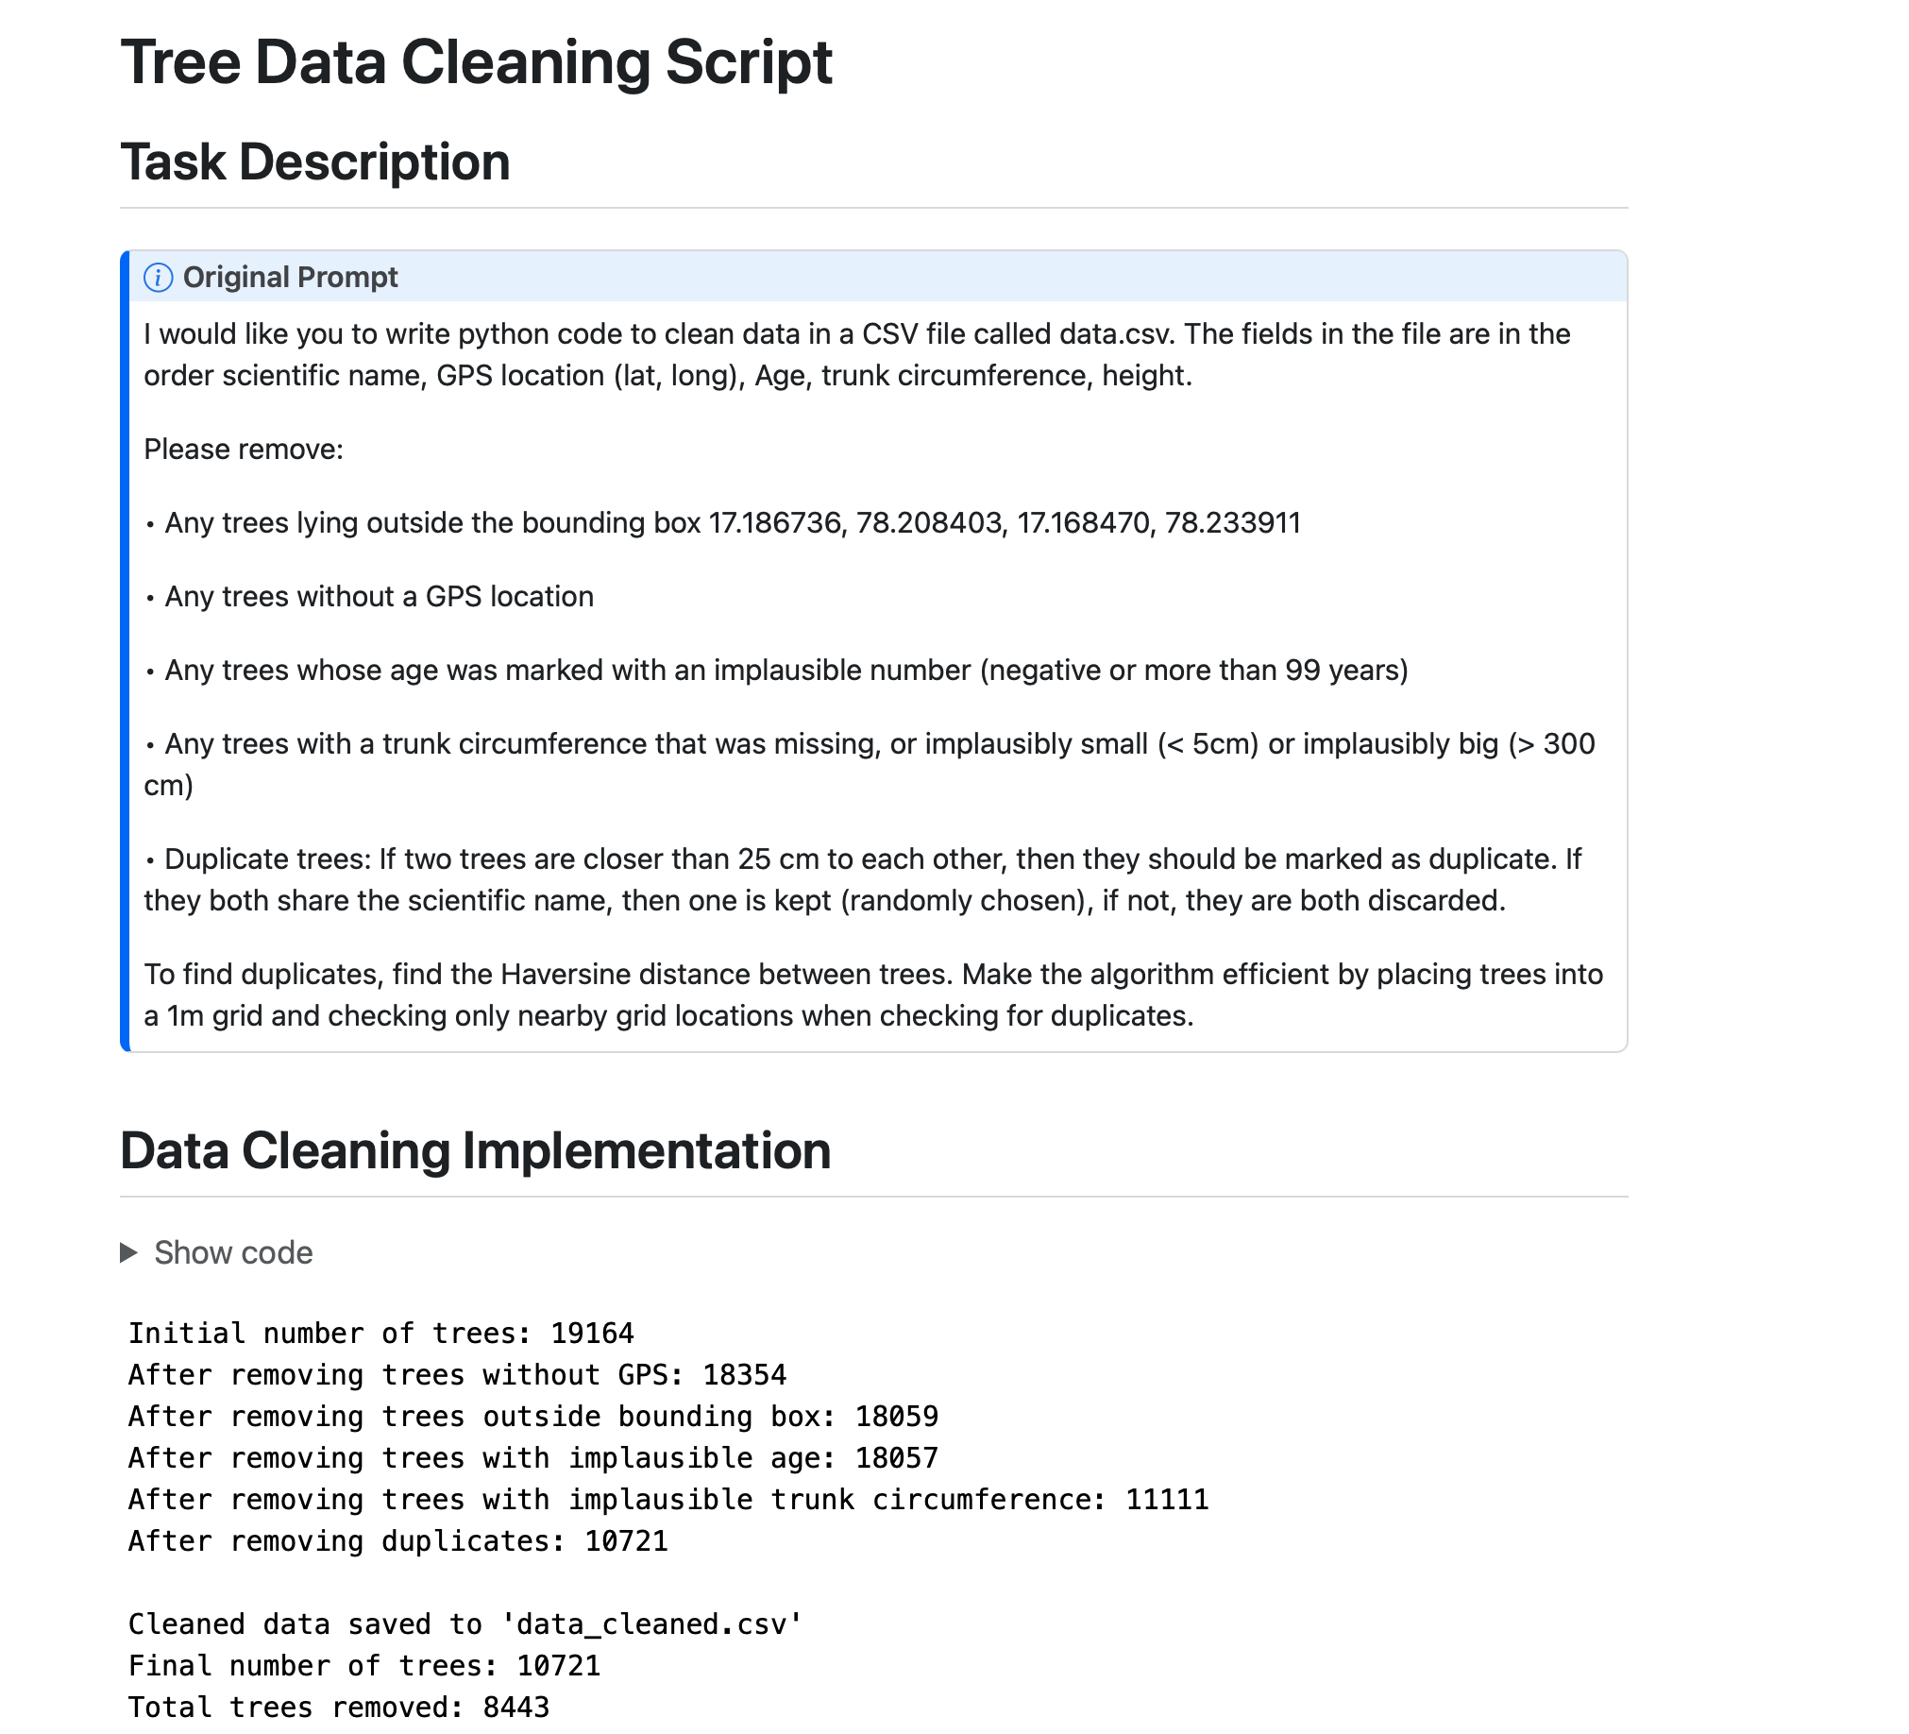

Slide 42
Ad astra

Slide 43
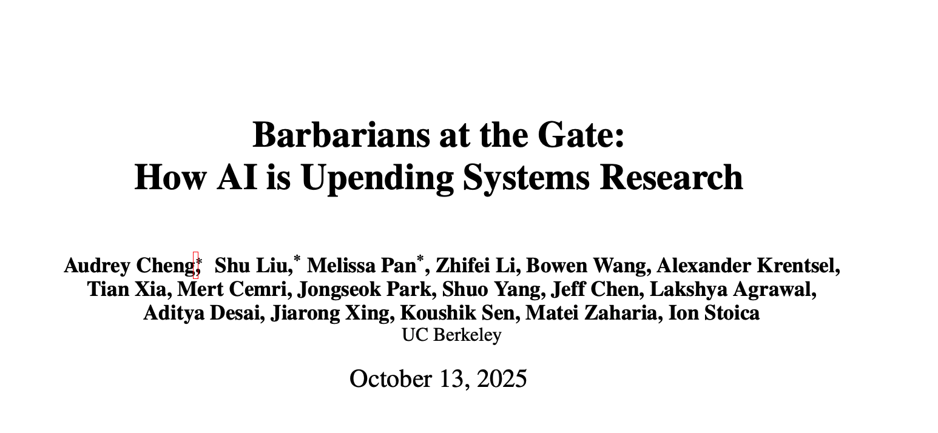
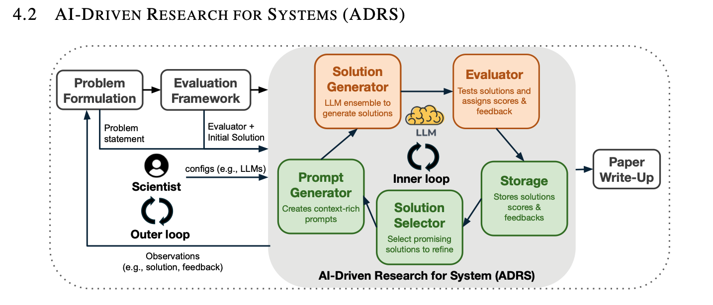
https://github.com/codelion/openevolve

Slide 44
Summary
We have extraordinary power at our fingertips
Claude.ai website to write code
Claude code for agentic actions
Tessera embeddings
Quarto-based executable self-documenting script that can be rendered as embedded HTML or PDF

