Slide 1
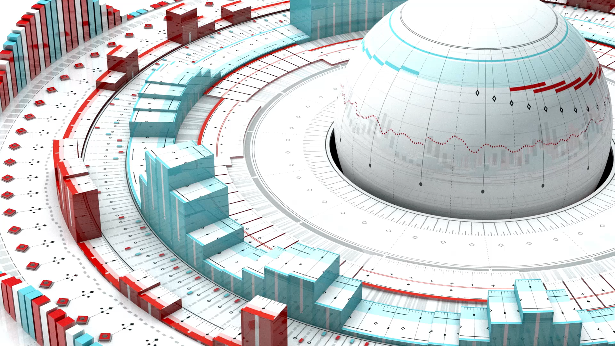
How can geospatial foundation models support ecological insights at scale?
with a case study on mapping Italian montane and subalpine forests
James Ball, Ecology Supergroup Meeting 06/07/2025

Slide 2
Overview
Motivations for geospatial foundation models
Available models: Tessera (Cambridge) and AlphaEarth (Google)
Example application: Trentino
Vision and next steps

Slide 3

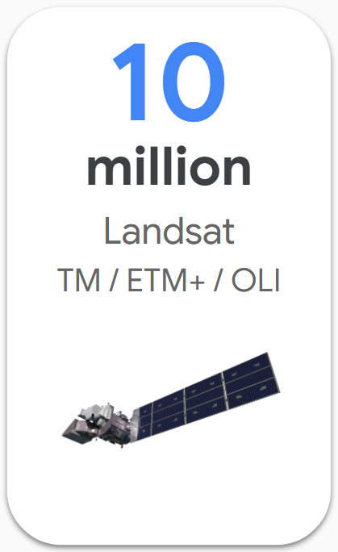
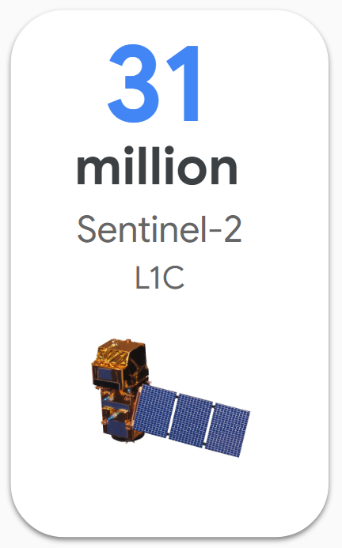
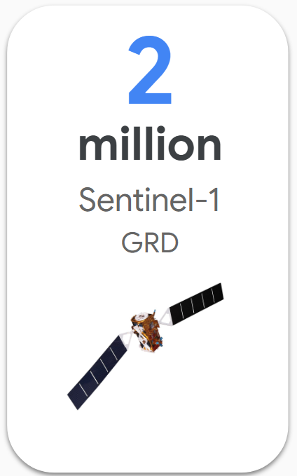

Remote Sensing Allows Monitoring at Scale
Continuous monitoring of land surface
Different, complementary sensors: optical, radar, lidar
Overwhelming volume of public satellite data!
Credit: SpaceX
Notes:
- How can we make use of them?

Slide 4
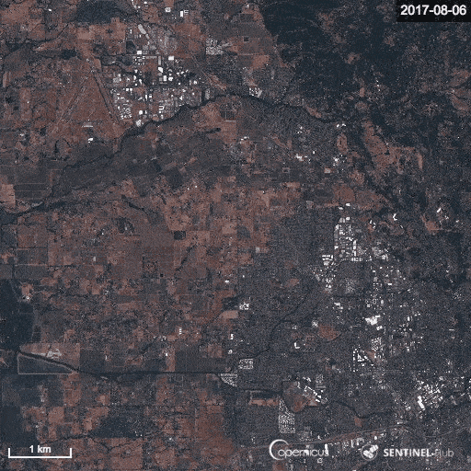
Challenges with current approaches
Fragmented models – bespoke classifiers for each site/sensor.
Data hunger – many ecosystems lack labelled data.
Limited transferability – poor generalization across regions.
Scale mismatch – local studies don’t scale globally.
Cloud, lighting & seasonality issues – hard to obtain consistent cloud-free imagery, especially in the tropics.
High entry barrier – technical complexity (wrangling) slows adoption.

Slide 5
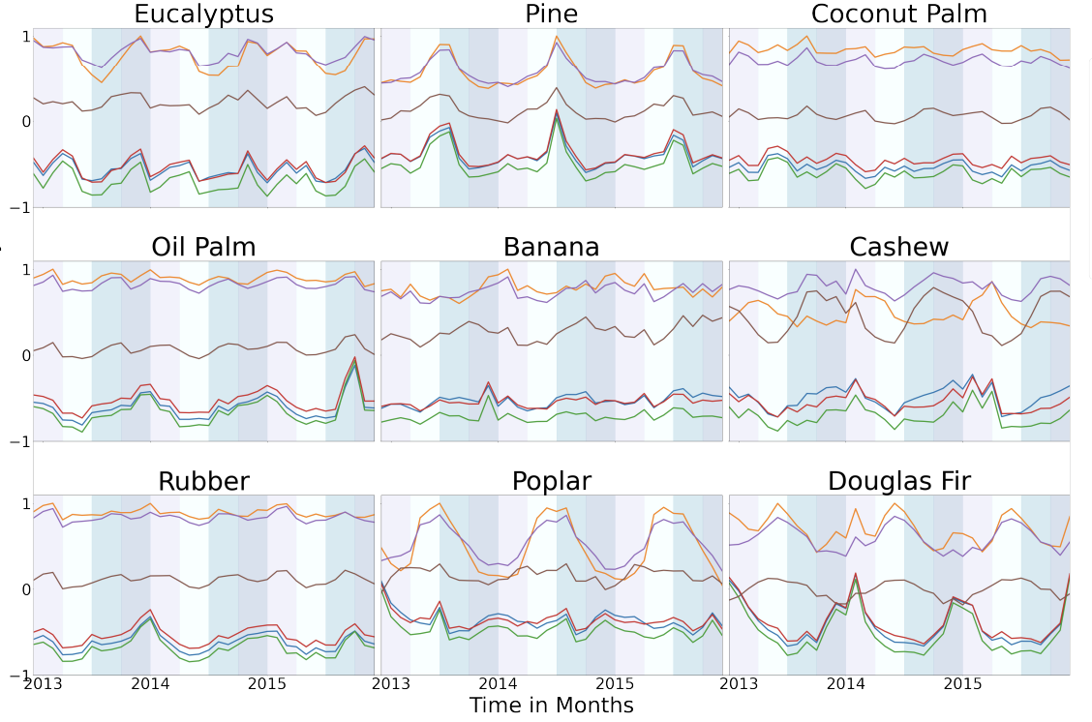
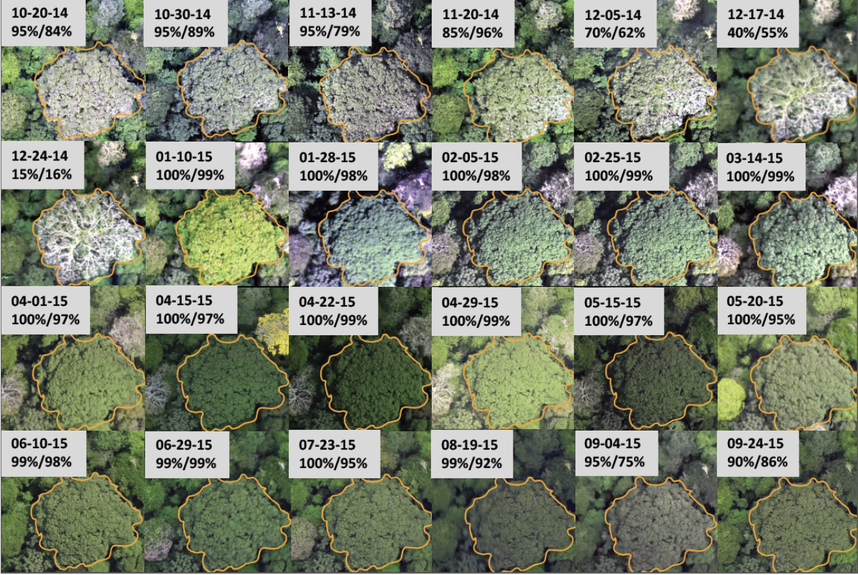
Temporal Signal
Pazos-Outon et al. (2024) arXiv:2406.18554
Park et al. (2019) Remote Sensing
Seasonal dynamics help identify land cover and detect change
Notes:
How can you include that in a simple, easy to use way?

Slide 6
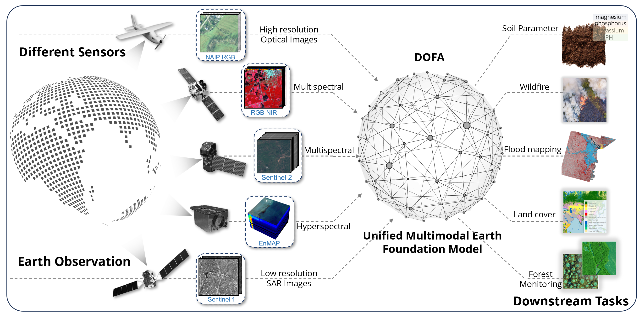
What is a geospatial foundation model?
Source: ESRI

Slide 7
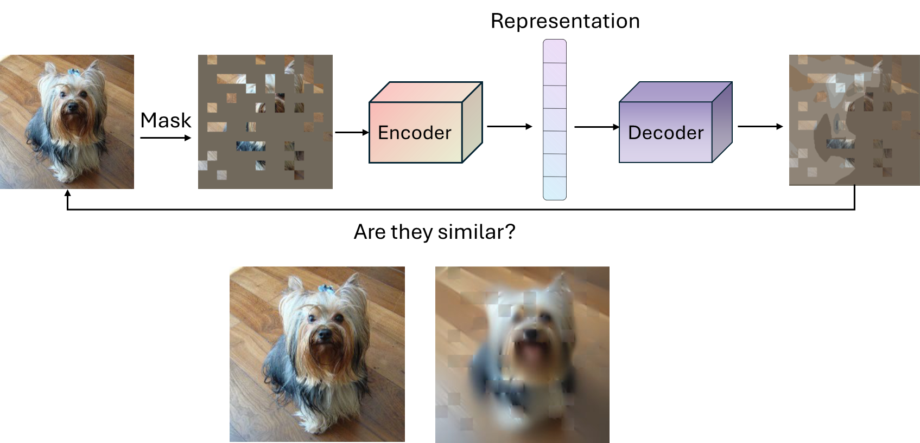
Self-supervised learning
Pretrain on mountains of unlabelled satellite tiles with a task that forces the model to understand space, time, and spectrum
Masked-patch modelling (MAE-style)
Hide most patches/bands/time steps and train the model to reconstruct what’s missing.
Contrastive learning (pull close, push apart)
Define “positives” as tiles from the same place/time/season (or the same place across seasons) and “negatives” as different places/times. Contrastive learning trains a model to pull together representations of data that are meaningfully similar—like two satellite views of the same place at different times—and push apart those that are different, so it learns what truly defines “sameness.”
Cross-modal contrast
Align satellite with something else – ground photos, text, or labels at coarser scales – so the embedding knows both appearance and semantics.
Big curated corpora & architectures
Pretraining happens on global, multi-sensor, multi-season sets (e.g., SSL4EO for S1/S2; NASA HLS for Prithvi). Architectures are usually ViTs or 3D transformers with temporal and spectral embeddings.
What this gives you (why it works)
General features from unlabelled, globally diverse data → stronger baselines with scarce labels, better domain transfer, and faster convergence. Masked modelling shines on long time series; contrastive shines when invariances and change cues matter.
Through these self-supervised objectives, the model builds embeddings – compact numerical representations of each image patch or scene that capture its spatial, temporal and spectral context.
Then you fine-tune for whatever you care about (segmentation, change, species, etc.).

Slide 8
Opportunities with Geospatial Foundation Models
Pretrained generality – capture broad spectral–spatial patterns from vast EO archives.
Few-shot adaptability – work with limited local labels.
Cross-sensor robustness – integrate optical + radar; reduce dependence on perfectly cloud-free data.
Multi-temporal learning – exploit repeated observations to fill gaps and handle seasonality.
Acceleration – faster, more accessible ecological monitoring and conservation tools.
Vision – towards “ecological GPTs” that generalize ecosystem understanding.

Slide 9
QUESTIONS
Do foundation models improve ecological mapping?
Can foundation models allow us to differentiate
  Species?
  Genera?
  Conifer/broadleaf?
How does data volume and purity affect classification?
Which available foundation model maps with greatest accuracy? (AlphaEarth vs TESSERA)

Slide 10
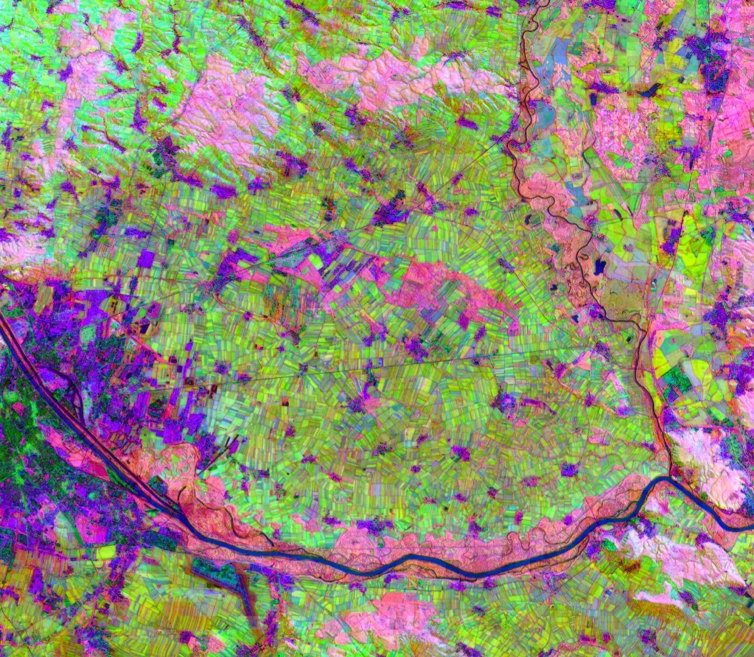
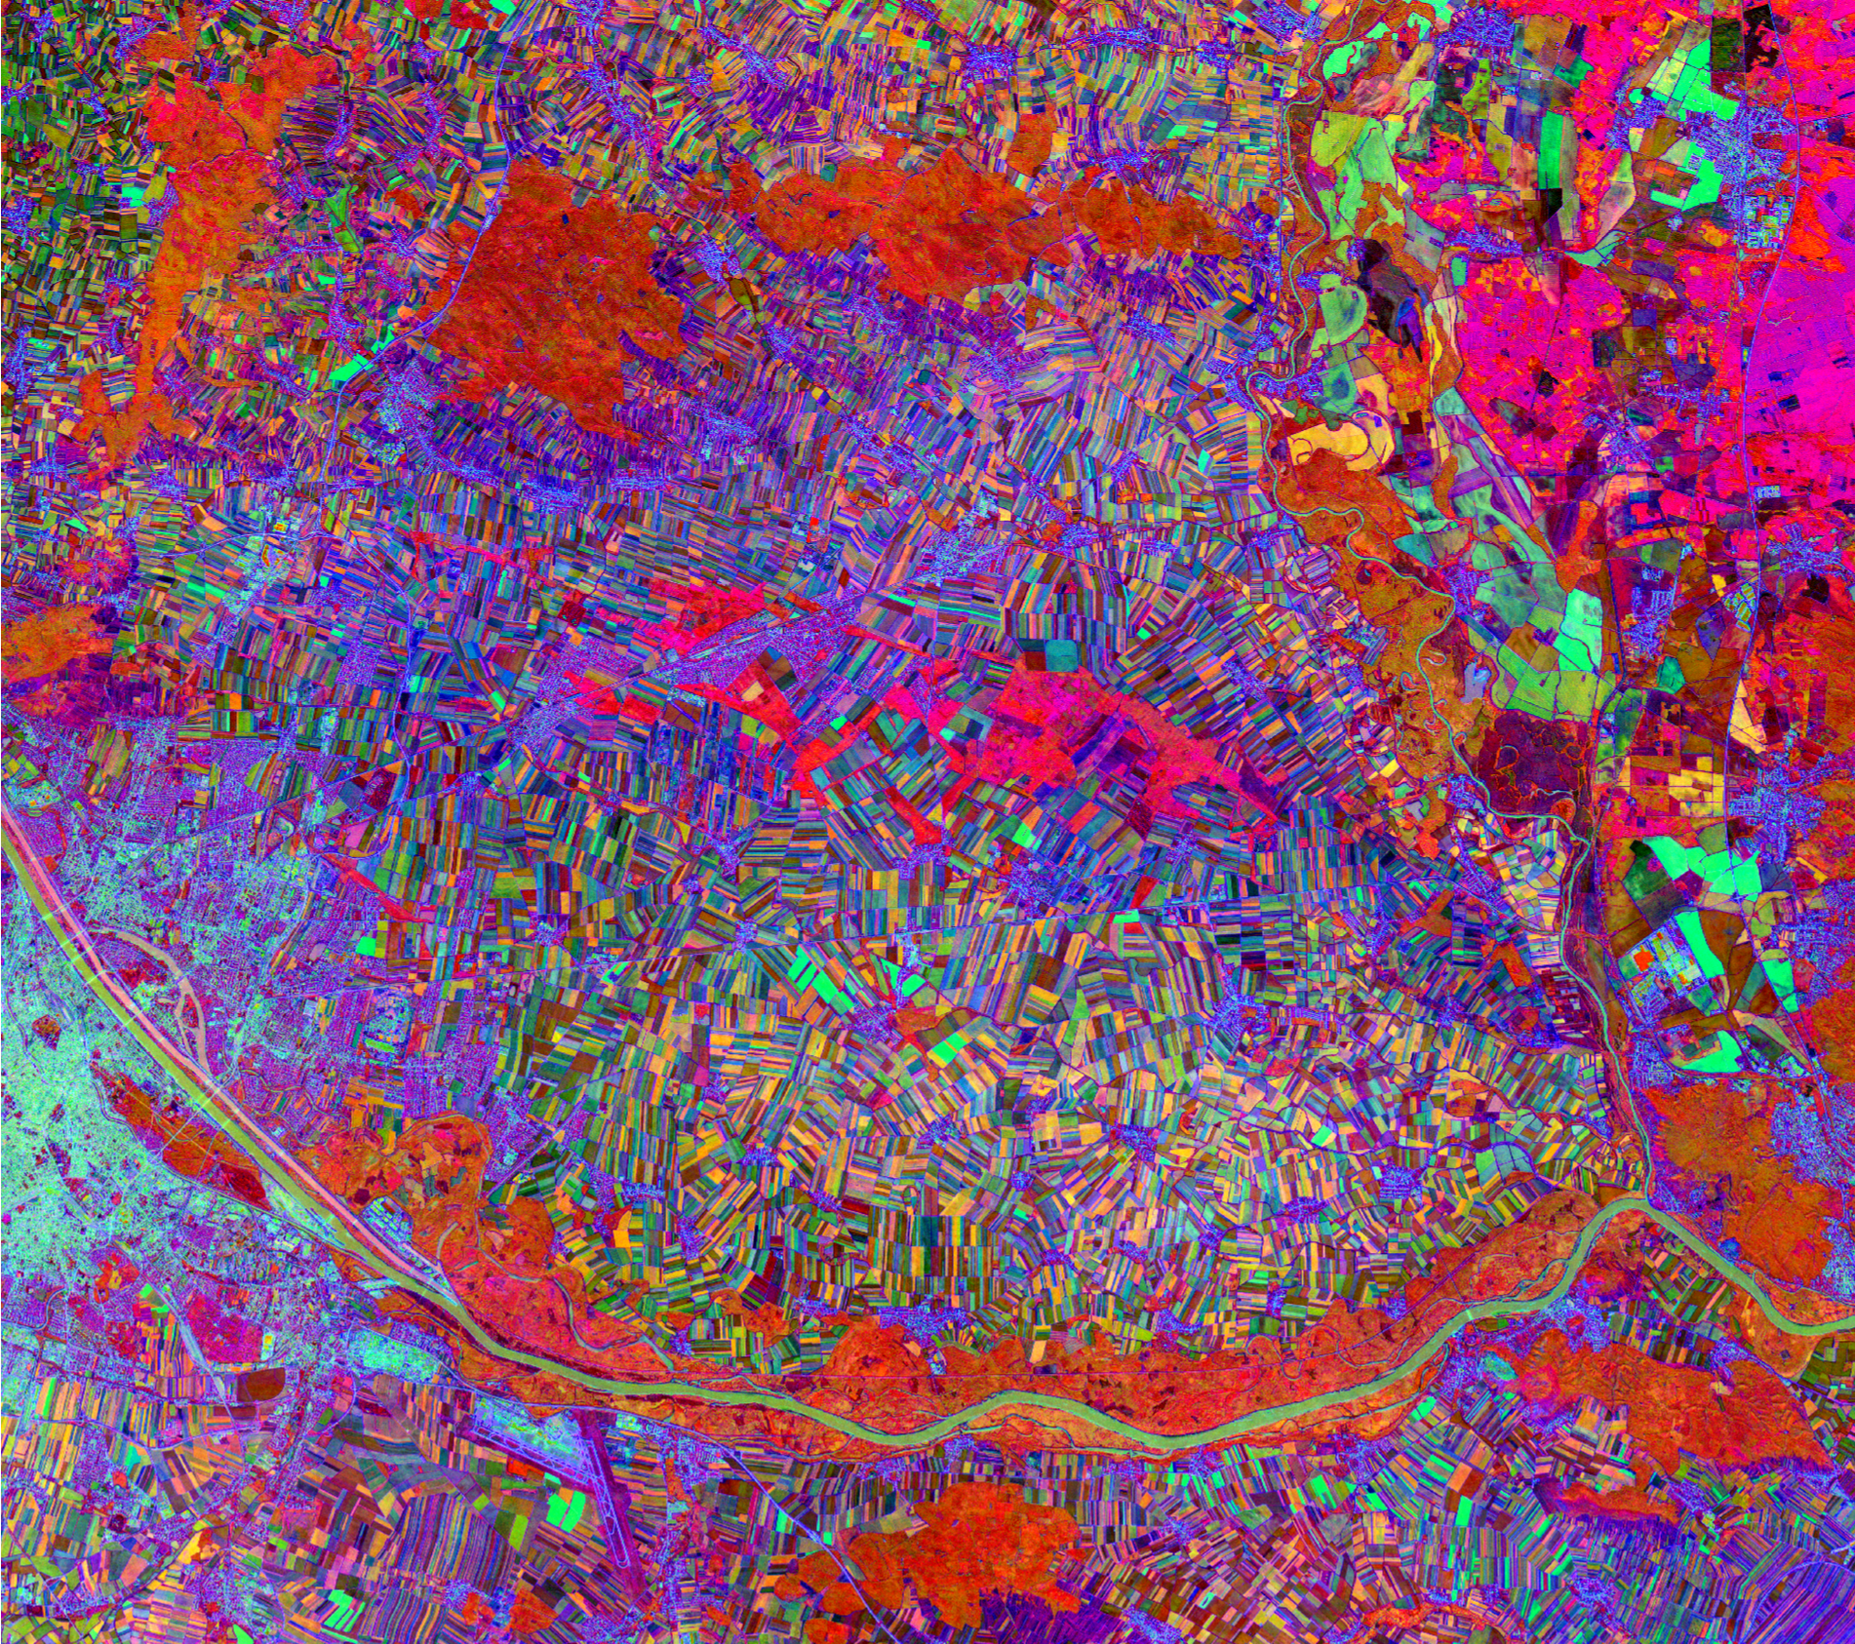
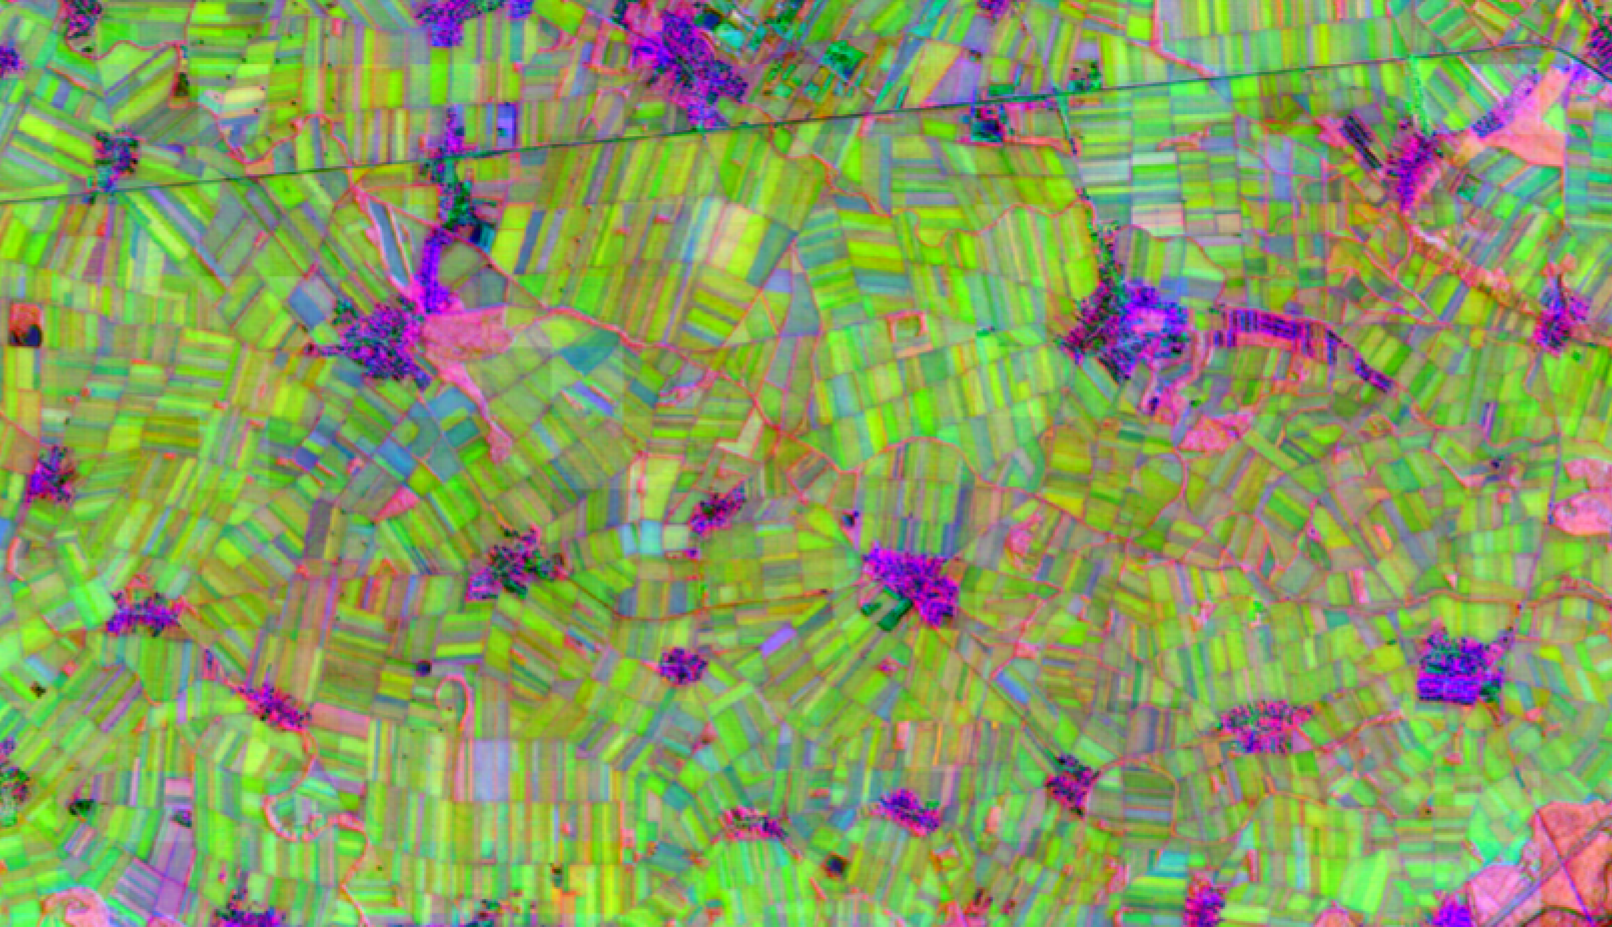
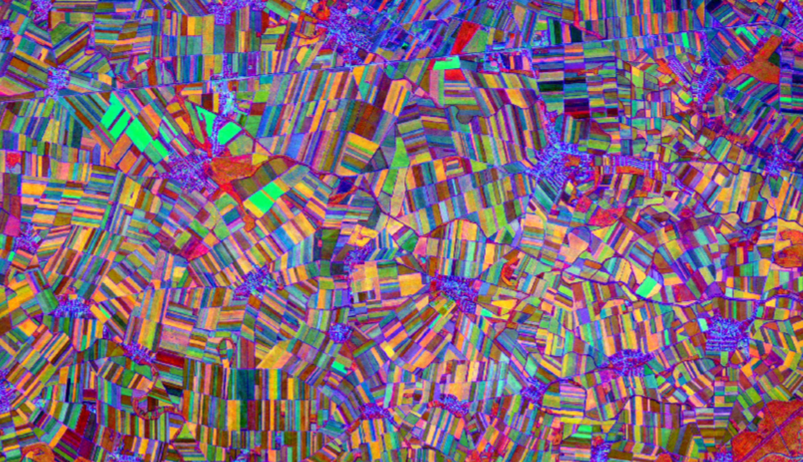
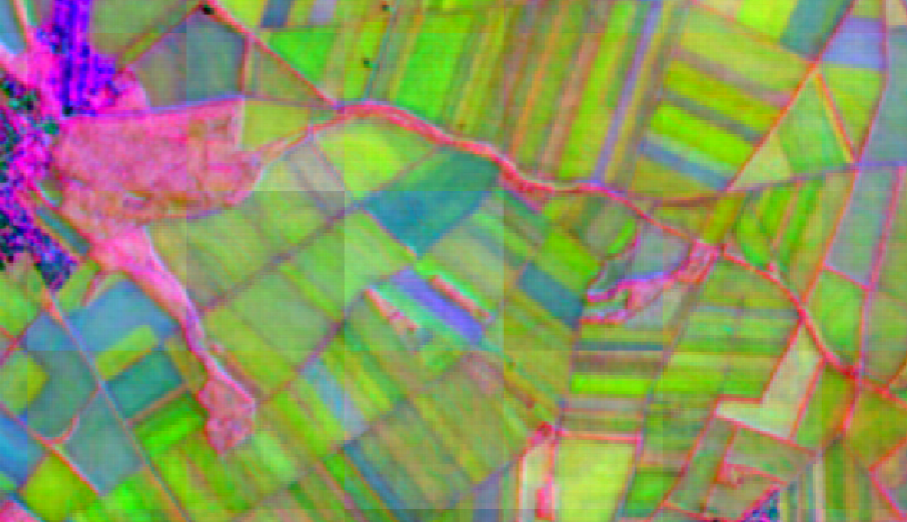
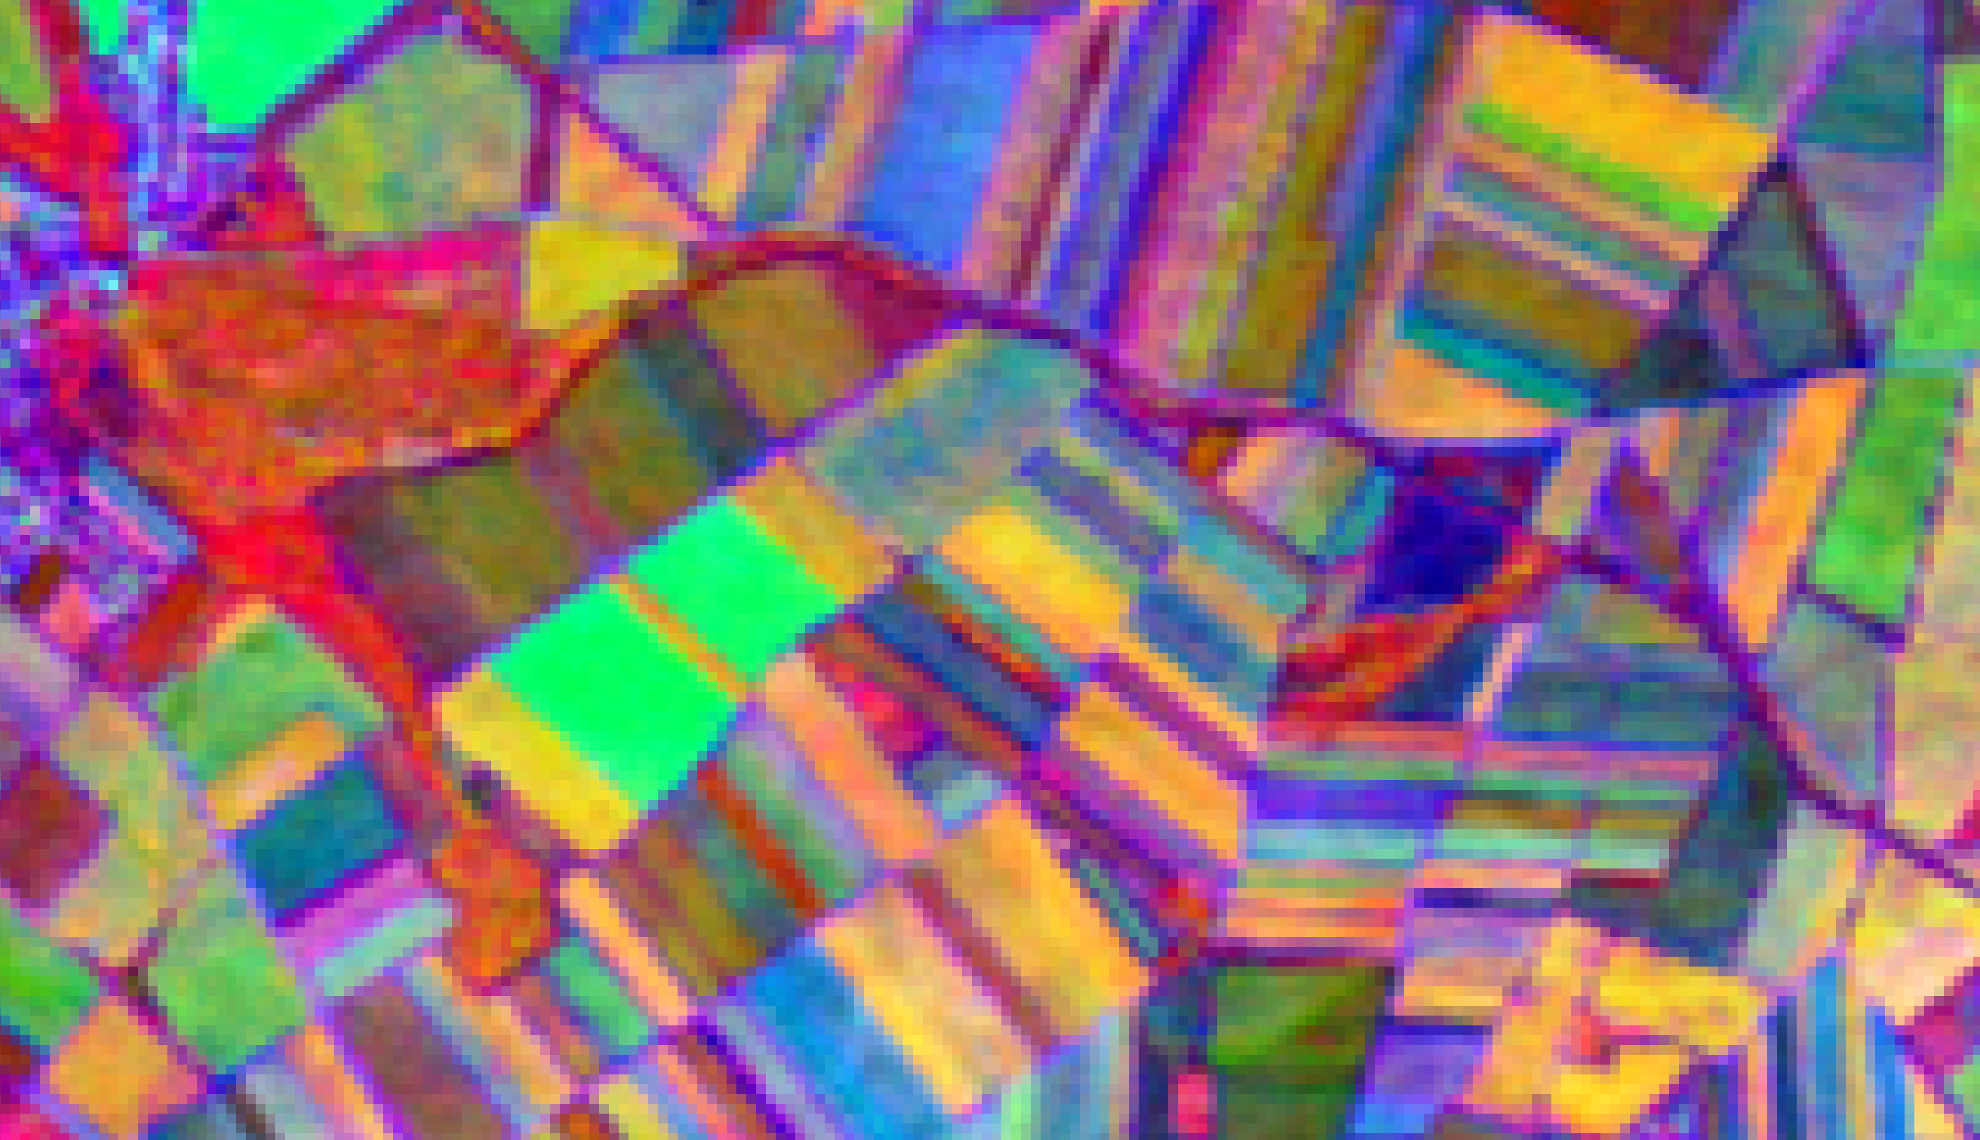
AlphaEarth
TESSERA

Slide 11
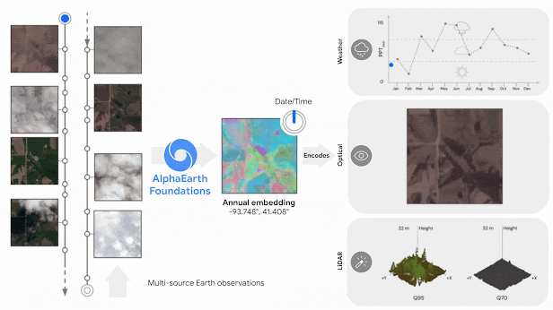
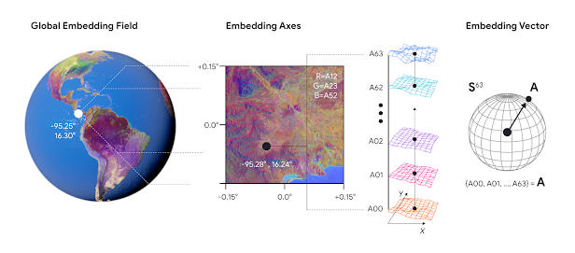
AlphaEarth (Google)
Goal:
Create a universal embedding space that fuses multi-sensor, multi-temporal Earth observation data to generate accurate global maps from sparse labels.
Core Idea:
AEF learns embedding fields – 64-byte vectors at 10 m resolution – that summarize local spectral, temporal, and contextual information.
Each embedding captures the temporal trajectory of Earth surface conditions over any chosen time period.
Architecture & Training
Space-Time Precision (STP) encoder: integrates spatial self-attention, temporal attention, and convolutional “precision” operators.
Teacher–student contrastive setup aligns video embeddings with text (Wikipedia + GBIF).
Implicit decoder handles continuous time and sensor metadata.
Trained on global multi-source data (Sentinel-1/2, Landsat 8/9, PALSAR-2, ERA5-Land, GEDI, GRACE).
Produces planet-scale annual embeddings (2017–2024) hosted on Google Earth Engine.
Source: Brown et al (2025) arXiv:2507.22291
Notes:
Google product

Slide 12
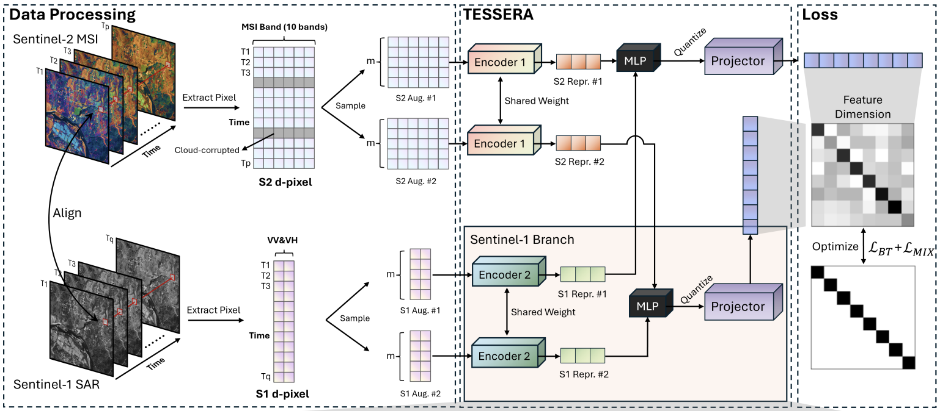
TESSERA (Cambridge)
Goal:
Provide ready-to-use, globally consistent embeddings for every 10 m pixel on Earth – enabling fast, label-efficient mapping from raw Sentinel-1/2 time series.
Core Idea:
TESSERA learns spectral-temporal embeddings that capture annual dynamics of the Earth’s surface directly from unlabelled optical and radar data.
Embeddings (128-dim vectors) summarize each pixel’s full seasonal signature.
Architecture & Training
Dual-encoder design: two Transformer-based branches – one for Sentinel-2 (optical), one for Sentinel-1 (SAR).
Fusion MLP + projector: merges modalities, expanded during training to 16 k-dim for redundancy reduction.
Self-supervised learning: modified Barlow Twins loss + mix-up regularization, learning invariance to cloud gaps and sampling noise.
Produces annual global embeddings (2017–2024) at 10 m resolution.
Entire model open-source and reproducible via GeoTessera library (PyPI).
Impact
Outperforms both Google AlphaEarth and PRESTO on five benchmark tasks – crop classification, biomass estimation, canopy height, fire mapping, and carbon stocking indices
First open, FAIR-compliant, pre-computed geospatial foundation model.
Removes the need for fine-tuning or high-performance compute – anyone can map ecosystems with a few labels.
Sets a new standard for transparent, accessible AI in Earth observation.
Source: Feng et al (2025) arXiv:2506.20380
Notes:
FAIR data is data which meets the FAIR principles of findability, accessibility, interoperability, and reusability (FAIR)

Slide 13
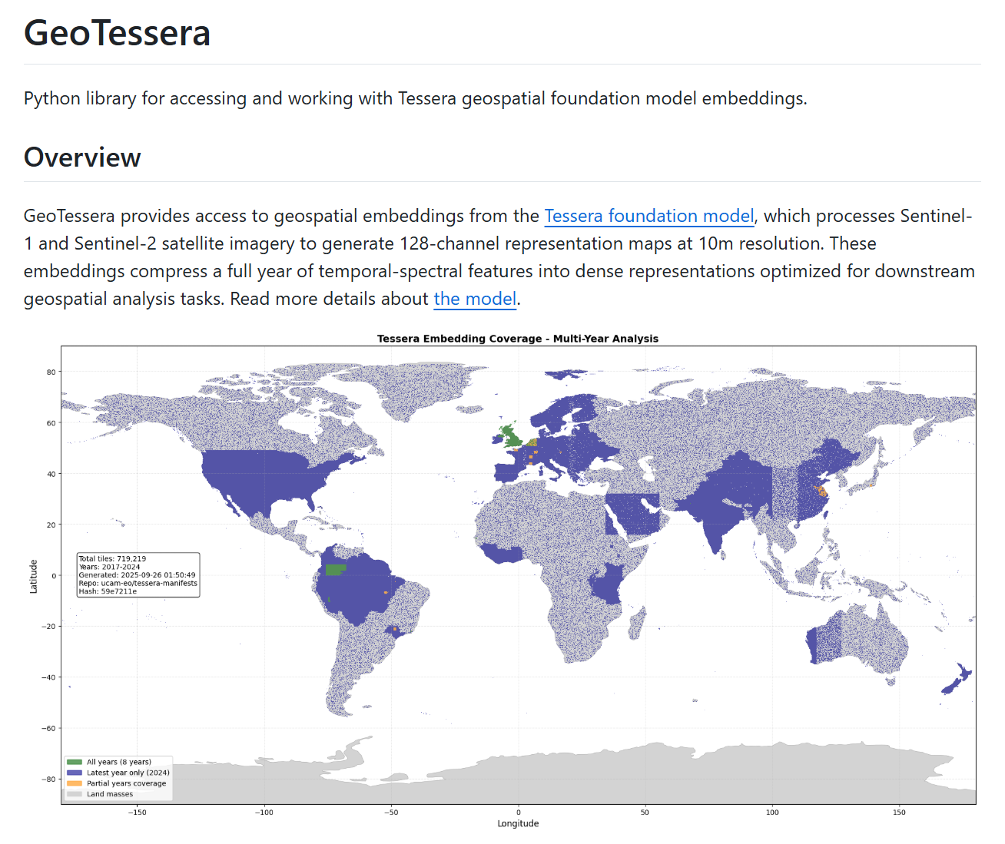
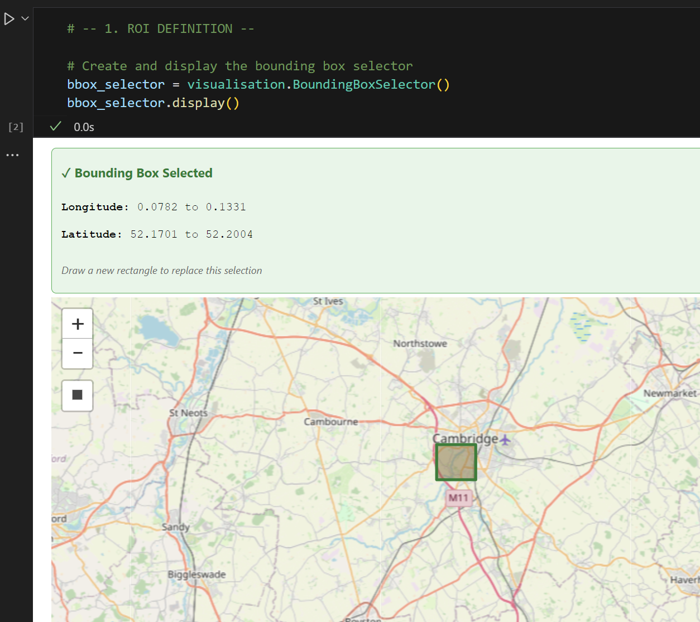
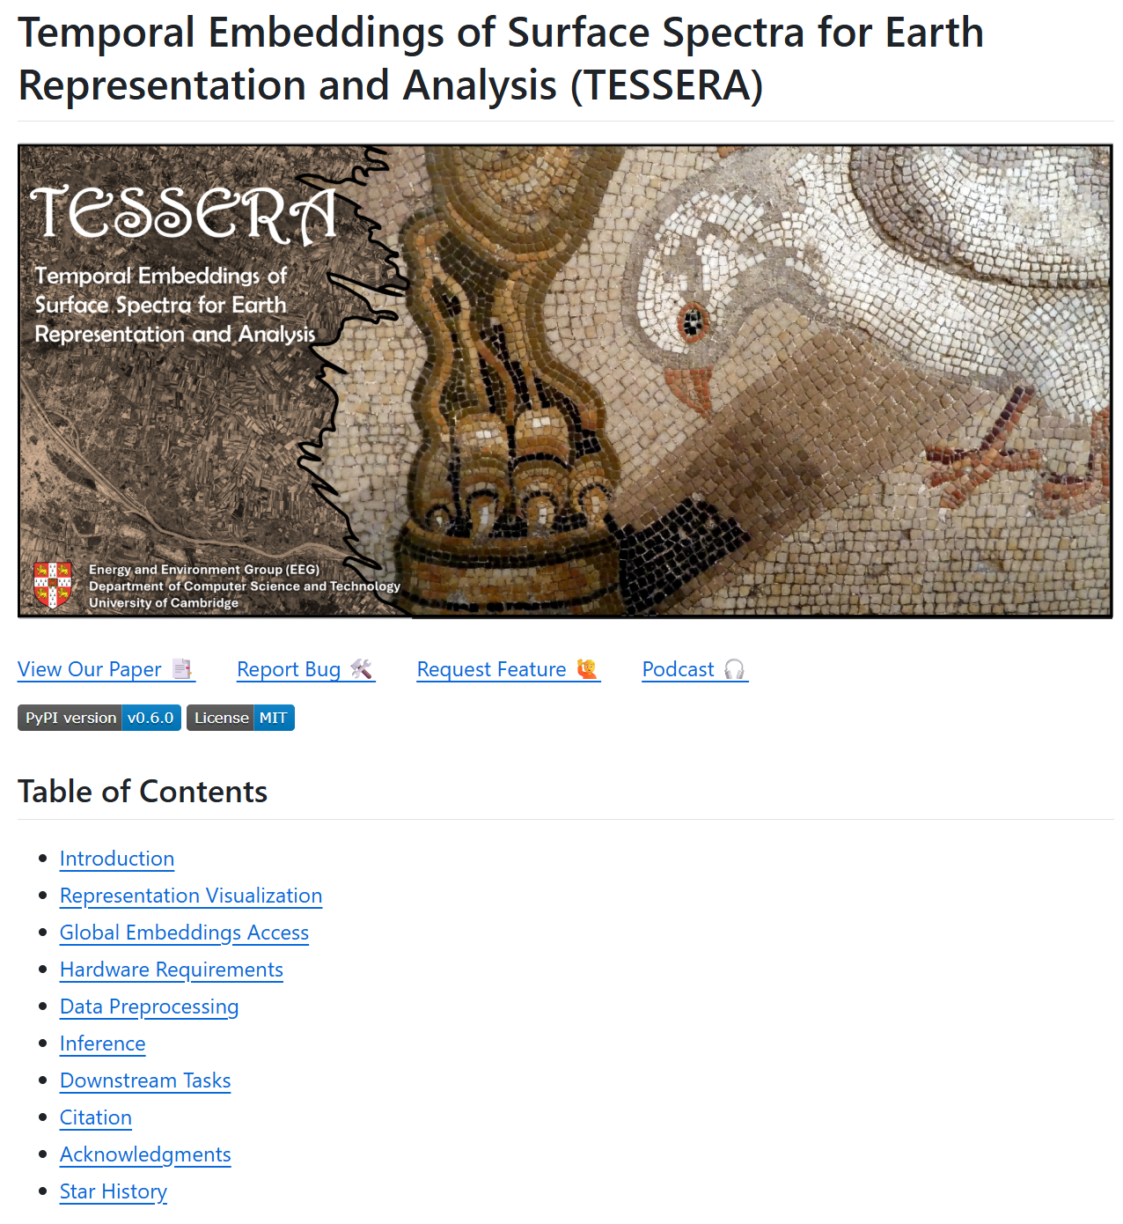
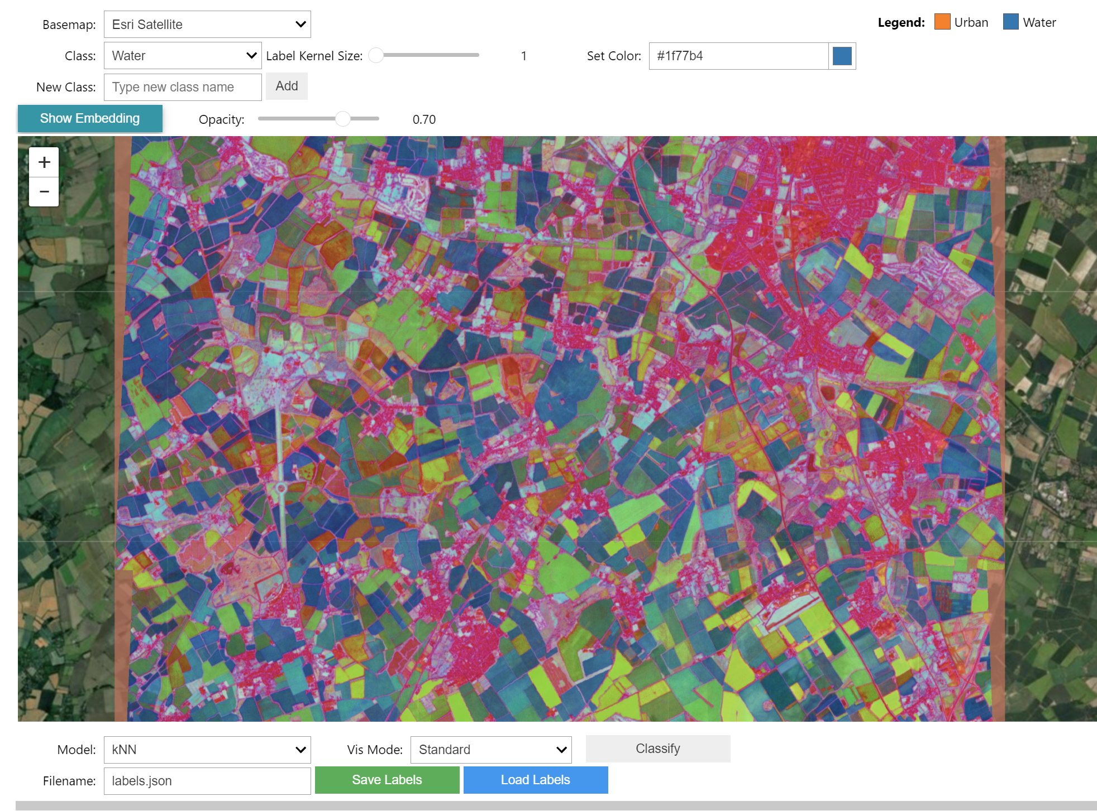
TESSERA Tool Kit
Tessera
Geotessera
Interactive Map
User Request (lat/lon bbox)
↓
Registry Lookup (find available tiles)
↓
Download Files (via Pooch with caching)
├── embedding.npy (quantized)
└── embedding_scales.npy
↓
Dequantization (multiply arrays)
↓
Output Format
├── NumPy arrays → Direct analysis
└── GeoTIFF → GIS integration
Fully open-sourced repo
Train the model
Evaluate the model
Create embeddings yourself

Slide 14
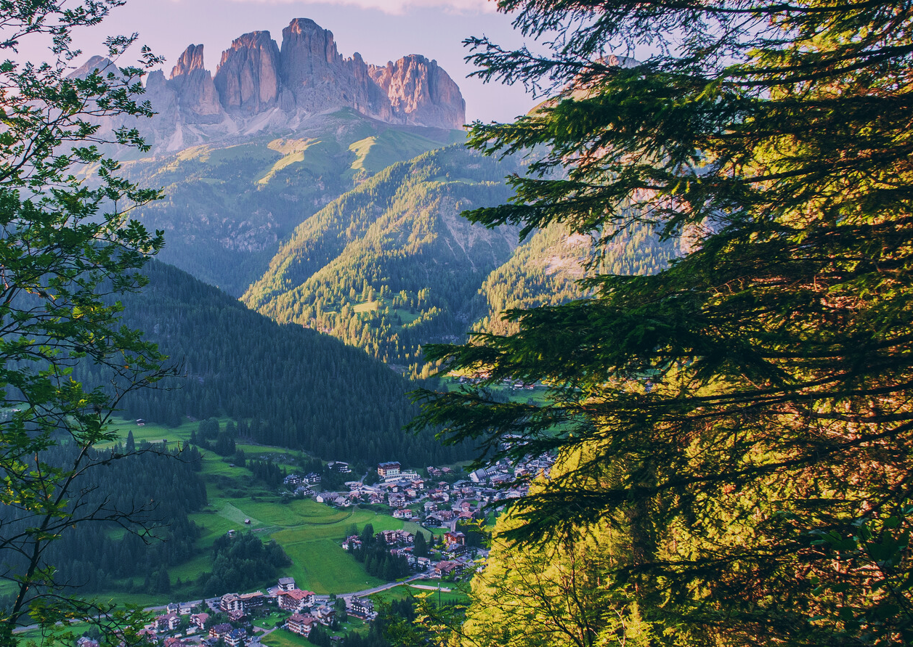
Case study: Trentino forests
Diverse mountain landscapes: from valley bottoms to high alpine peaks (200–3,800 m).
Montane forests (600–1,200 m): dominated by European beech (Fagus sylvatica), mixed with oak, hornbeam, and chestnut in warmer sites.
Submontane–montane conifers (1,200–1,800 m): Norway spruce (Picea abies) and silver fir (Abies alba) form extensive productive forests.
Subalpine belt (1,800–2,200 m): European larch (Larix decidua) and stone pine (Pinus cembra), often in mixed stands with spruce.
Above treeline (>2,000 m): alpine meadows, dwarf shrubs (e.g. Rhododendron ferrugineum), scree and rock habitats.
High biodiversity: transitional zone between Mediterranean and central European floras; strong elevational gradients support varied communities.
Human influence: centuries of forestry, grazing, and meadow management have shaped forest structure and distribution.

Slide 15
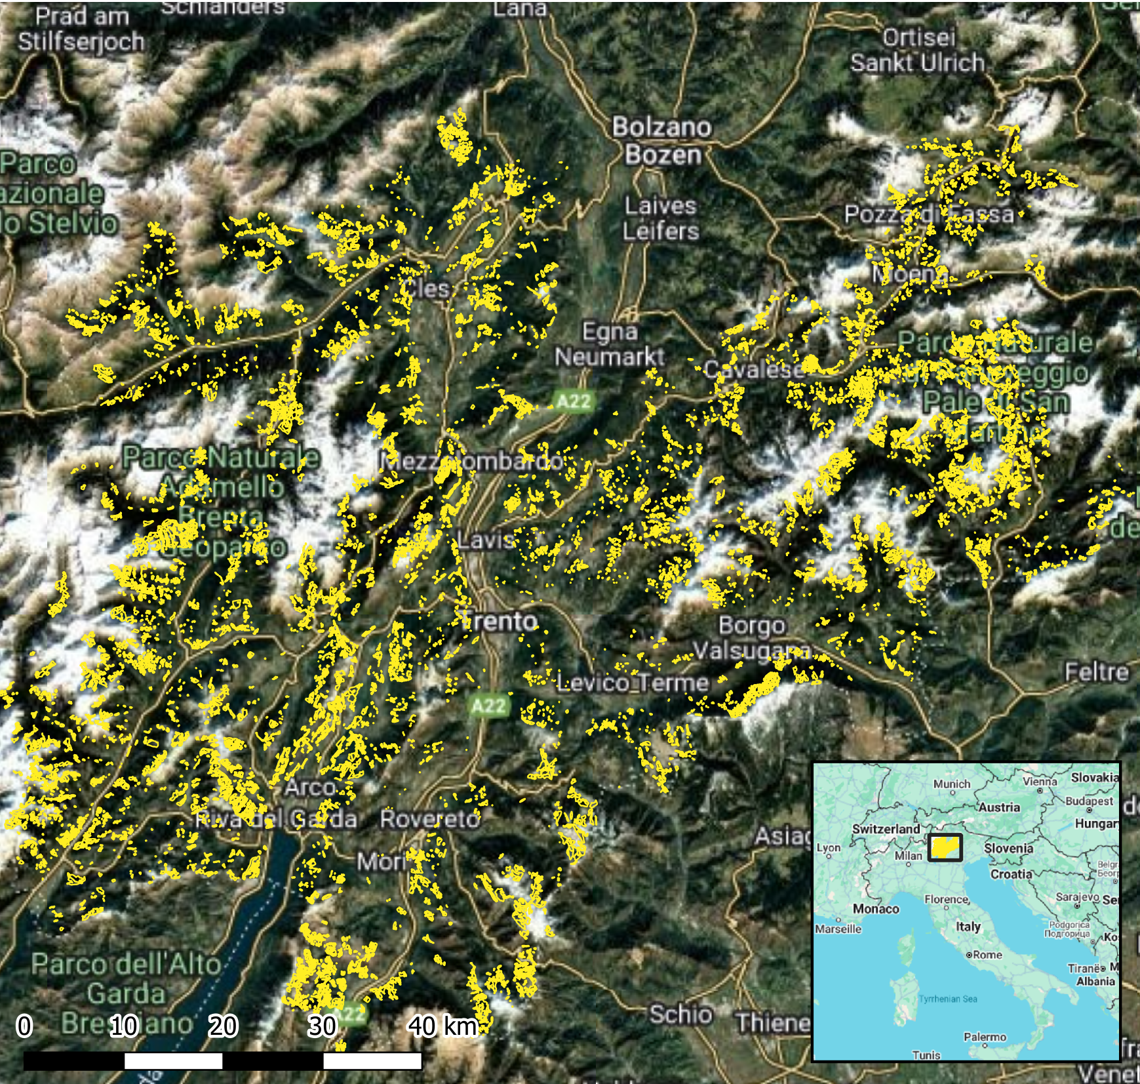
Trentino dataset
Collected 2010-2021
100,000+ mixed parcels
Assessed by local foresters
47 species
Crown area proportions (% sp. cover)
E.g. Parcel 1: 60% Larix decidua, 40% Picea abies
Courtesy of Michele Dalponte and Jana Wicklein (Edmund Mach Foundation)

Slide 16
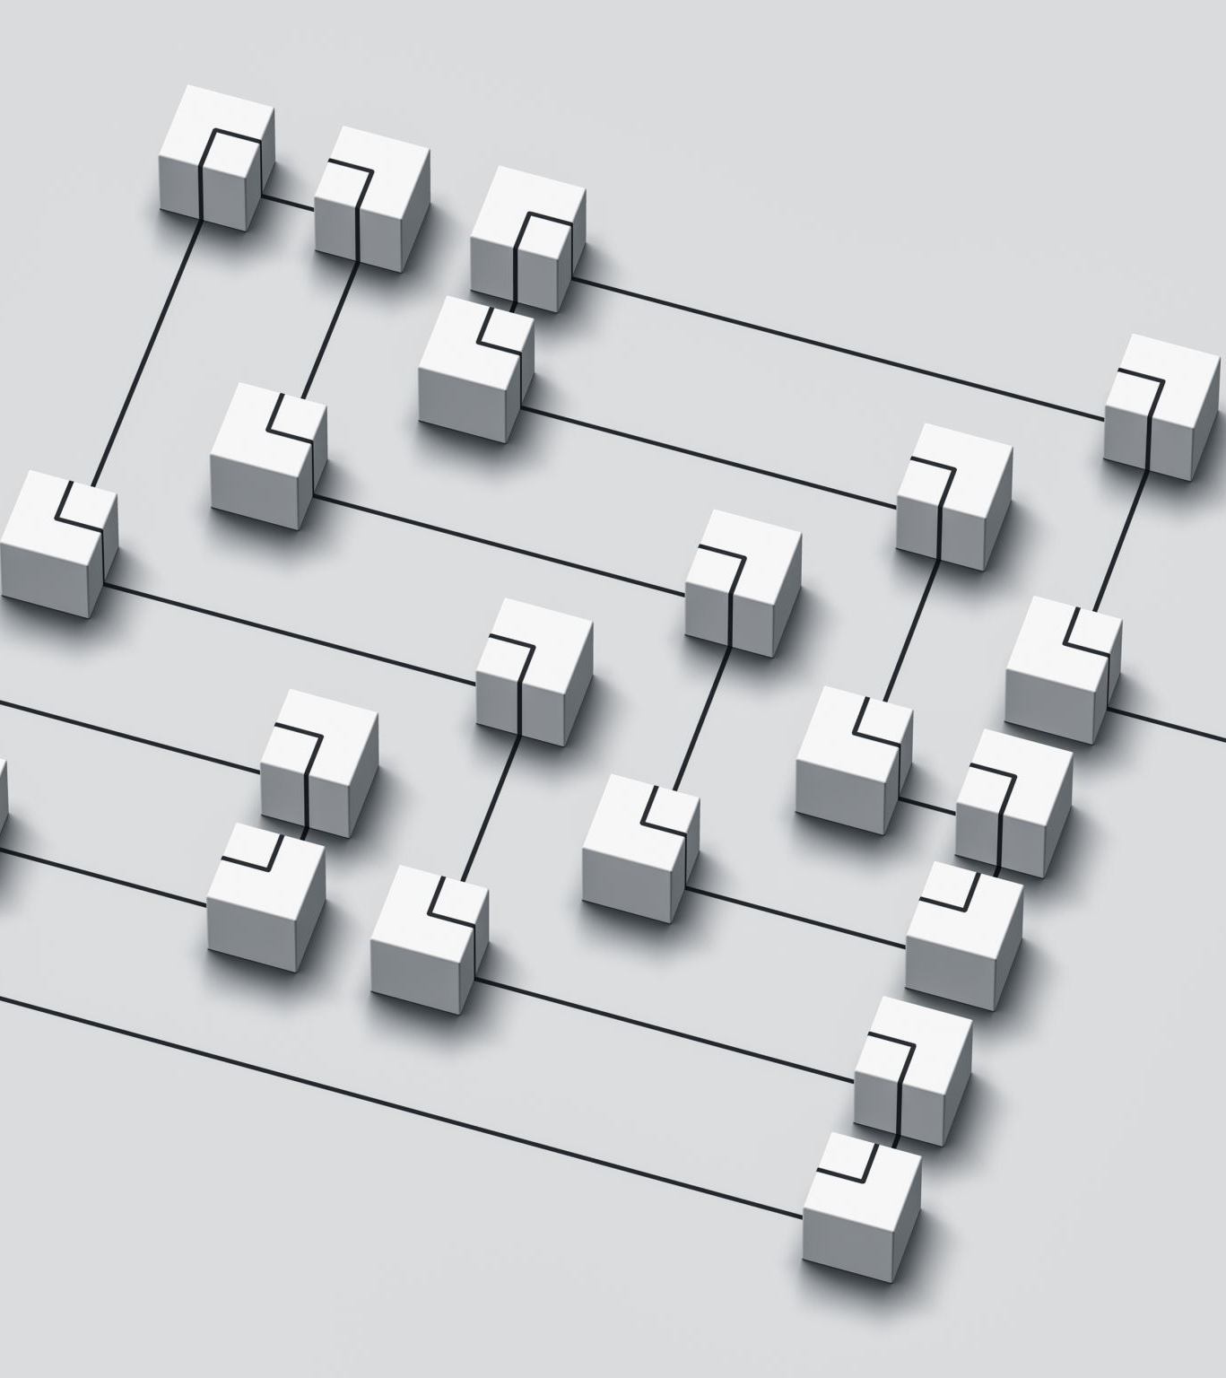
Methods
Read the foundation-model raster stack (optionally stacking a DEM) so every pixel already carries a feature vector aligned to the target grid
Clean the polygon labels by filtering on purity/year, removing ambiguous classes, optionally collapsing to genus, and mapping each parcel to an integer class and parcel id
Rasterize those polygons onto the imagery grid to create per-pixel label and polygon-id rasters, drop classes with too few pixels, and flatten the feature cube into a per-pixel table while masking out unlabelled or invalid samples
Build parcel-intact folds with StratifiedGroupKFold, then derive train/validation/test masks so no polygon leaks across splits
Grid search RandomForest hyperparameters against the validation fold, and refit the best model on train+val before scoring the held-out test pixels
Generate confusion matrices, classification reports, and (if requested) wall-to-wall predictions or label-fraction sweeps
Notes:
Elevation – to provide extra context on top of the satellite data

Slide 17
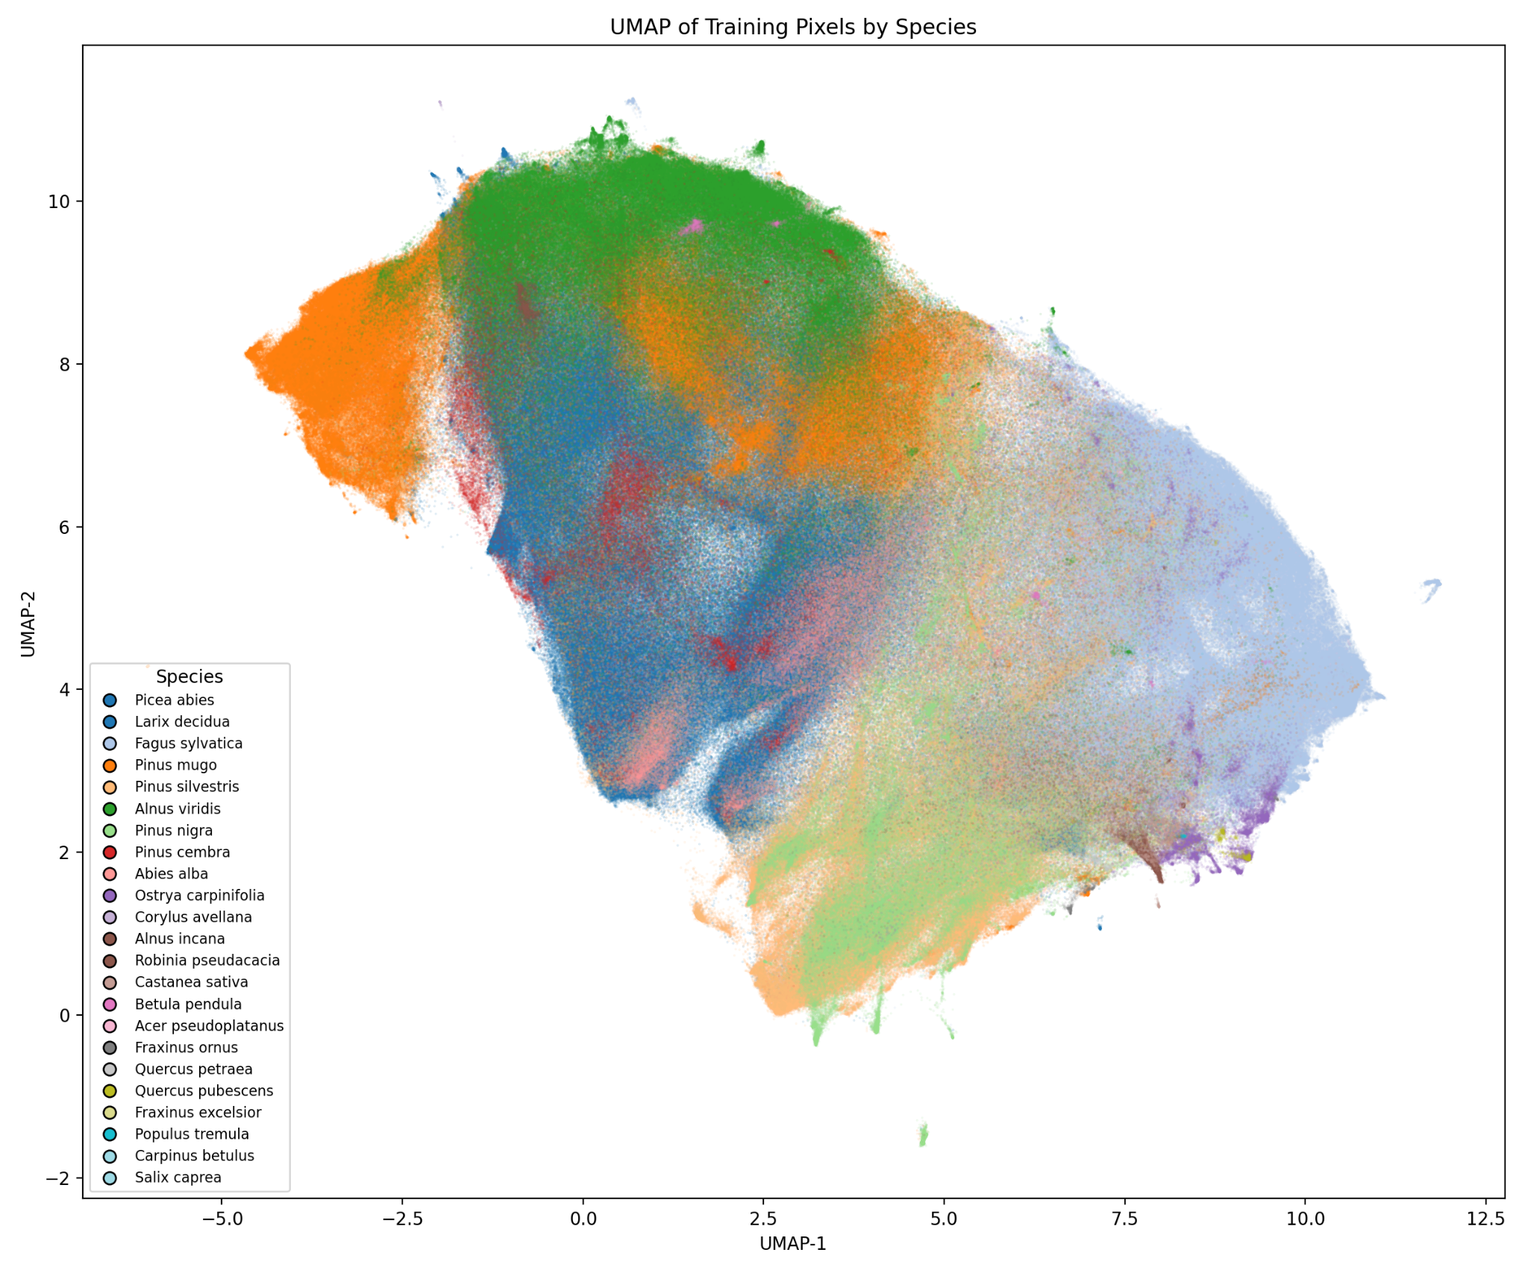
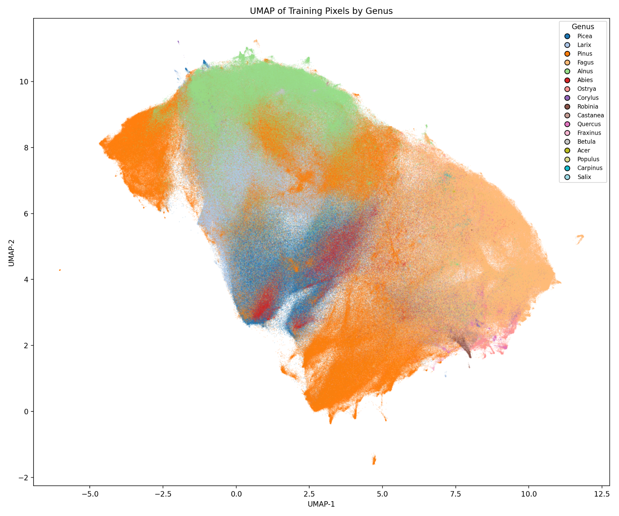
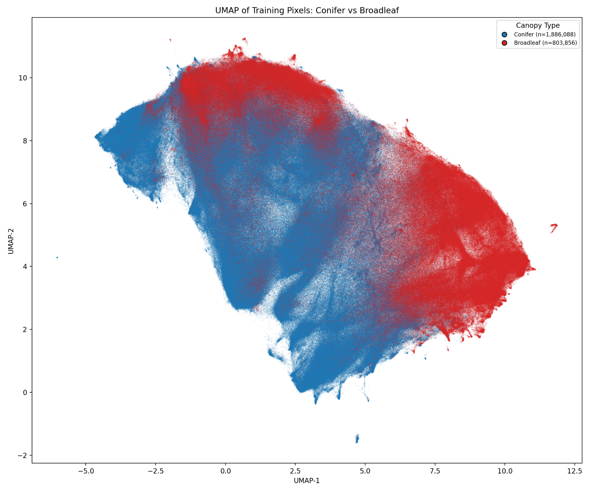
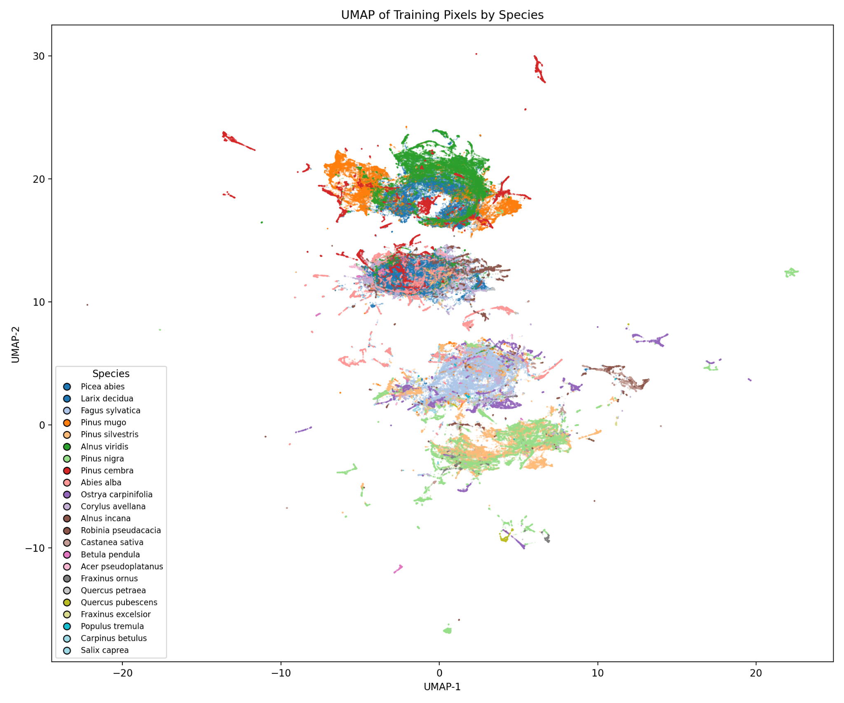
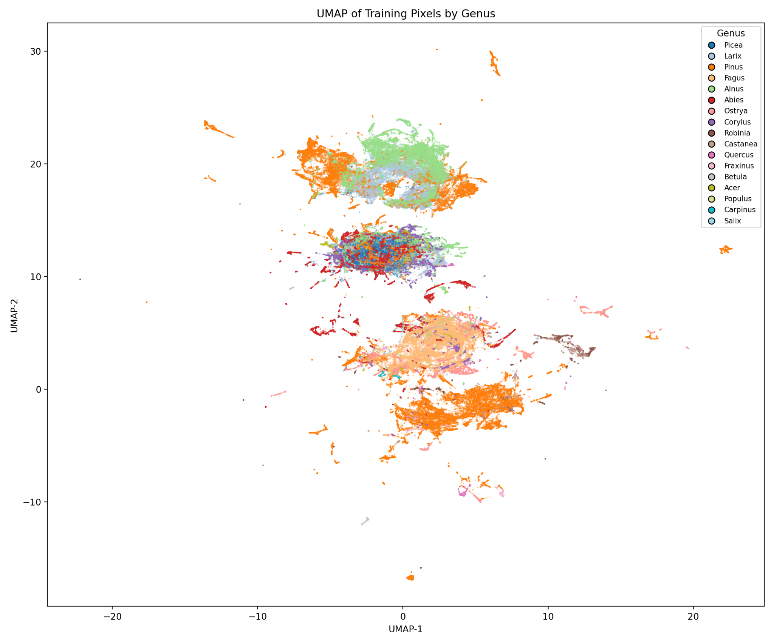
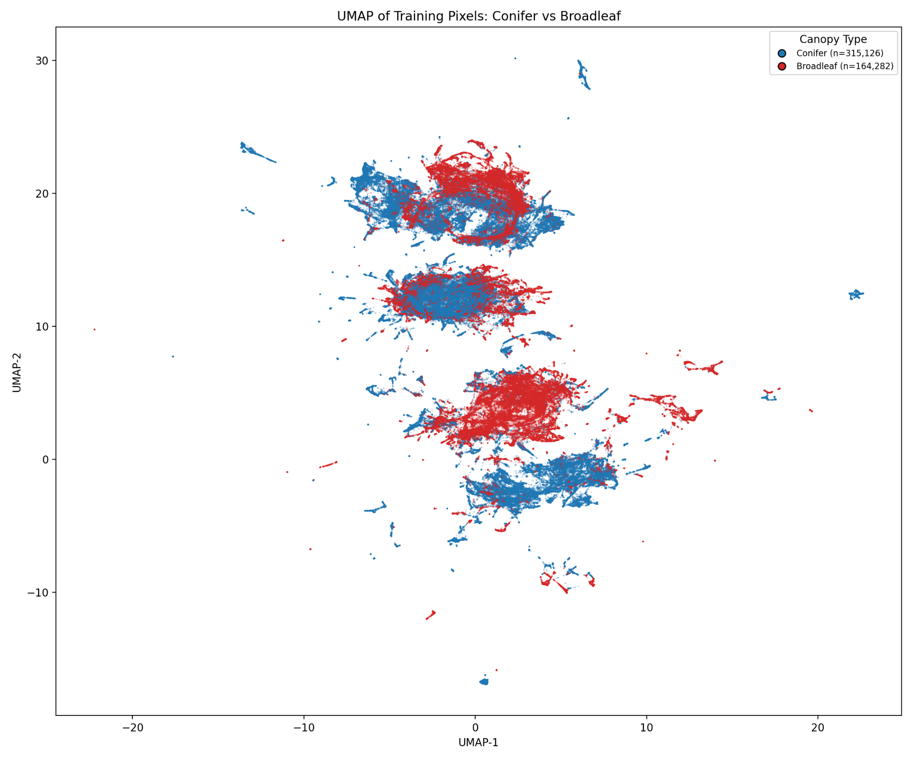
Species
Genus
Broadleaf/conifer
TESSERA
AlphaEarth
Notes:
UMAP - What do the different clusters mean?
How is temporal (phenology information locked up in the embeddings)
TESSERA seems more continuous, AlphaEarth split between more distinct groups

Slide 18
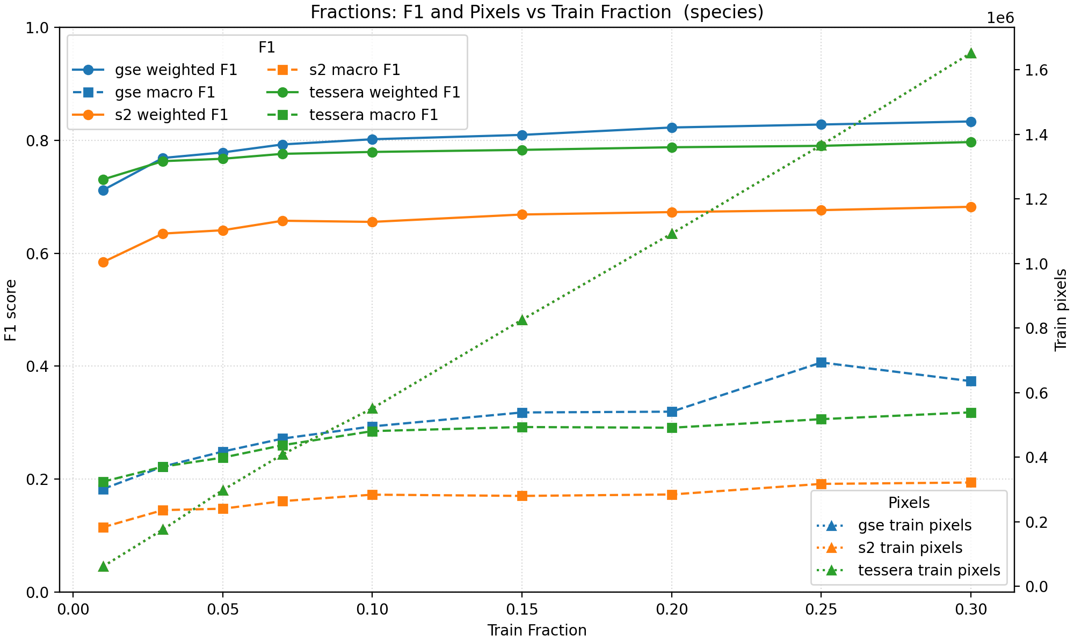
Performance of RF models
Pixels of parcels with purity ≥ 0.8
AlphaEarth (gse) slightly outperforms TESSERA
Both foundation models much better than Sentinel S2 composites

Slide 19
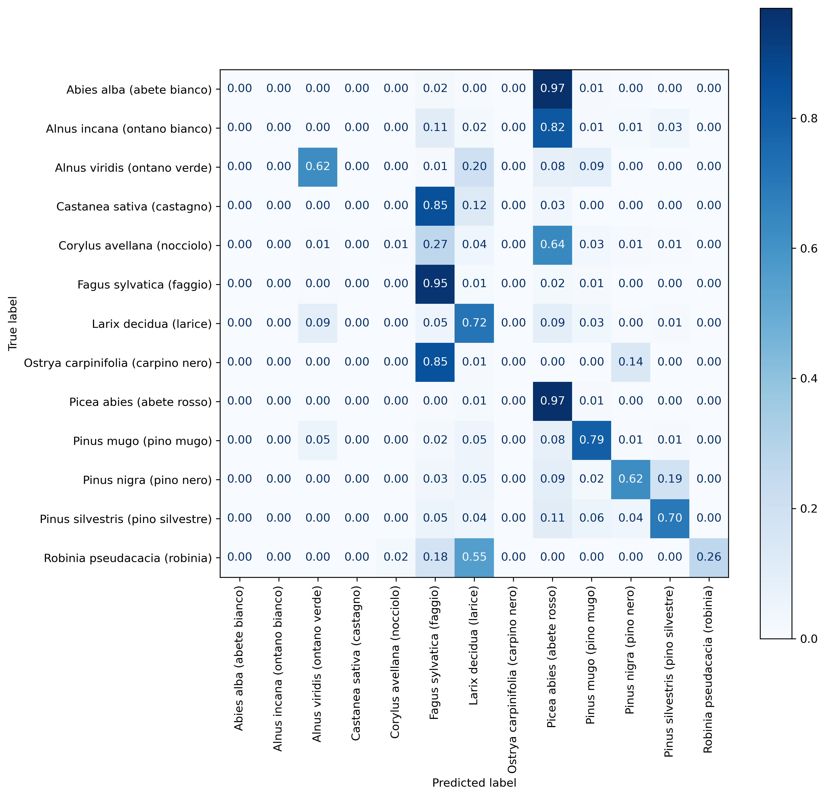
Confusion
Notes:
Normalised confusion matrix

Slide 20
Vision: A Dynamic, Plot-Anchored Ecosystem Map
Ecological purpose
Track state, function, and change: formation → alliance → habitat.
Quantify succession, disturbance, degradation, and recovery through time.
Surface biodiversity-relevant structure (height, heterogeneity), not just land cover.
Data spine (ecology first)
Plots (ForestGEO/RAINFOR/AfriTRON, NFI, sPlot, ForestPlots.net) as truth anchors.
Traits & structure: TRY, GEDI/UAV LiDAR for height/canopy complexity.
Climate/soil/disturbance: ERA5/WorldClim, soils, fire/flood/storm catalogs.
EO embeddings (e.g., TESSERA) to project plot knowledge across space/time.
Harmonisation → ecological classes that travel
Taxonomic cleaning → hierarchical typology (biome → formation → alliance).
Plot-to-pixel linking with season match, crown cover filters, geolocation QC.
Noise-aware labels for mixed stands, ecotones, and mosaics.
Mapping engine (temporal ecology)
Pixel embeddings → lightweight head (classifier + UNet context).
State-and-transition layer: probabilities of succession, disturbance, and recovery.
Ecological indicators per year: structural diversity, fragmentation, edge, alpha/beta turnover.
Outputs for ecologists
Annual 10 m ecosystem maps + transition rasters + uncertainty.
Change narratives (e.g., “degraded moist forest → agroforestry, 2019–2023”).
Open tiles/API for species distribution models, MRV, restoration planning.

Slide 21
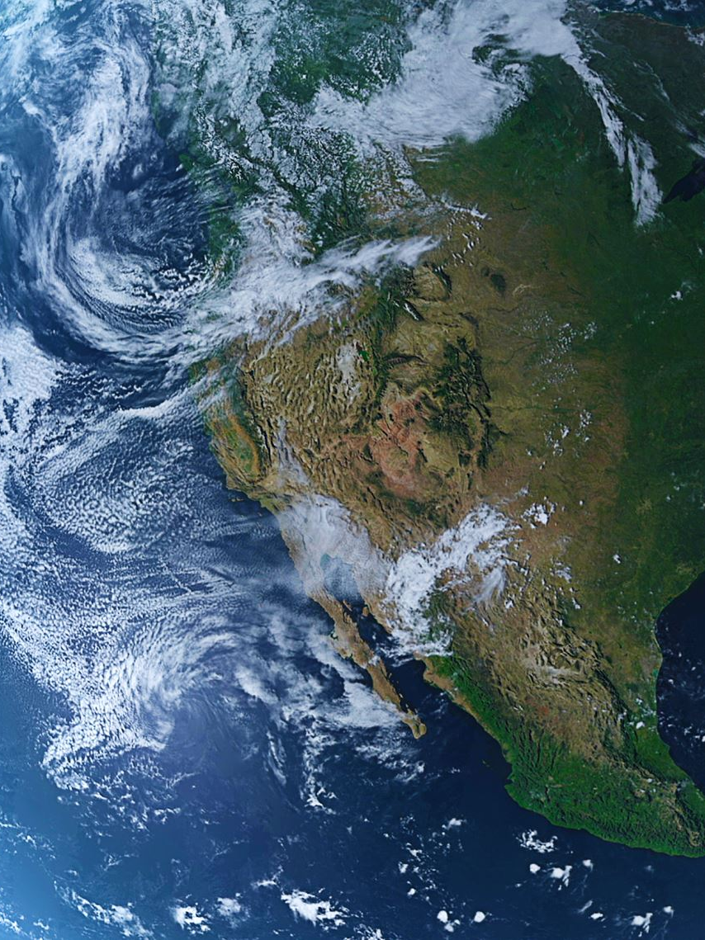
Conclusions
Foundation models → less wrangling, more ecology. Embeddings (e.g., TESSERA/AlphaEarth) turn messy S1/S2 time series into compact, annual features, so effort shifts from cleaning data to asking ecological questions.
Superior performance over traditional satellite classification
Ecology first, not just land cover. These representations carry signals of structure, seasonality, and disturbance – letting us track succession, degradation, and recovery (not just classes).
What’s not solved (yet). Embedding interpretability (trait/phenologeny links) and temporal stability (trustworthy change points, no spurious flips) still need work.
Path forward. Harmonise plot typologies; add transition models + uncertainty; publish open benchmarks so ecologists can audit.

Slide 22

TESSERA interactive map demo
https://github.com/ucam-eo/tessera-interactive-map

Slide 23
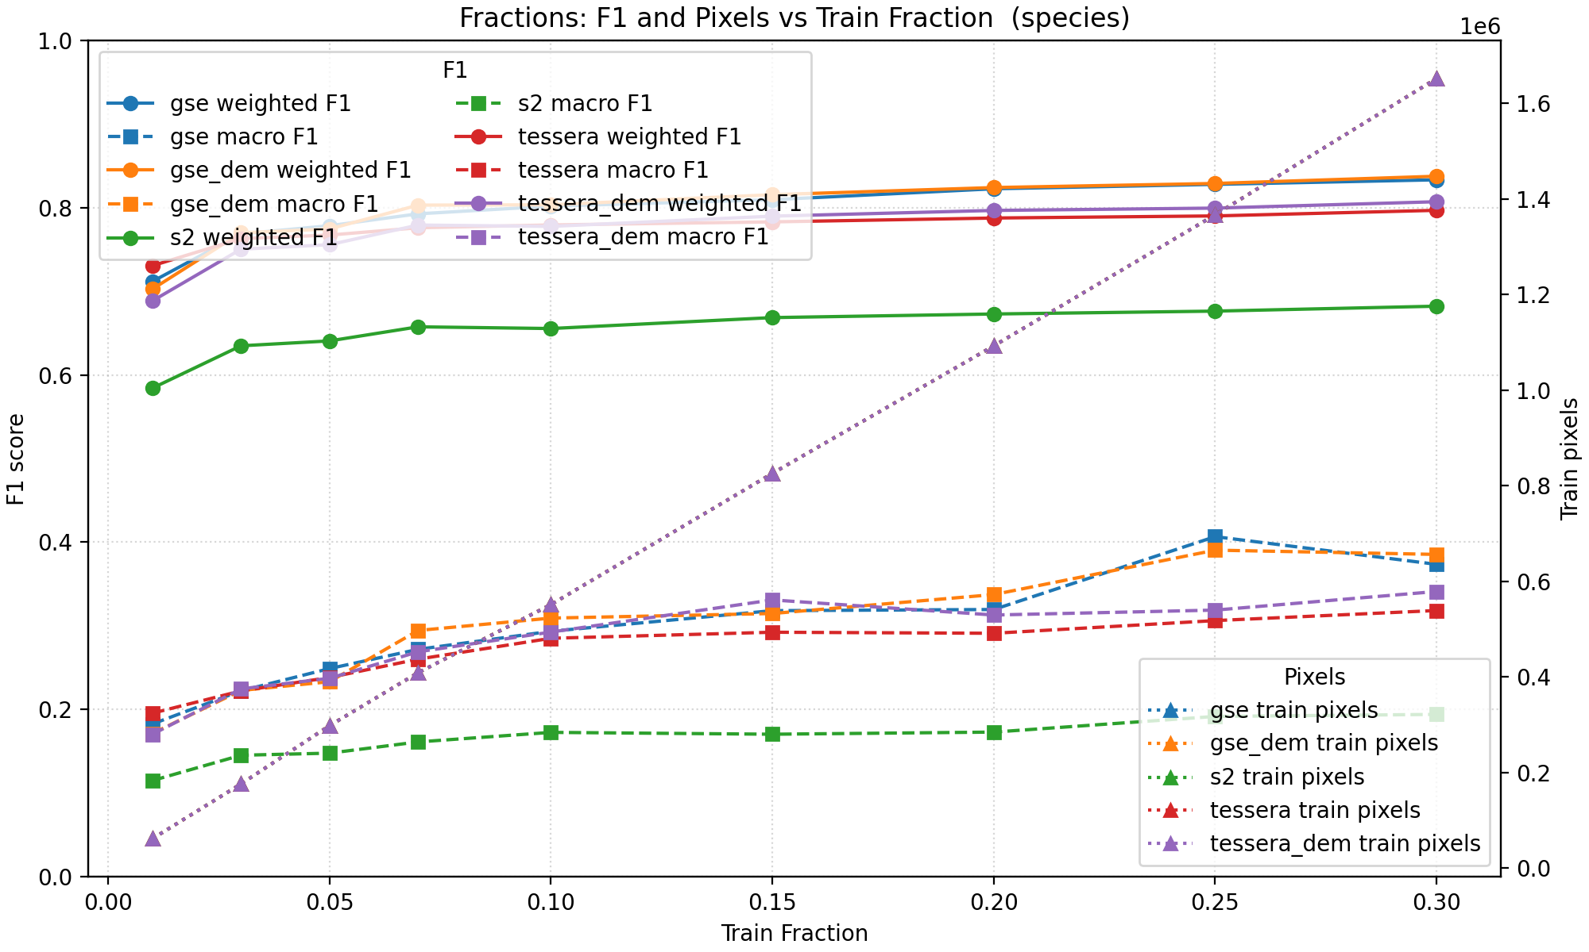

Slide 24
