Slide 1
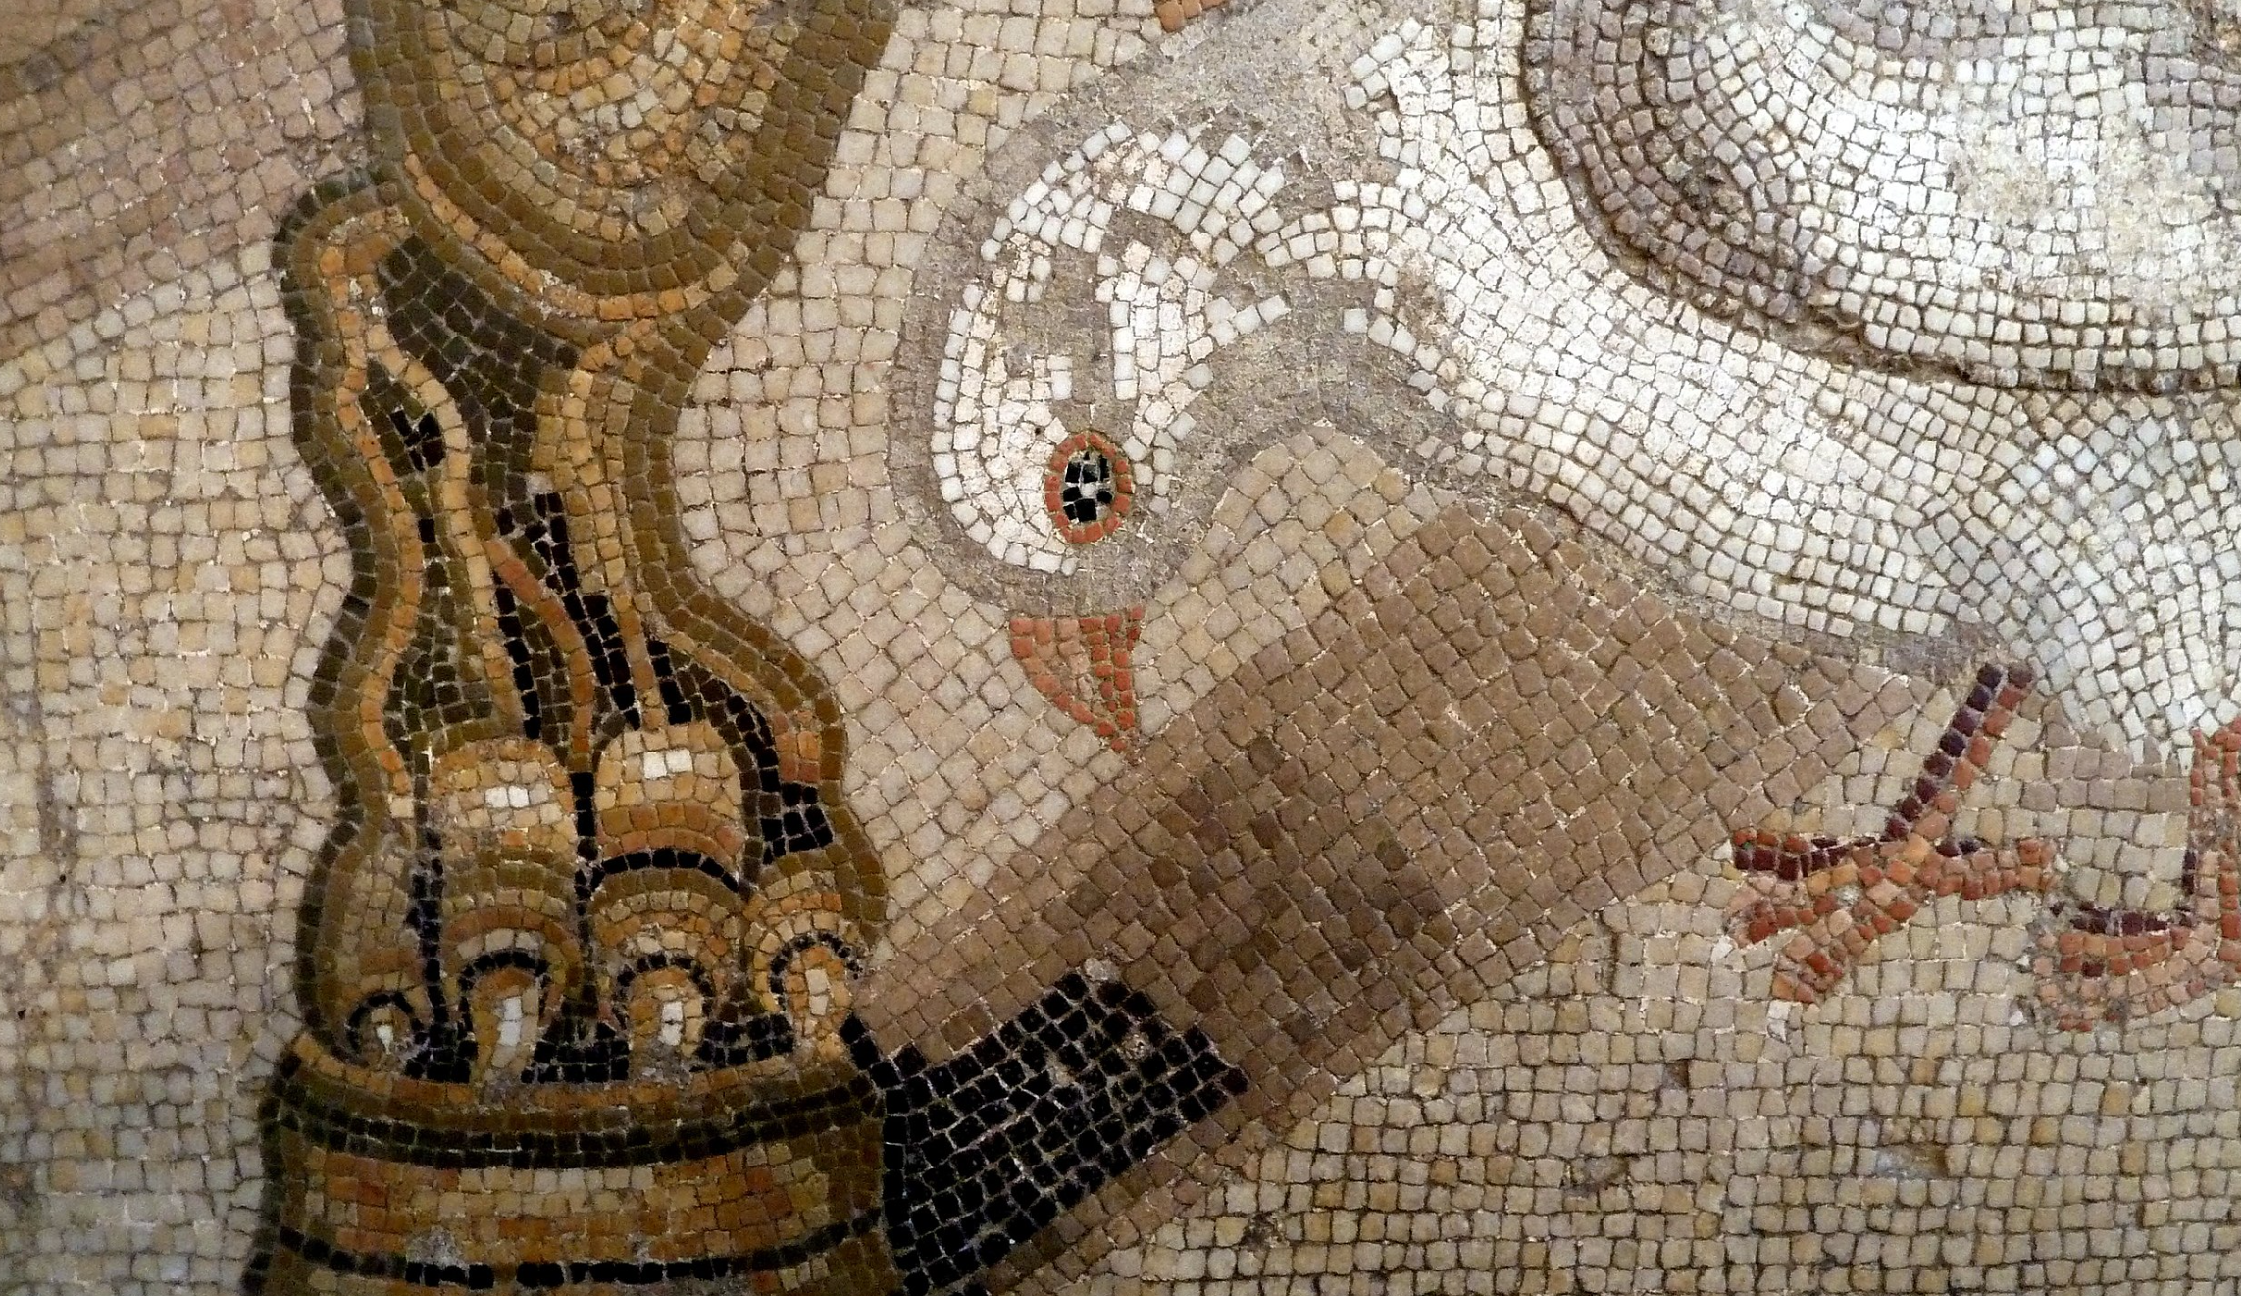

TESSERA
S. Keshav
September 29, 2025
with Z. Feng, C. Atzberger, S. Jaffer, J. Knezevic, S. Sormunen, R. Young, M. C. Lisaius,
M. Immitzer, T. Jackson, J. Ball, D. A. Coomes, A. Madhavapeddy, and A. Blake
Department of Computer Science and Technology
Energy and Environment Group
sk818@cam.ac.uk

Slide 2
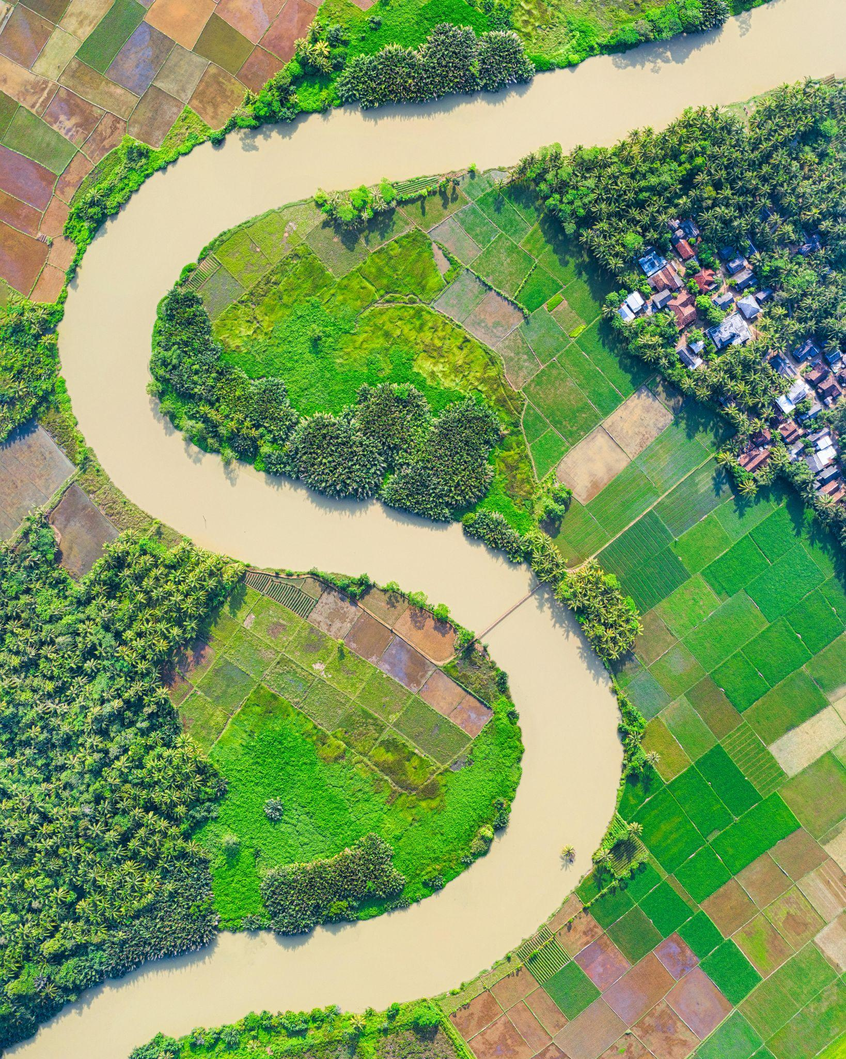

Why Observe Earth from Space?
Monitor
Land use
Biodiversity
Assess status of
Crops
Soils
Forests
Quantify
Forest degradation
Deforestation
Carbon stock
Credit: Tom Fisk
Notes:
- How can we make use of them?

Slide 3
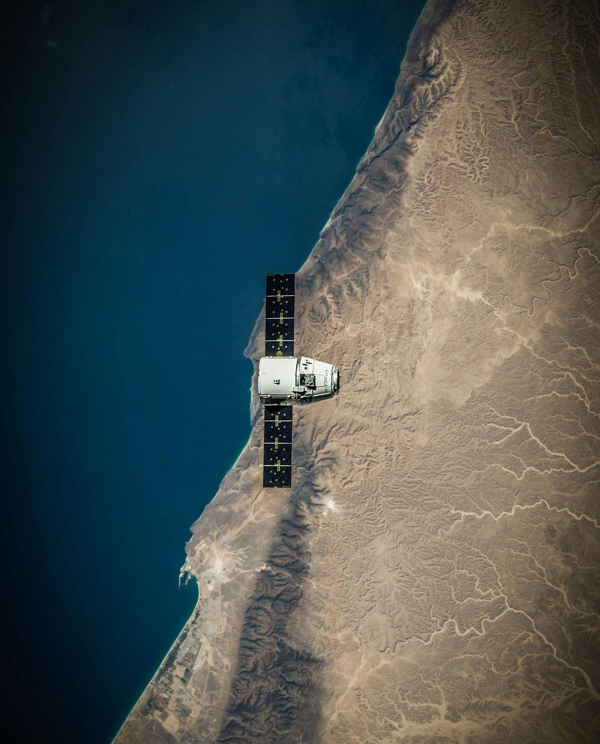
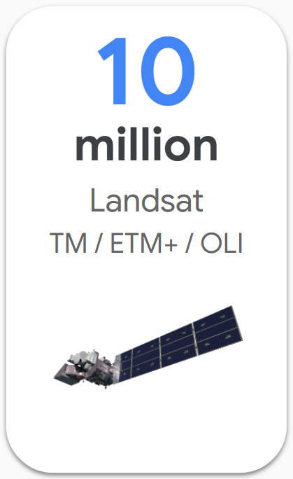
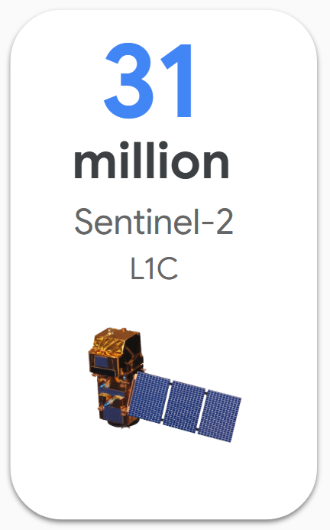
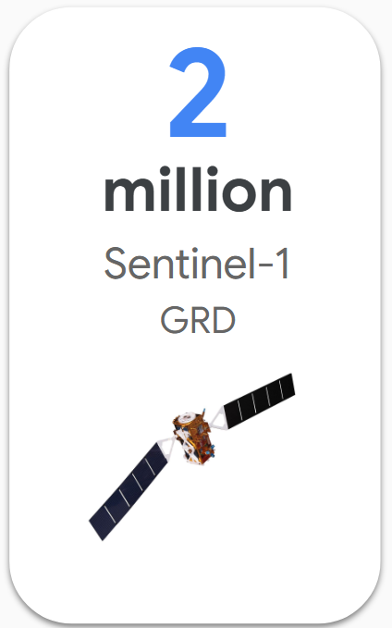
Remote Sensing Allows Monitoring at Scale
Continuous monitoring of land surface
Different, complementary sensors: optical, radar, lidar
Lots of public satellite data!
Credit: SpaceX
Notes:
- How can we make use of them?

Slide 4
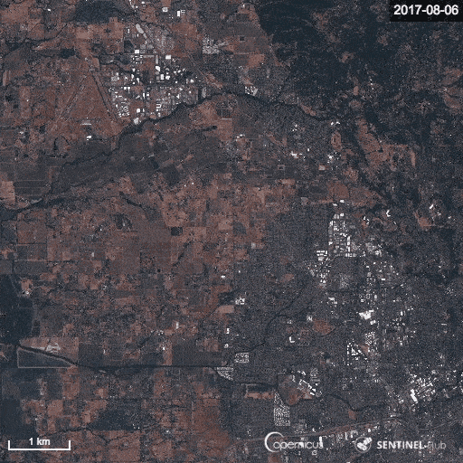
Challenges
Clouds
Changes in lighting
Varying time gaps
https://www.geographyrealm.com/new-tool-sentinel-hub-lets-create-time-lapse-gifs-satellite-imagery/

Slide 5
Noise Removal & Calibration
Terrain Correction
Filter / Despeckle
SAR
Satellite
Images
Atmospheric
Correction
Cloud+Shadow
Masking
BRDF Correction
Feature Extraction
Modeling &
Analysis
Insights!
Optical
etc...
...
Image Credit: Google Alpha Earth

Slide 6
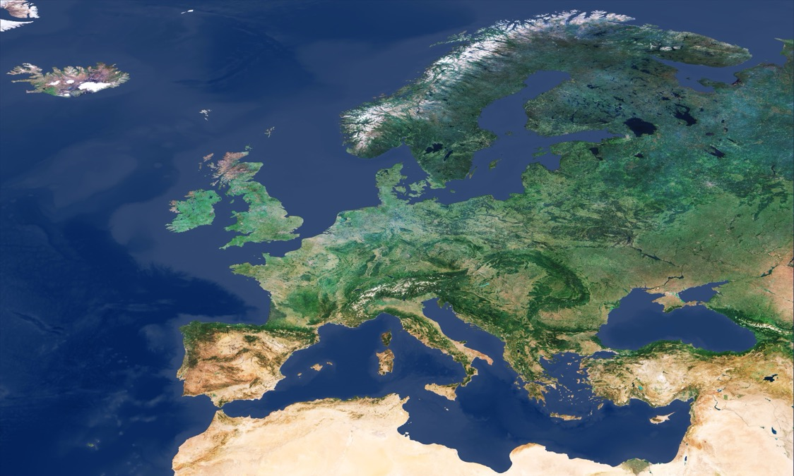
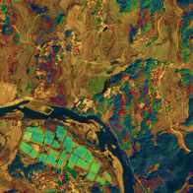
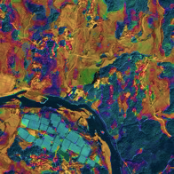
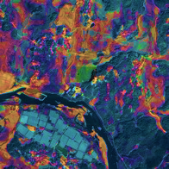
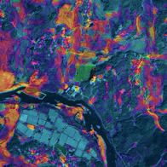
SSL
Barlow Twins (BT)
BT for RS
Cloud corrupted
Sentinel-2 MSI
Tp
T3
T2
T1
Paradigm
……
Time
https://www.esa.int/ESA_Multimedia/Images/2018/05/Cloud-free_Europe_from_Sentinel-3
Notes:
Can we create a shortcut that converts Images to Insights? Please note that the term 'images' is quoted here.
So, what's the difference between this image and other images? As a spoiler, this image has 128 channels.
If we can create such images, then we can simplify the old workflow. We can get rid of fuction f(x) here.

Slide 7
SSL
Barlow Twins (BT)
BT for RS
But compositing hides the temporal signal
R,G,B, NIR, …
Time
}
T1
T2
C1
C2
C3
T3
}
}
Tp
Notes:
Can we create a shortcut that converts Images to Insights? Please note that the term 'images' is quoted here.
So, what's the difference between this image and other images? As a spoiler, this image has 128 channels.
If we can create such images, then we can simplify the old workflow. We can get rid of fuction f(x) here.

Slide 8
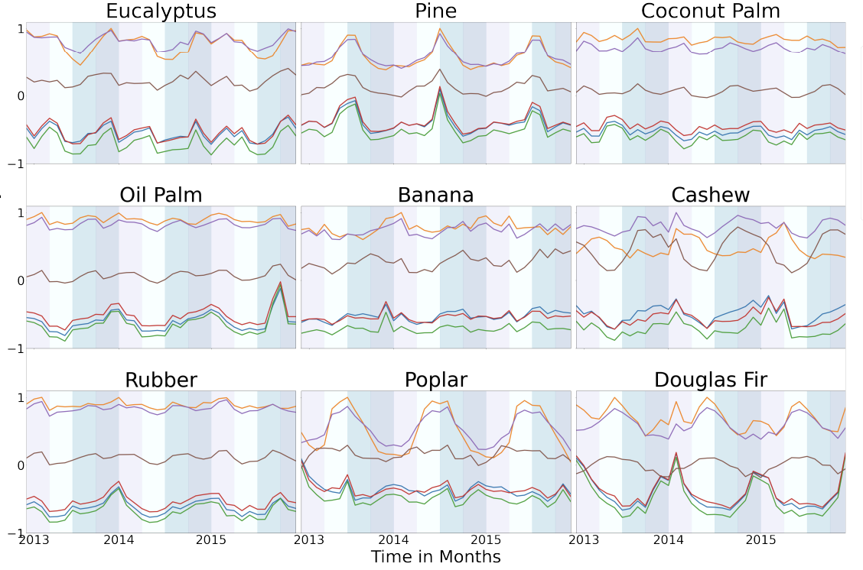
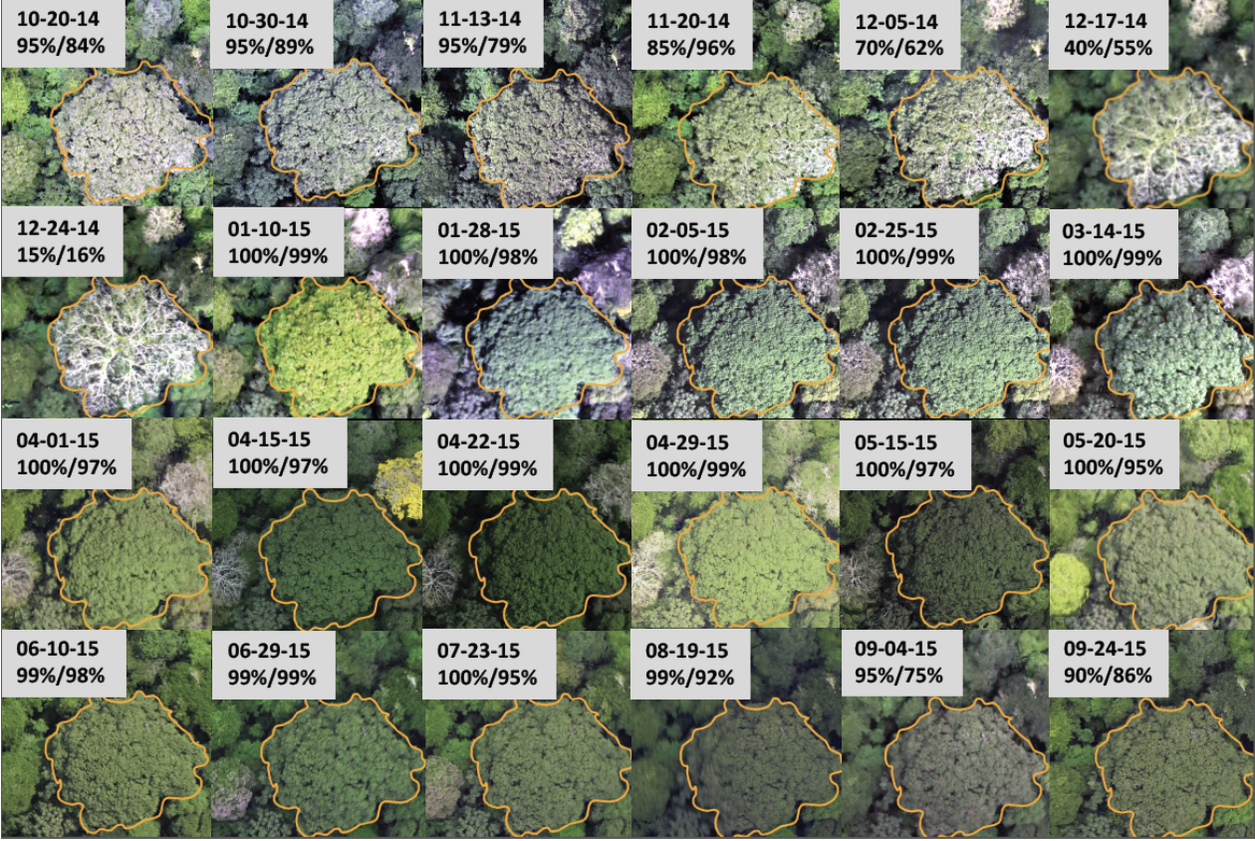
The Temporal Signal is Critical
Pazos-Outon et al. (2024) (https://arxiv.org/abs/2406.18554)
Park et al. (2019) (https://www.mdpi.com/2072-4292/11/13/1534)
Seasonal dynamics help identify land cover and detect change

Slide 9
Noise Removal & Calibration
Terrain Correction
Filter / Despeckle
SAR
Satellite
Images
Atmospheric
Correction
Cloud+Shadow
Masking
BRDF Correction
Feature Extraction
Modeling &
Analysis
Insights!
Optical
etc...
...
Image Credit: Google EFM

Slide 10
Noise Removal & Calibration
Terrain Correction
Filter / Despeckle
Self-supervised learning
SAR
Satellite
Images
Atmospheric
Correction
Cloud+Shadow
Masking
BRDF Correction
Feature Extraction
Modeling &
Analysis
TESSERA GeoFM
Insights!
Optical
etc...
...
128-dim Representation for each 10x10m pixel

Slide 11
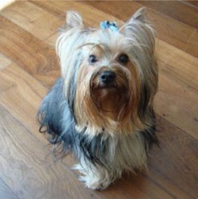
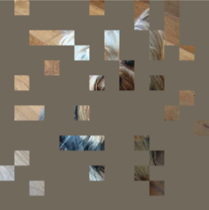

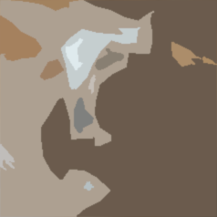


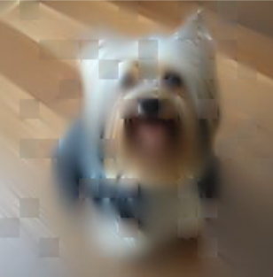
Self-supervised Learning
Masked Auto Encoding (MAE)
Representation
Encoder
Decoder
Mask
Barlow Twins (BT)
Are they similar?
BT for RS
Notes:
You may ask how is possible to train a ML model without labels? But actually, from my perspective, SSL requires label, but this is label is the training data itself.
Let’s take a look at one of the most famous SSL paradigm, MAE.

Slide 12
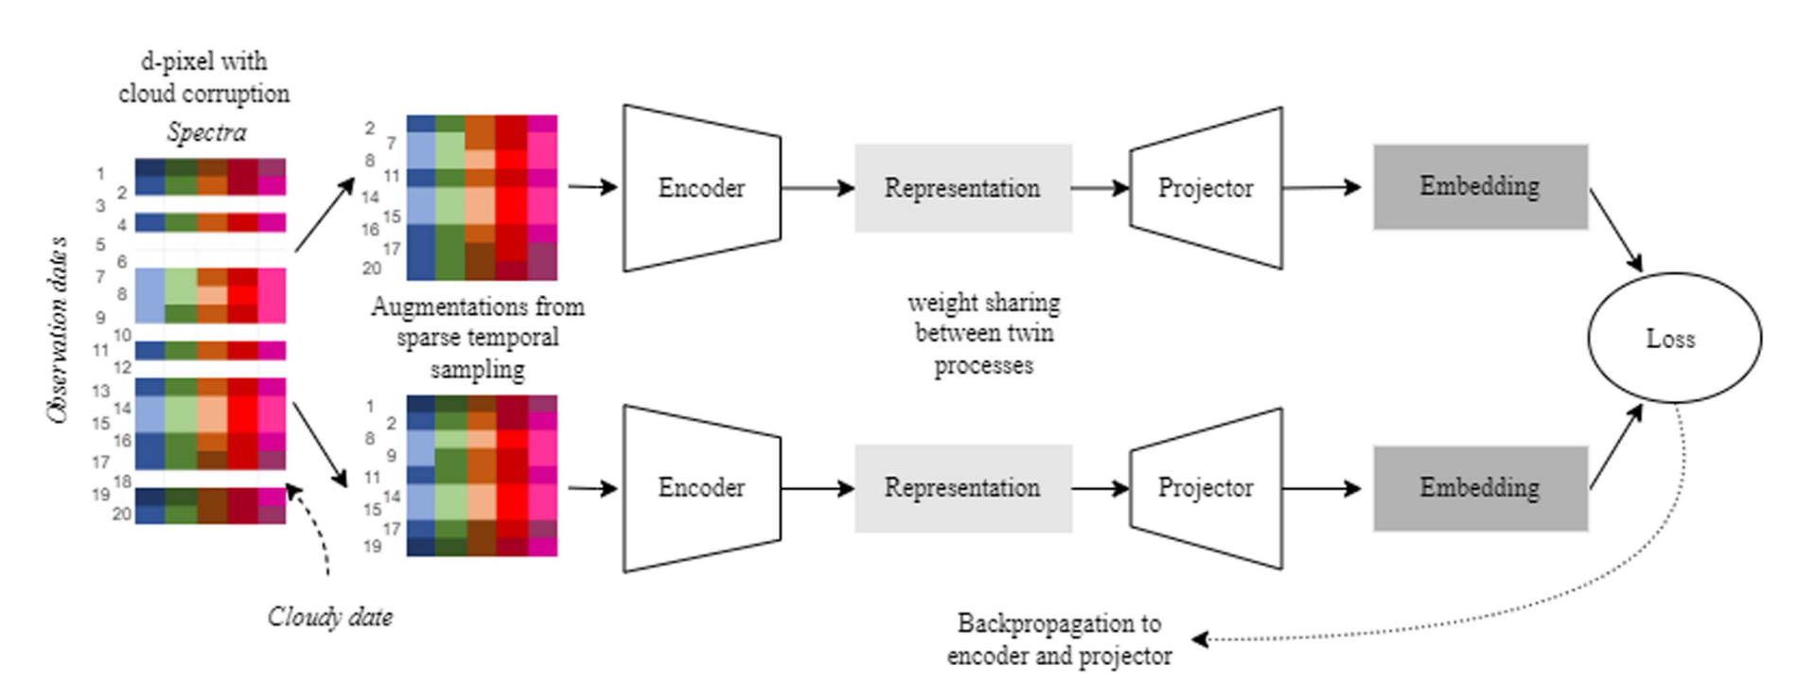
Sentinel-2 MSI
Tp
T2
T3
T1
……
Time
Lisaius et al. (2024) (https://ieeexplore.ieee.org/document/10592304)

Slide 13
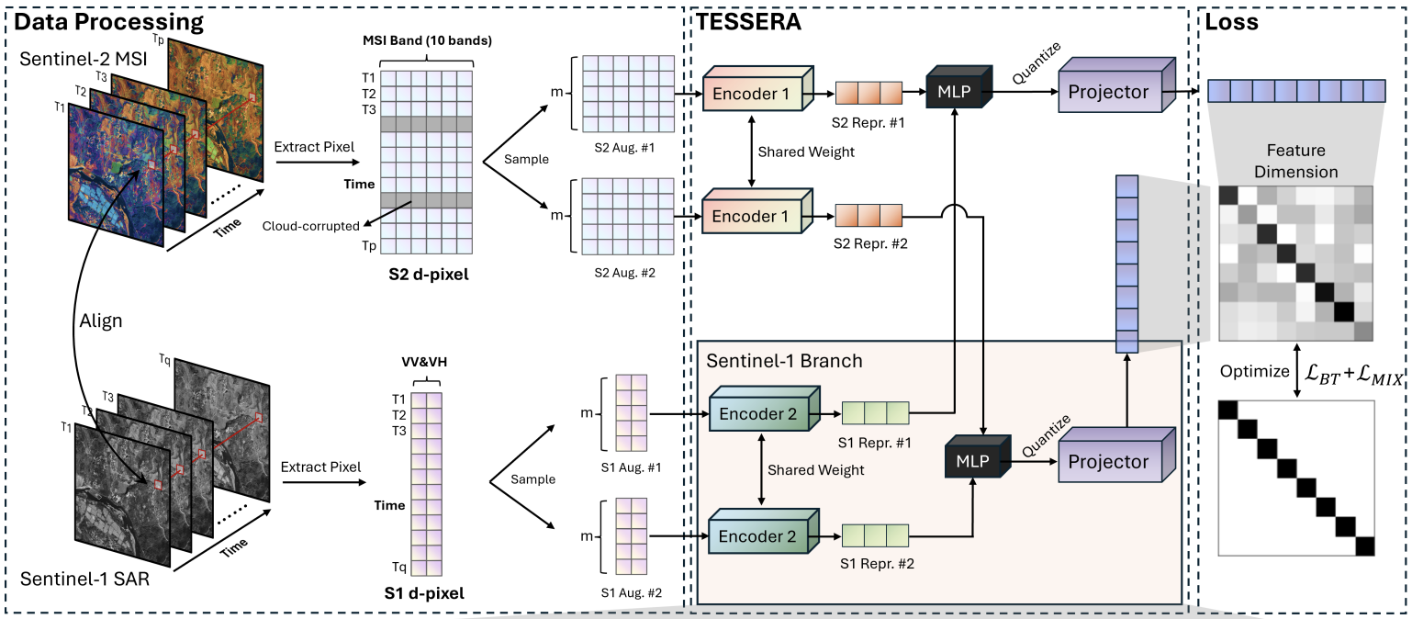

Slide 14
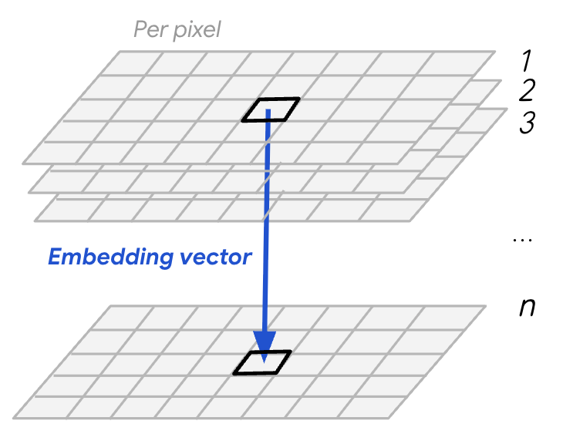
Ready to use representations
Cloud-free, encoding temporal spectral signal
Sensor fusion:
optical + radar data
Globally available at 10m resolution, annually
Open source
TESSERA Embeddings
128

Slide 15
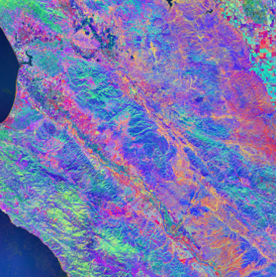
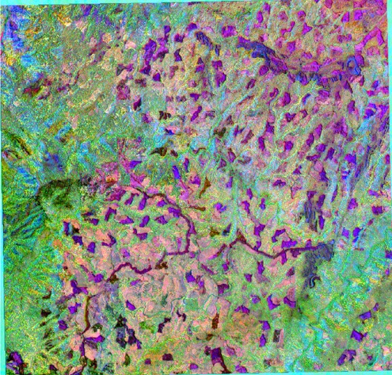
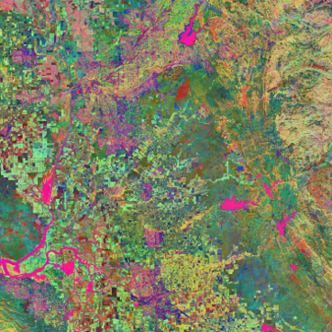
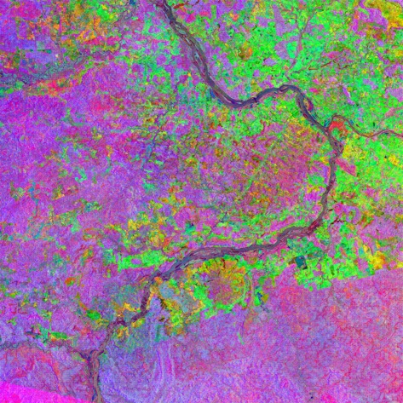
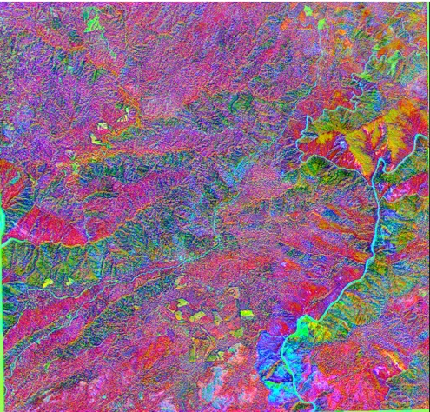
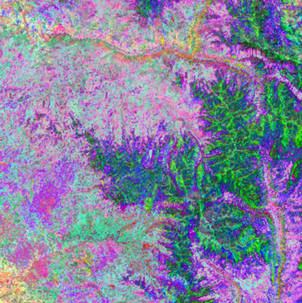

Slide 16
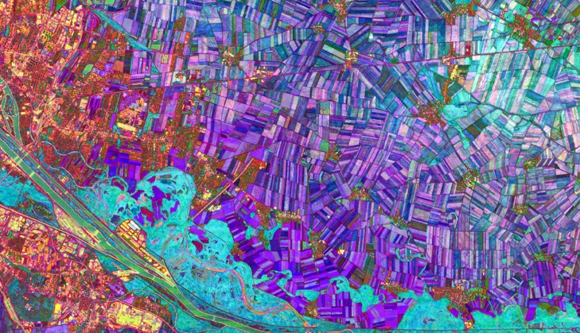
SSL
Barlow Twins (BT)
Notes:
My favorite part. By apply the model to a downstream task, we evaluate them in a quantitive way. We can also quickly evaluate the quality of the representation via visualization.
128 D, I randomly select 3 channels to create a false color map.
The more similar their colors are, the more likely they are to be the same type of land cover.

Slide 17
How well does it work?

Slide 18
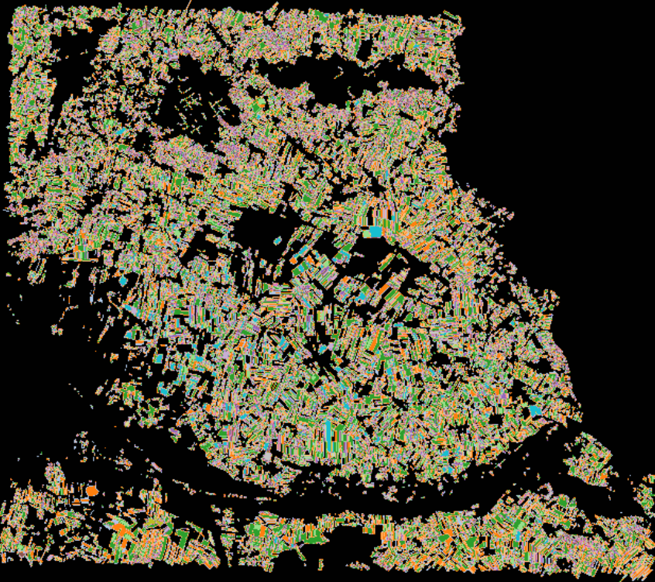
Crop Classification
INVEKOS Austrian Crop Dataset
Name | Number of Samples | Percentage
Legume | 2227 | 3.31%
Soy | 5892 | 8.76%
Summer Grain | 2475 | 3.68%
Winter Grain | 24914 | 37.05%
Corn | 6902 | 10.27%
Sunflower | 207 | 0.31%
Mustard | 1734 | 2.58%
Potato | 2514 | 3.74%
Beet | 1257 | 1.87%
Squash | 2019 | 3.00%
Grapes | 222 | 0.33%
Tree Fruit | 347 | 0.52%
Cover Crop | 1418 | 2.11%
Grass | 2349 | 3.49%
Fallow | 4484 | 6.67%
Other (Plants) | 8220 | 12.23%
Other (Non Plants) | 57 | 0.08%
Total | 67238 | 100%

Slide 19
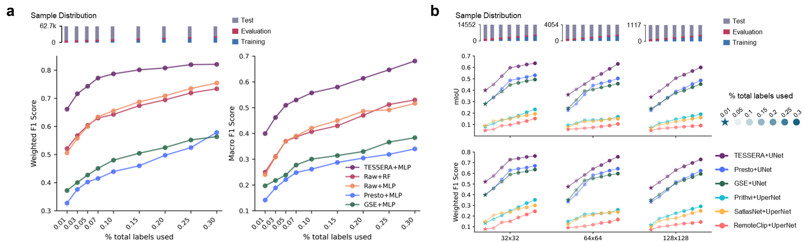
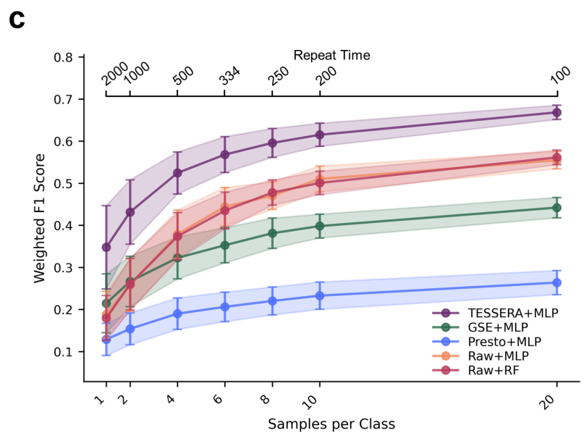
Performance
GSE is AlphaEarth

Slide 20
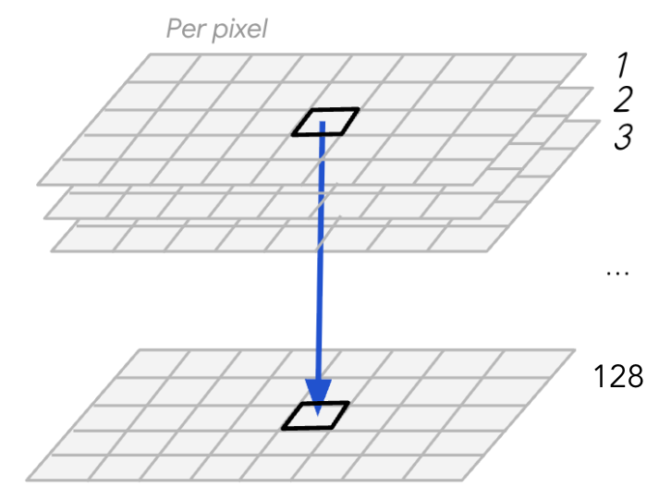
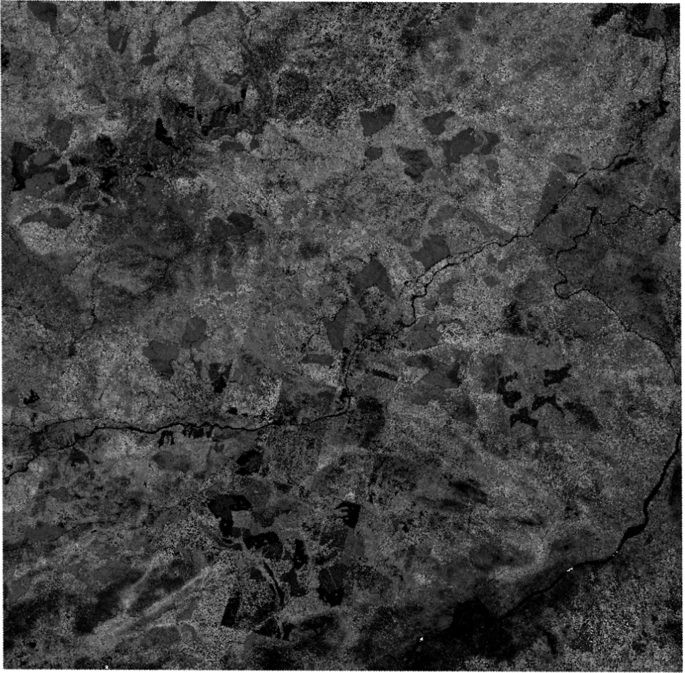
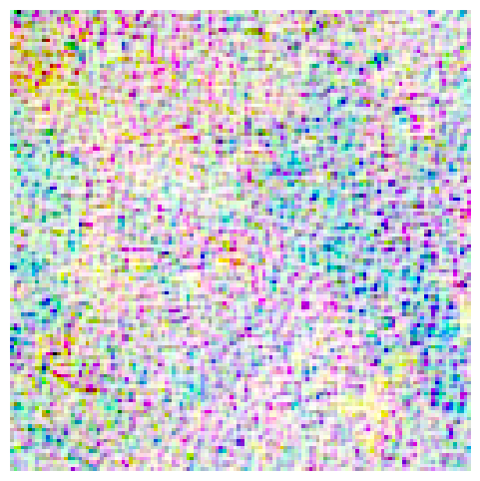
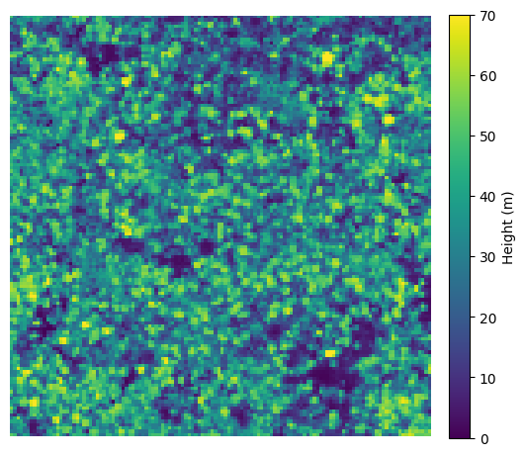
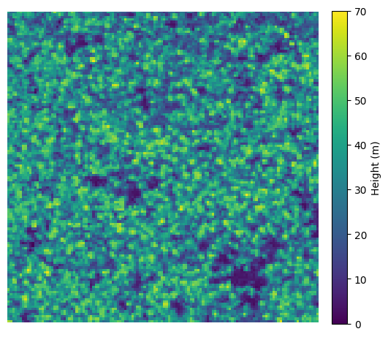
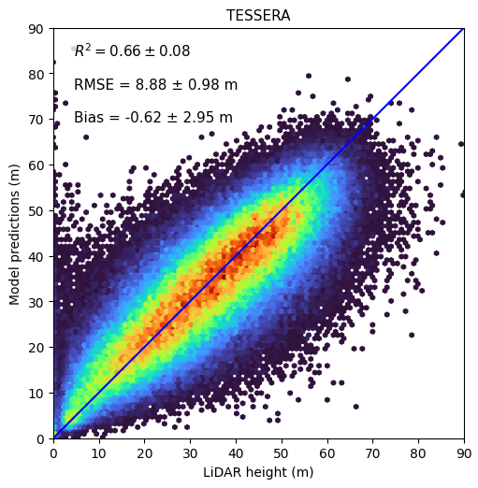
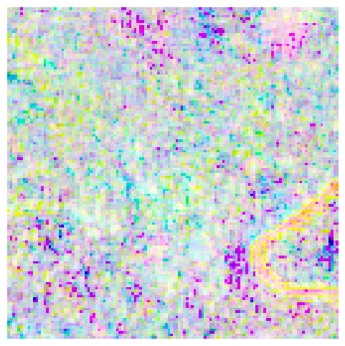
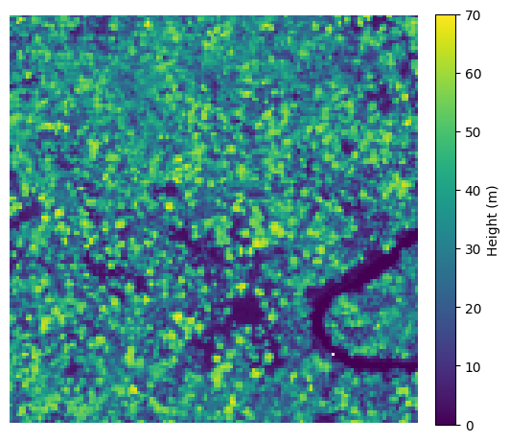
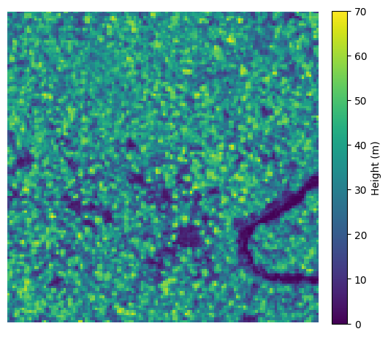
Predicting Forest Height
Canopy Height from Airborne LiDAR
U-Net
TESSERA Representations
Ground Truth
Prediction

Slide 21
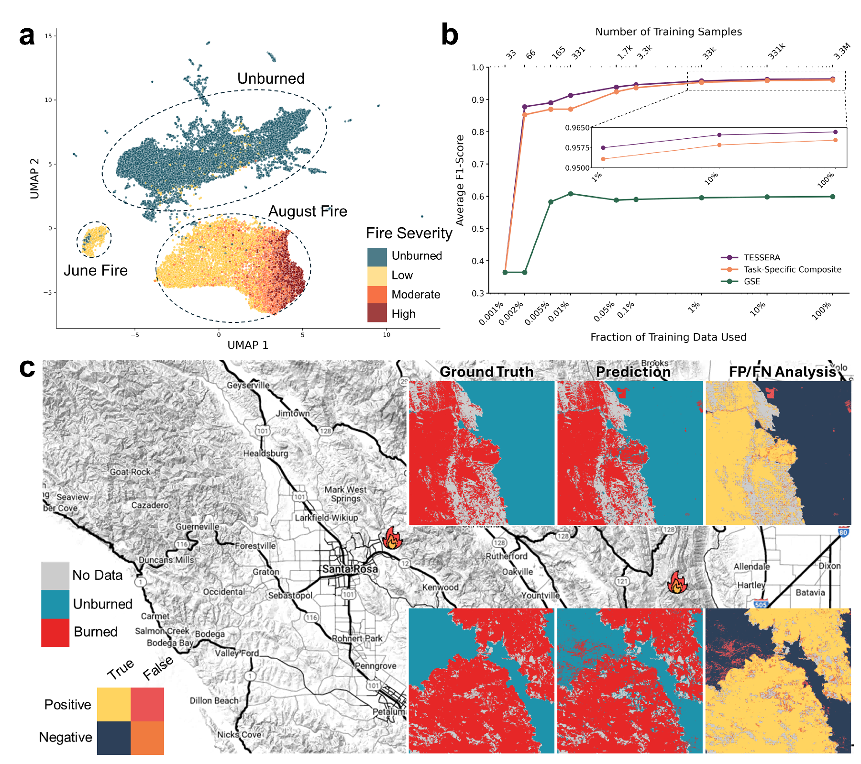
Detecting Disturbances: Wildfires in California

Slide 22
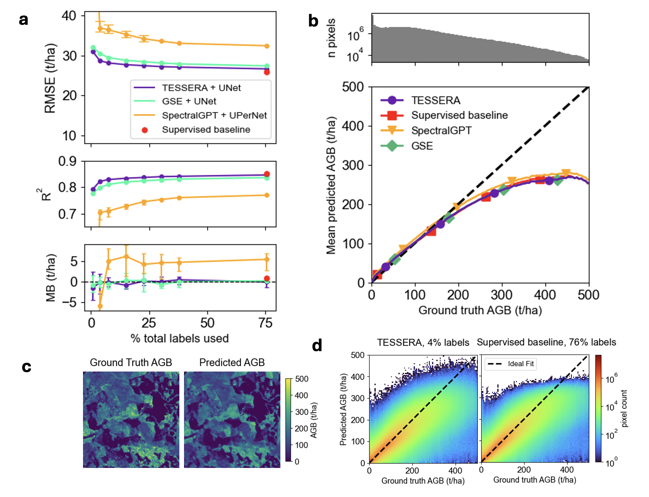
AGB in Finland (BIOMASSTRS)

Slide 23
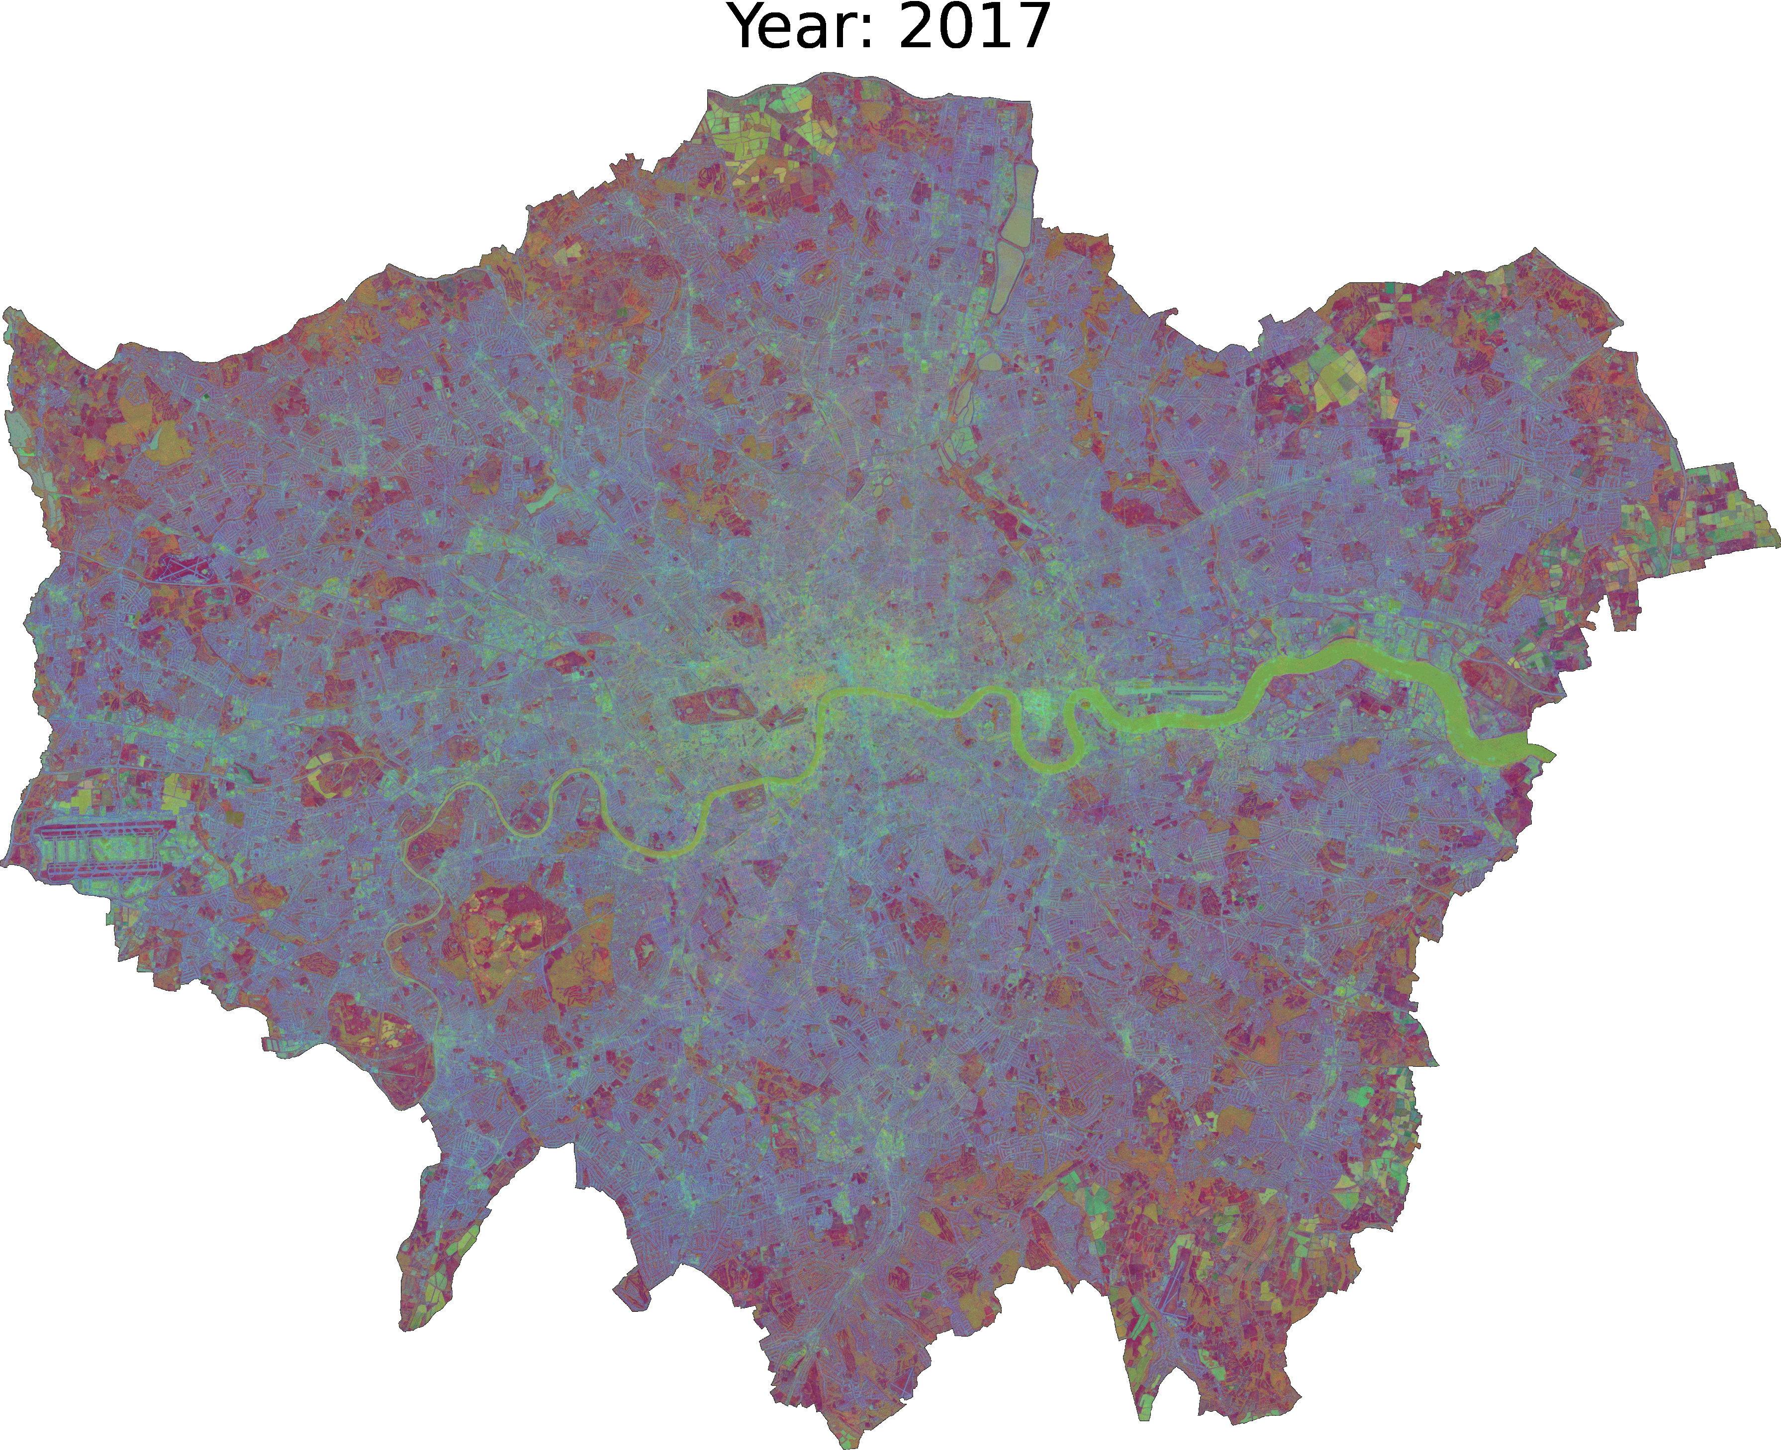
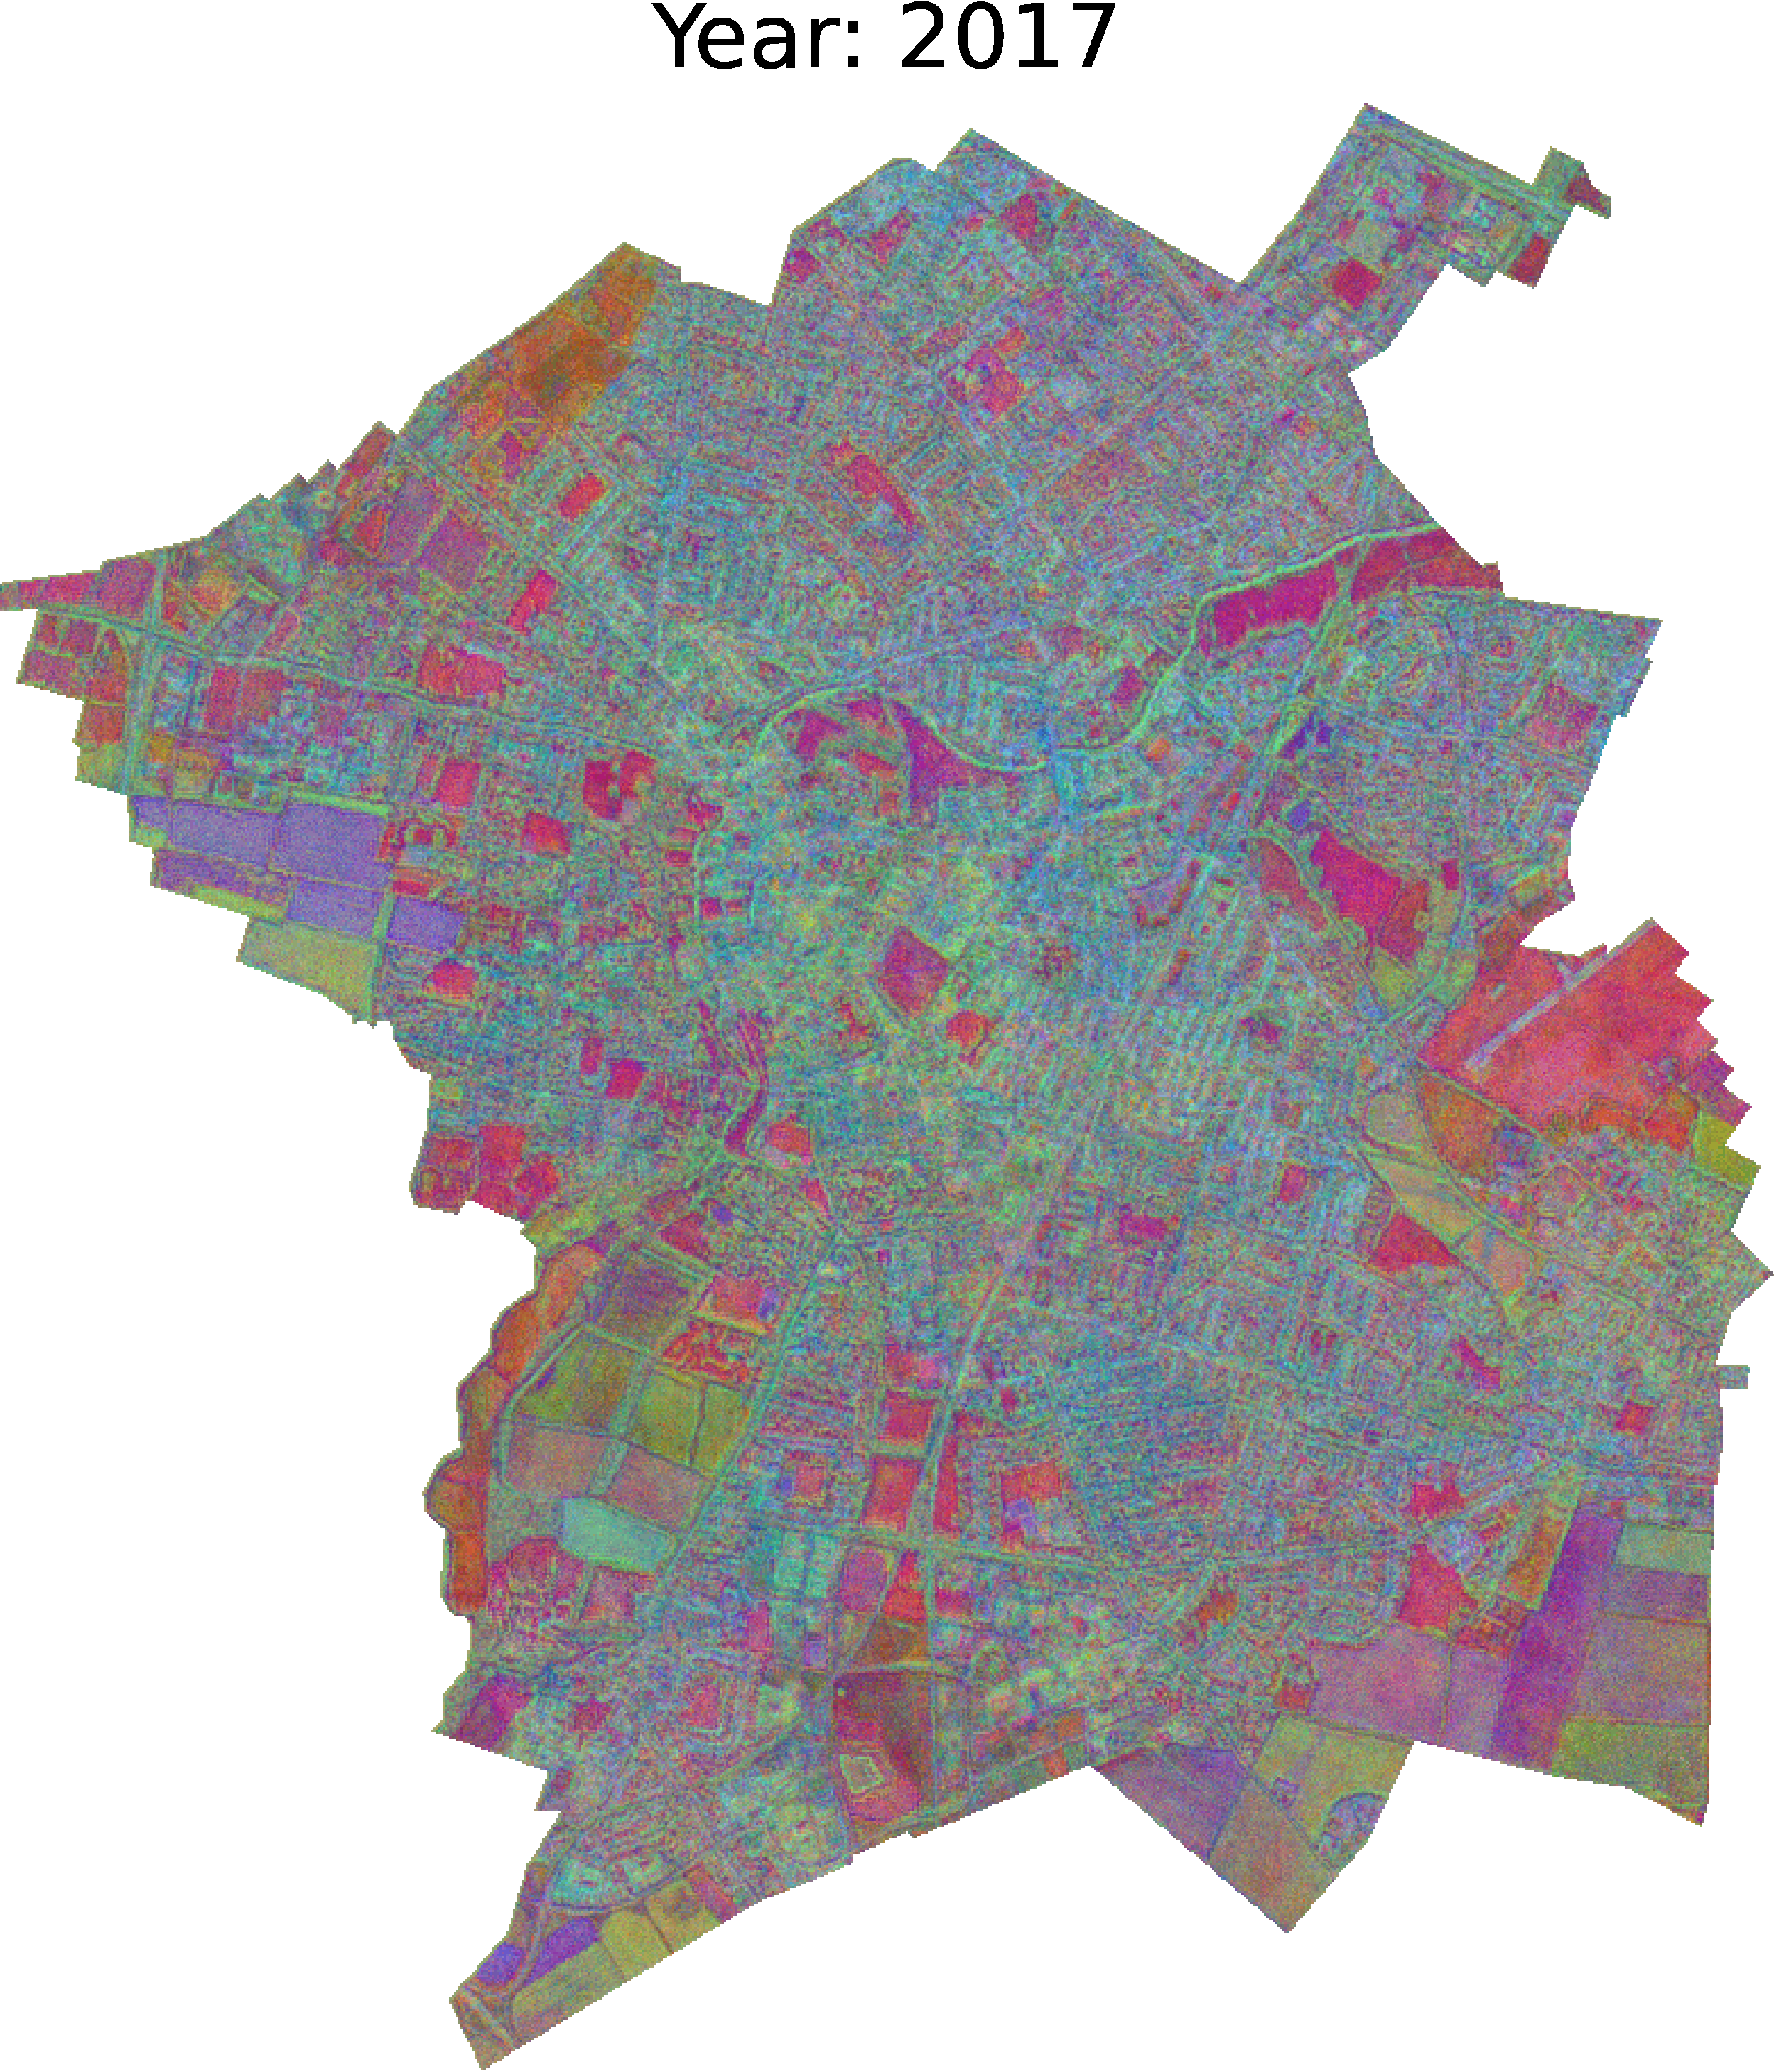
Land Use Change Detection

Slide 24
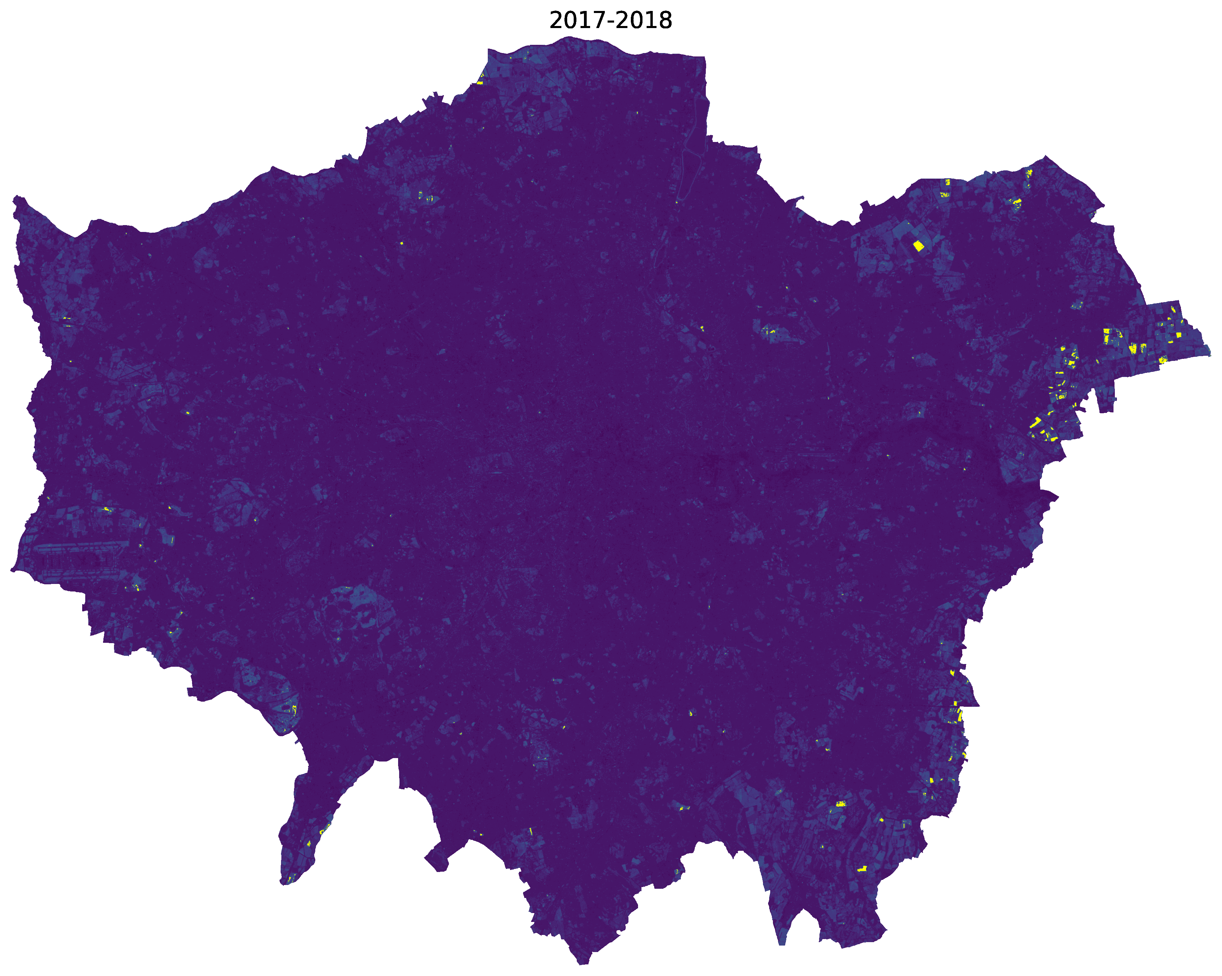
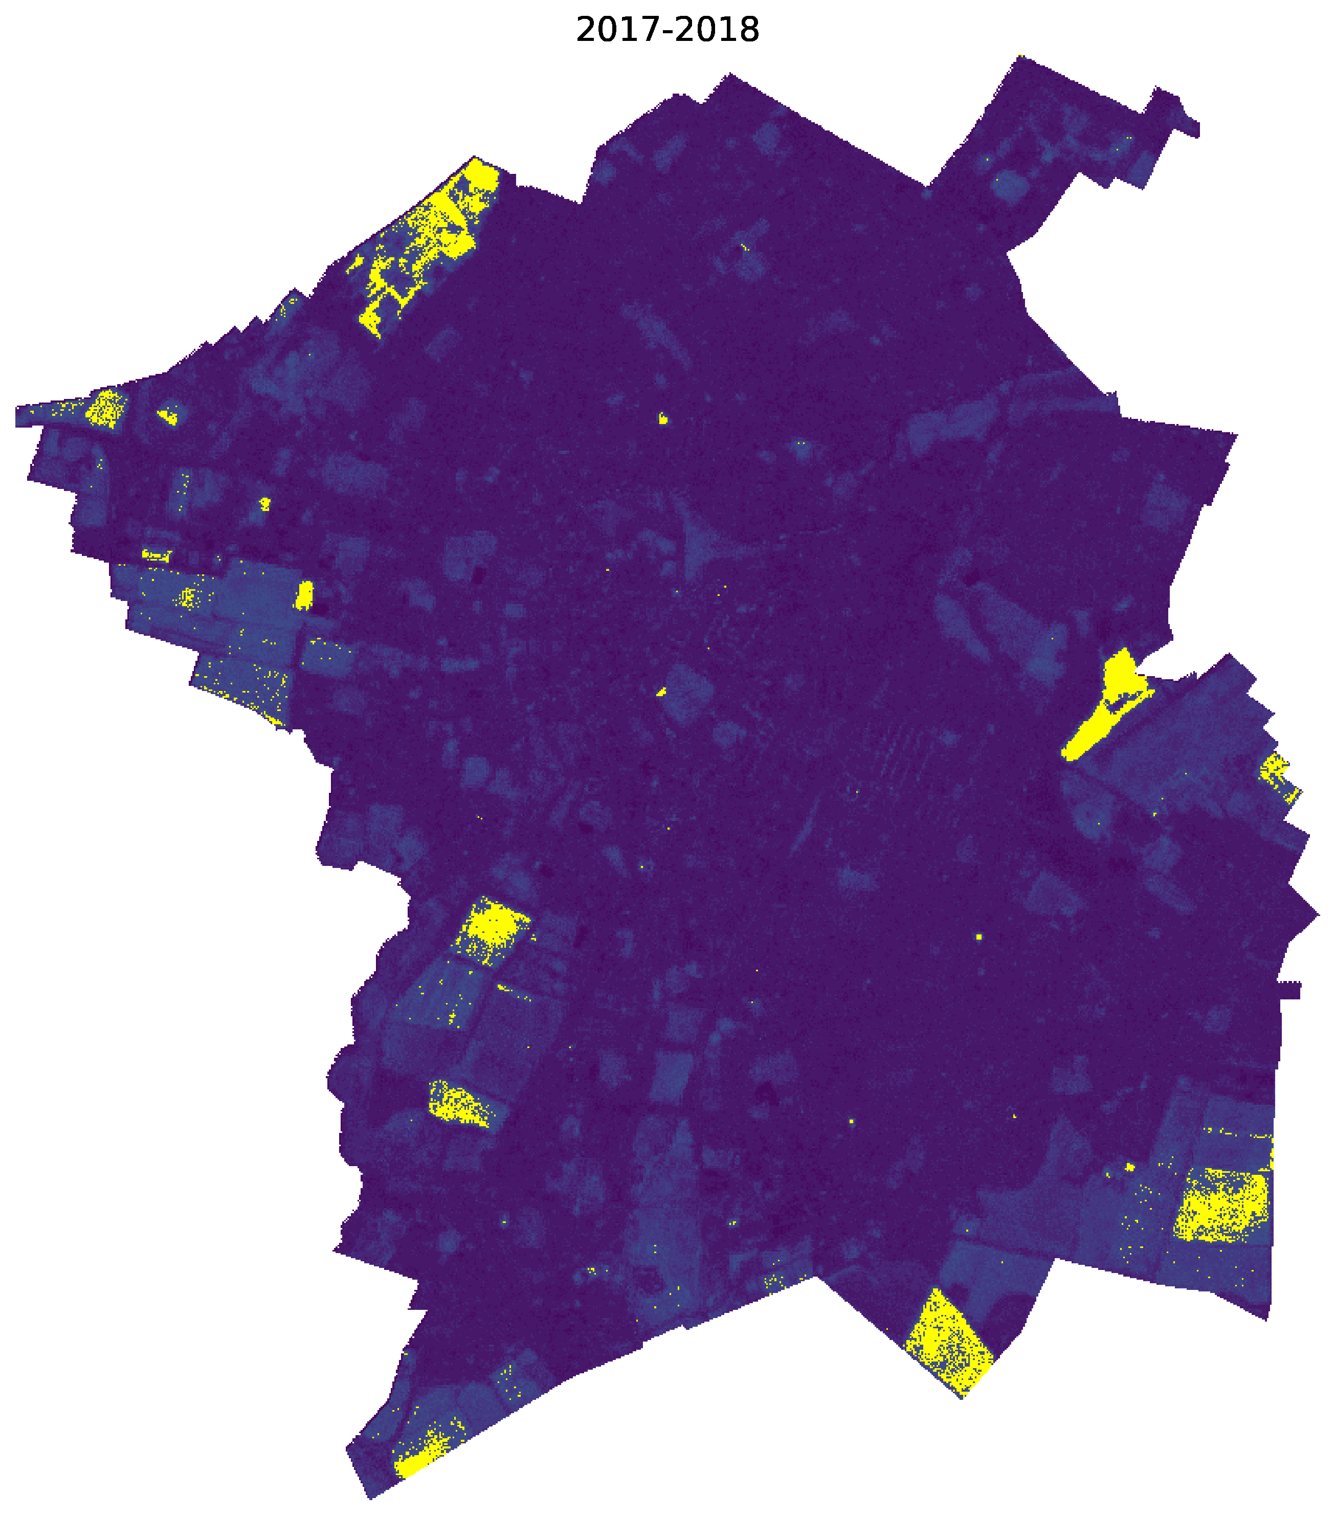
Land Use Change Detection

Slide 25
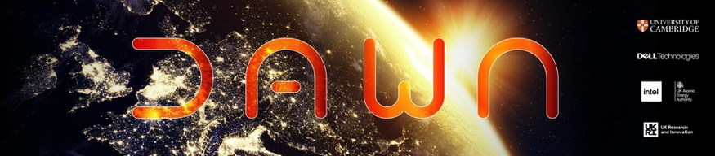
Some Systems Aspects
Data intensive task
each tile is 150 GB
we need to stream and process ~24PB
1.6M GPU hours!
Need both raw compute and algorithmic design
Compute
Dawn HPC
AMD 8-GPU node
256-core 1TB RAM server
~300TB SSD
Notes:
- The way we do this is to apply the model in a downstream task.

Slide 26
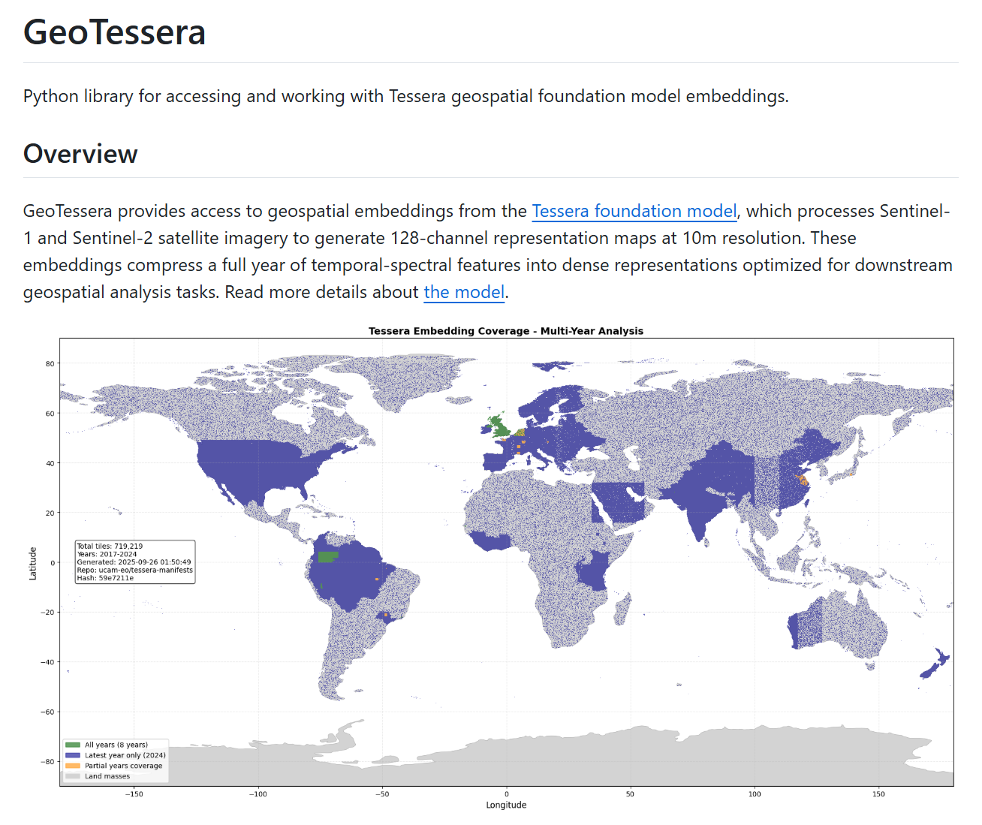
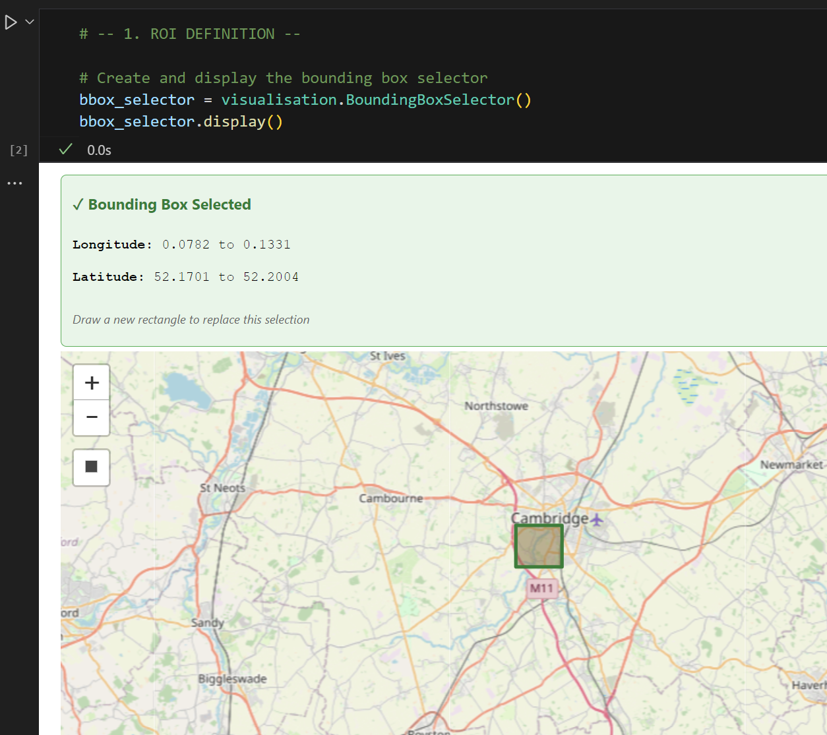
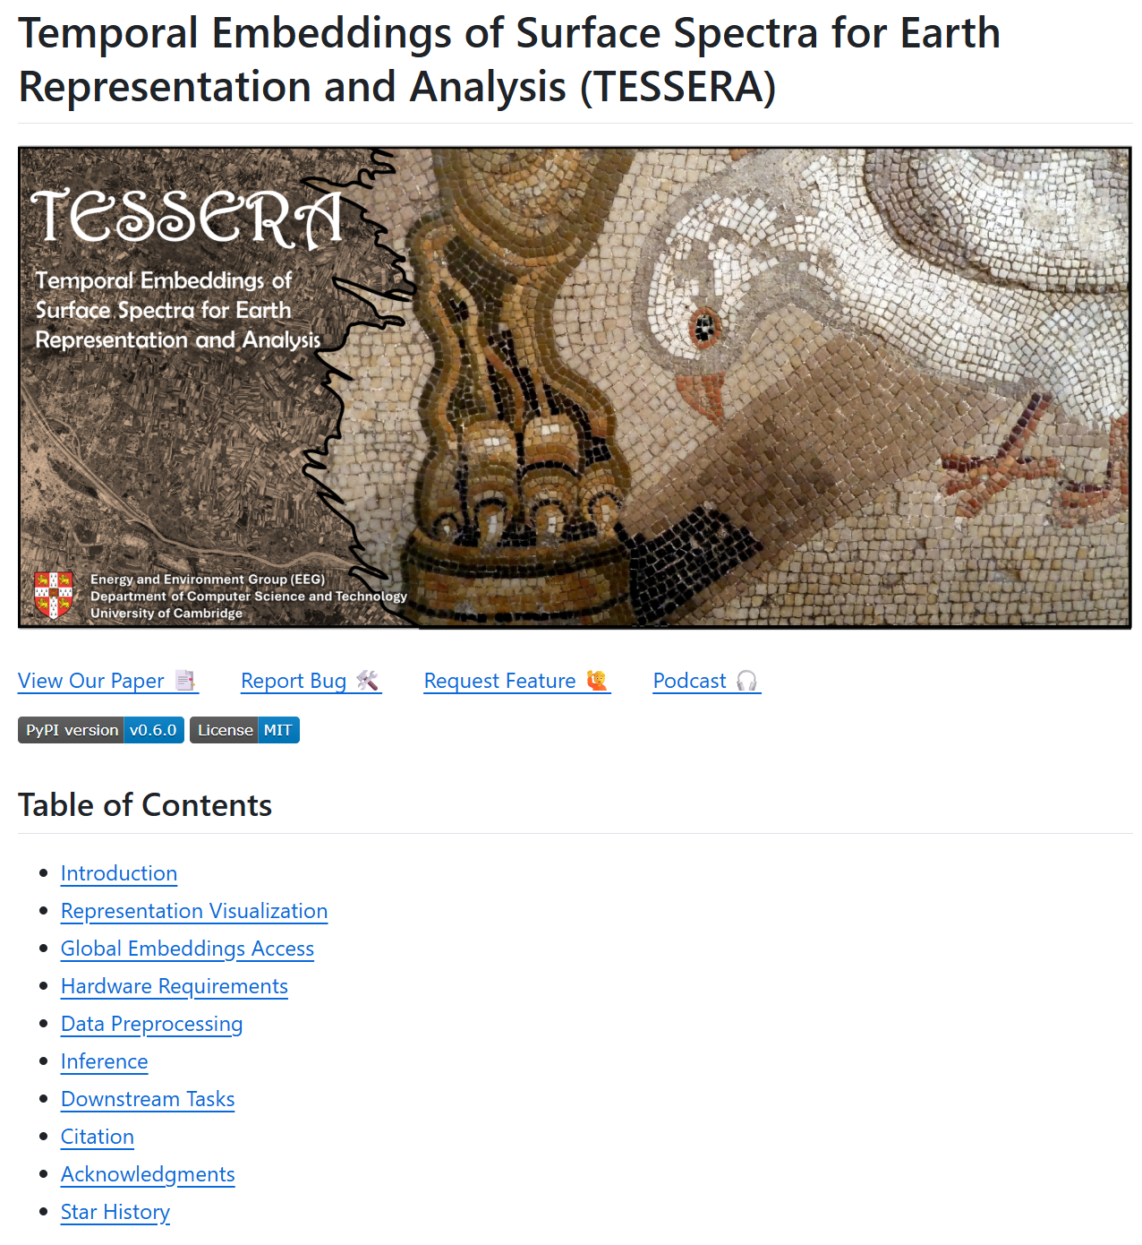

TESSERA Tool Kit
Tessera
Geotessera
Interactive Map
User Request (lat/lon bbox)
↓
Registry Lookup (find available tiles)
↓
Download Files (via Pooch with caching)
├── embedding.npy (quantized)
└── embedding_scales.npy
↓
Dequantization (multiply arrays)
↓
Output Format
├── NumPy arrays → Direct analysis
└── GeoTIFF → GIS integration
Fully open-sourced repo
Train the model
Evaluate the model
Create embeddings yourself

Slide 27
Interdisciplinary team
Computer Science
AI
Systems
Computer vision
Frank Feng
Jovana Knezevic
Robin Young
Sadiq Jaffer
Andrew Blake
S. Keshav
Anil Madhavapeddy
Remote sensing
Satellite data
Radiative transfer models
Maddy Lisaius
Frank Feng
Clement Atzberger
Markus Immitzer
Agriculture/Ecology
Forest processes
Crop behaviour
Maddy Lisaius
Clement Atberger
David Coomes
James Ball

Slide 28


TESSERA
We are looking for collaborators!
Read our paper on arXiv
(https://arxiv.org/abs/2506.20380)
Our Python Library
(https://github.com/ucam-eo)

