Slide 1
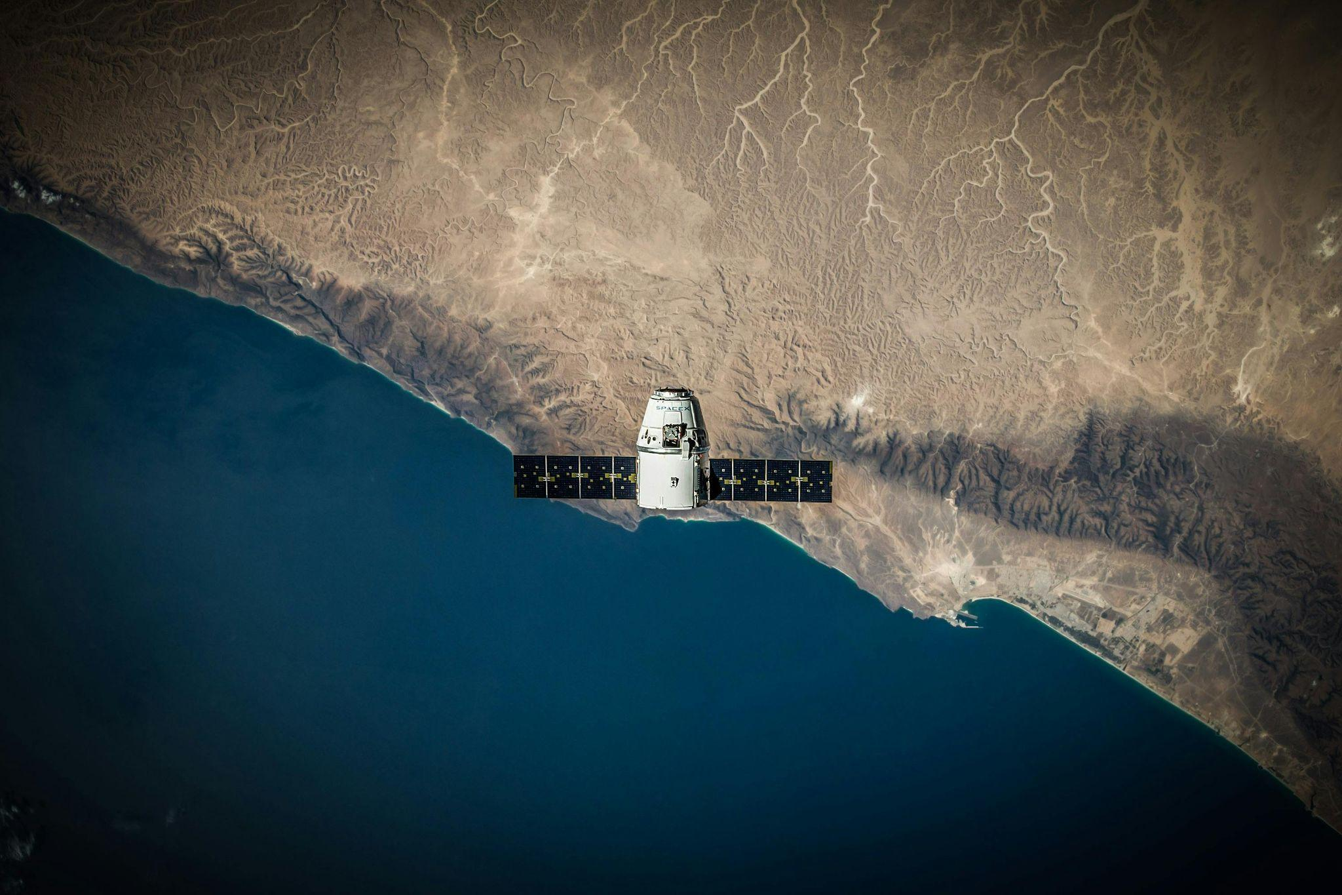
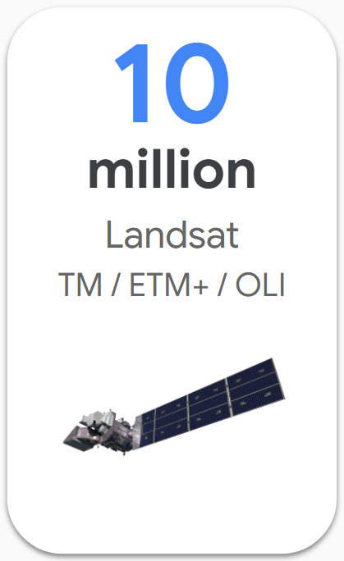
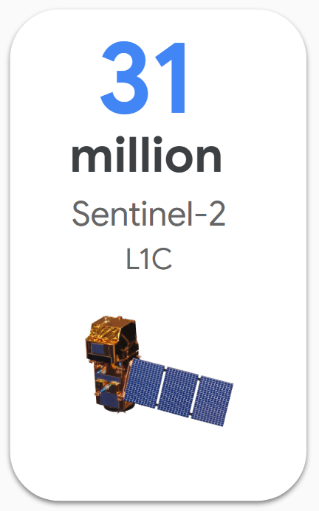
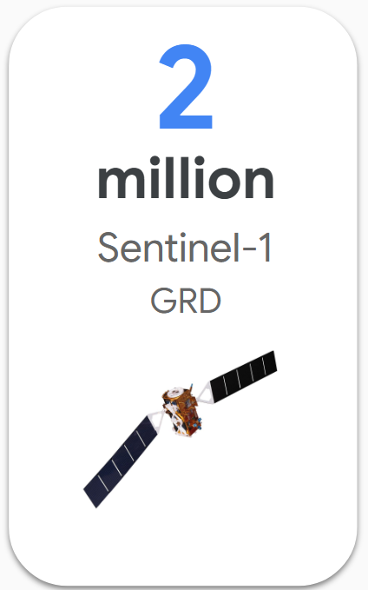
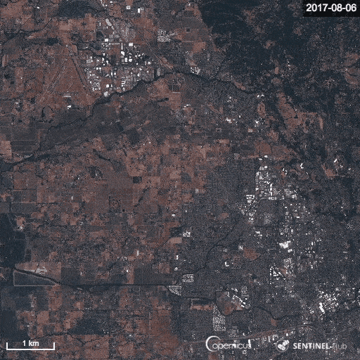

Satellites continuously monitor land surface with optical, radar, lidar sensors
Can be used to map habitats, forests, crops, urban infrastructure, and land use change
Lots of public satellite data – but cloud corrupted and hard to use
TESSERA
Z. Feng, C. Atzberger, S. Jaffer, J. Knezevic, S. Sormunen, R. Young, M. C. Lisaius, M. Immitzer, T. Jackson, J. Ball, D. A. Coomes, A. Madhavapeddy, A. Blake, and S. Keshav
Credit: SpaceX
Notes:
- How can we make use of them?

Slide 2
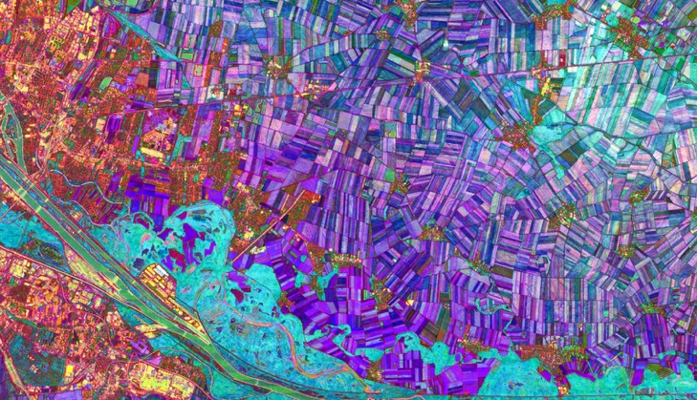
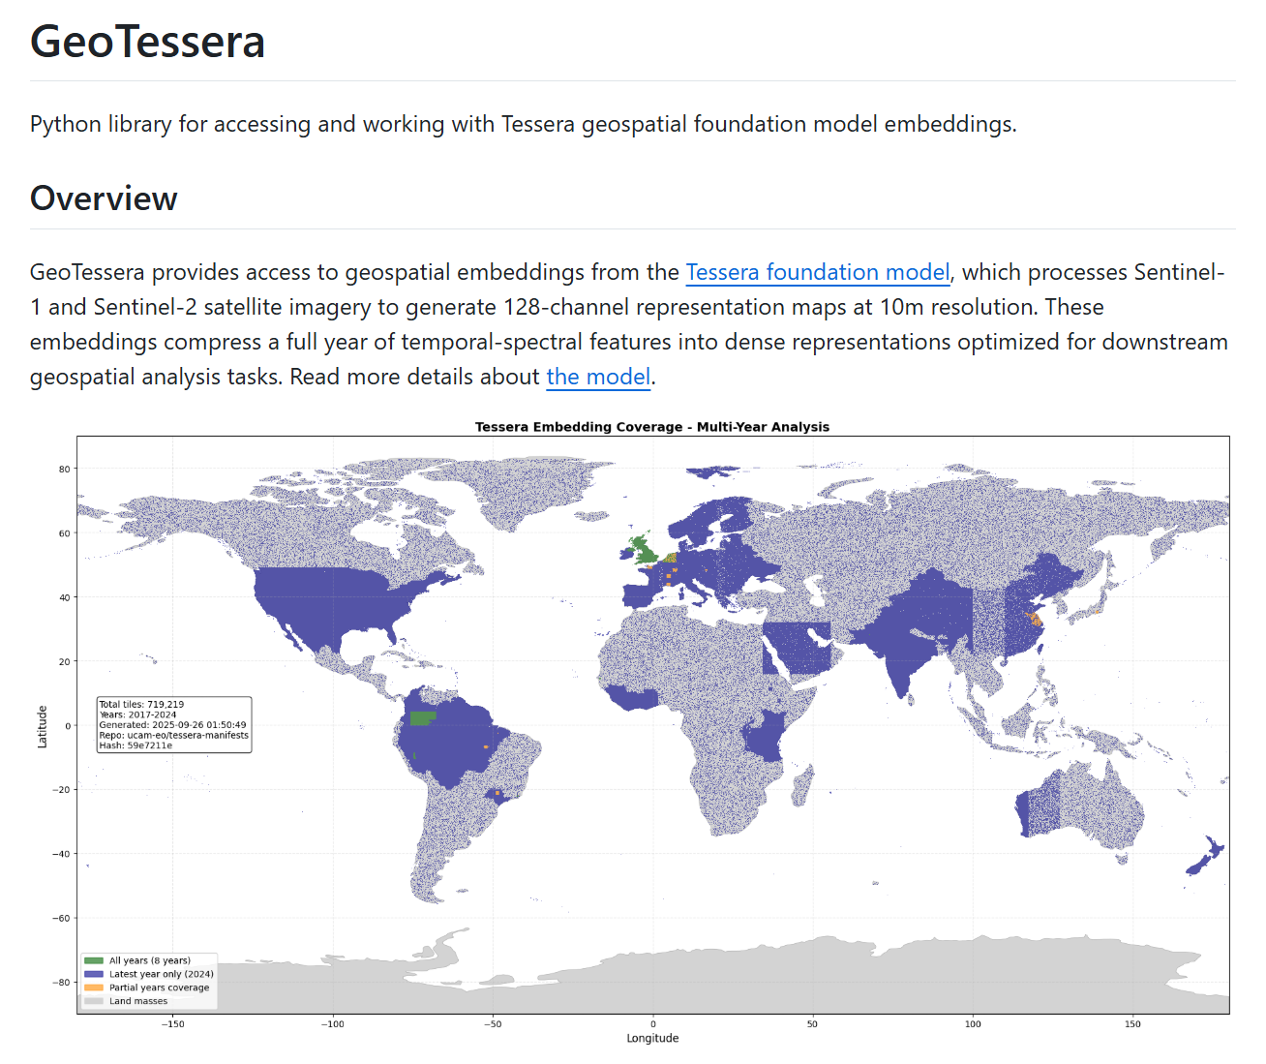
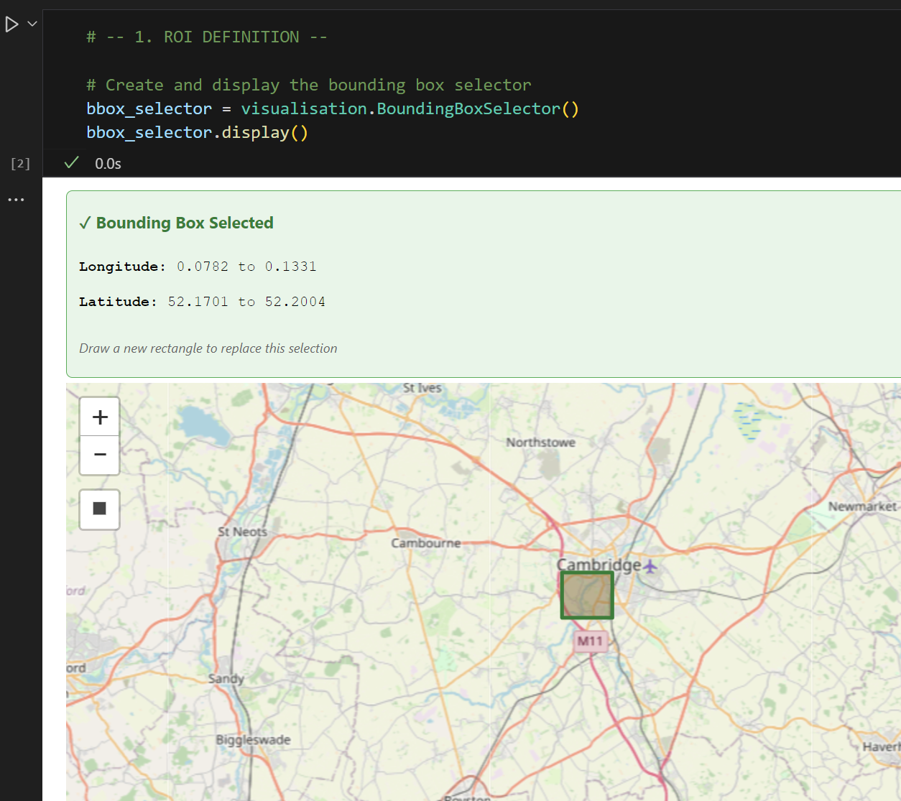
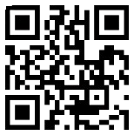
TESSERA
Cloud-free, 128-band encoding of annual temporal spectral signal
Sensor fusion: optical + radar data
Ready to use
Globally available
10m resolution
Open source
Geotessera
Interactive Map

